Slide 1

Teaching about the Eucharist in school
Fr Jeremy Hellier
Secondary RE Adviser
June 2021

Slide 2


Why is this important
• Well, its’ in the SIAMS 2018 inspection schedule………..
• It’s one of the illustrative descriptors for a school looking to be excellent……
• It’s one of the important things Jesus asked his disciples to do. “Do this in remembrance of me…..”

Slide 3

Lots of different titles
One of the first things a teacher needs to do is to make pupils aware that there are lots of different titles for the same thing;
  The Eucharist (a Greek word for Thanksgiving)
  Mass (comes from the Latin at the end of the service ‘ite missa est…)
  Holy Communion
  The Lord’s supper
  The Last Supper
  The Breaking of the Bread

Slide 4
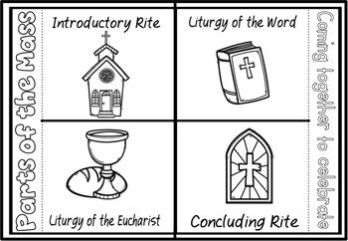
Four areas to teach
The Eucharist falls into four distinct areas as follows;
The Gathering
The Liturgy or Ministry of the Word
The Liturgy or Ministry of the Sacrament
The Mission and Sending out
The following slide suggests content for each area. They are nor meant to be prescriptive but to act as a guide. As Head of RE I always left my teachers free to express their own individual approach in teaching.

Slide 5
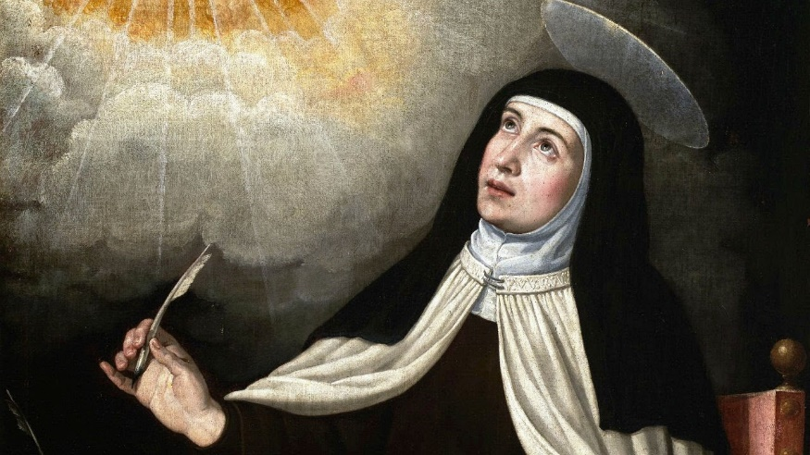
The Gathering
Pupils usually associate the word church with a building so it’s important to get them to understand the really it is a community of people.
The early church met in homes (read the Acts of the Apostles)
Encourage pupils to think about the variety of communities they belong to and what they gain from them. School/family/club/sports team etc
The gathered church is the body of Christ on earth. It is how Christ lives and has a presence in the world. See Prayer of St Teresa of Avila
https://www.goodreads.com/quotes/66880-christ-has-no-body-now-but-yours-no-hands-no

Slide 6

Liturgy/
Ministry of the Word
This area of teaching needs to cover how Christians use The Bible.
There are at least two readings at the Eucharist.
  The Epistle – a reading about how the early Christians understood Christ’s message (Epistle meaning letter)
  The Gospel – a reading from one of the four accounts of Christ’s life often containing direct teaching.
  So how do Christians use this?
  ‘All scripture is given by inspiration of God and is profitable for doctrine, for reproof, for correction, for instruction in righteousness’ 2 Timothy 3:16
  Look at some Bible verses to demonstrate how Christ’s teaching is applicable to daily life. Parables etc.

Slide 7

Liturgy/
Ministry of the Word
  A sermon often follows the readings. Here the preacher tries to help the congregation understand the readings and their relevance to daily living.
  Worshippers may recite the Creed. This is a statement of basic Christian belief. http://anglicansonline.org/basics/nicene.html
  A time of prayer will follow bringing the worshippers into a personal relationship with God and interceding (praying for) the world.
  The Peace is then shared. This is an expression of fellowship and reconciliation with each other, usually symbolised by the shaking of hands (Pre-Covid times, currently the ‘Zoom wave’ is usually employed).

Slide 8
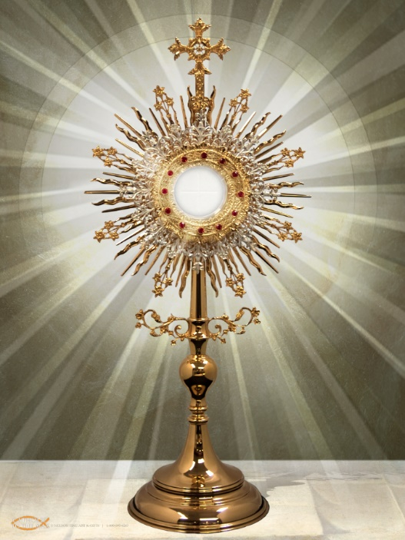
Liturgy/
Ministry of the Sacrament
  An explanation of the word Sacrament is required here. The Catechism of the church (instructional material) describes this as ‘An outward and visible sign of an inward and spiritual grace.’
  Thus a sacrament has two parts, an outer sign and inner meaning.
  In the Eucharist the outer sign is the bread and wine. The inner meaning (whilst open to a variety of understandings) is that Christians are drawn in inexorably into the presence of Christ in a very powerful way/

Slide 9
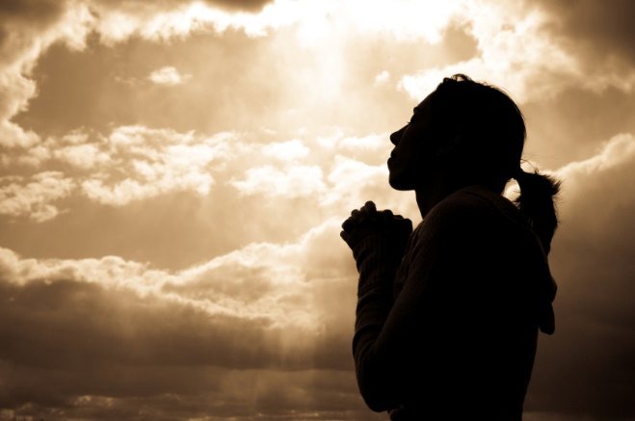
Liturgy/
Ministry of the Sacrament
  Sacraments are more then mere symbols. Their efficacy does not depend on the mood of the believer. The grace of God is freely offered in the moment of communion regardless of the believers response.
  Many regular communicants speak of an almost visceral response to the act of receiving communion, a deep down gut feeling of Gods presence.
  After receiving communion there is usually a period of silence whilst communicants reflect upon the presence of God in their lives.

Slide 10

Mission and
Sending Out
  Following the receiving of the sacrament there is usually a prayer of thanksgiving. This may include the words ‘Send us out into the world in the power of your Spirit to live and work to your praise and glory.’
  Thus those who have received the sacrament are now charged with the mission of the church. This involves living Christian lives and trying to make the world the sort of place that God intended.
  The concluding rite involves a blessing from the priest and dismissal with the words ‘Go in peace to love and serve the Lord.’ The response is ‘in the name of Christ, Amen.’

Slide 11

Mission and
Sending Out
  Your school will have a distinctive Christian vision shared by the whole school community.
  So this is a moment in teaching when you could reinforce the school vision together with promoting an understanding of the global Christian vision.
  This is expressed in an variety of ways so here’s a moment to take a look a Christianity as a multicultural world faith. Another SIAMS objective! As an inspector I often find this is a neglected area so here’s an opportunity to link several things together.

Slide 12

Some further thoughts
  Extension lessons could include a deeper look at the other sacrament of the Anglican church. For example, Baptism has water and the making pf promises as an outer sign, whilst the inner meaning is initiation onto the Christian church (contact me for further thoughts on this).
  Another example might be to compare and contrast different accounts of the Last Supper in the Bible.
  NB The Eucharist is much more than a meal. To reduce it to this is to demean its significance. Meals are about us, the Eucharist is about being drawn into the presence of God.

Slide 13
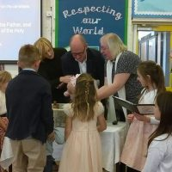
Some further thoughts
  Schools should not play act the sacraments. Wherever possible, do it for real. When celebrating the Eucharist in school there will be some present who are able and willing to receive communion.
  Another example might be baptism. Why not find a family who wish to have a child baptised and who are not entirely comfortable with formal church. There is no reason why the baptism cannot take place in school. I’ve done this occasionally myself and it has been a wonderful occasion with a whole class interested and supportive especially if it is someone’s younger sibling. Example in pic from a school in Gloucester Diocese.
  Teaching about the Eucharist and Baptism shows the real depth of the Christian faith and is an opportunity for teaching to have a real impact on spiritual development.

Slide 14

And finally
Clearly there’s much more that could be said but I hope this simple guide might stimulate some thinking about how to teach the Eucharist in school.
Further advice is available from me or any member of the Diocesan School Effectiveness Team. We are at your service! Details at the bottom of the page on this link: https://www.bathandwells.org.uk/schools/re-collective-worship-and-spirituality/

