Slide 1

Presidential address
16 November 2024

Slide 2


Safeguarding

Slide 3
Diocesan Synod…
Contributes to the culture of the whole diocese
Is a place where deep conversations and deep listening take place
Ensures that the views of our churches and communities are heard
Avoids being simply a receiver of information
Joins in the co-creation of diocesan policies and strategy
Gets behind what God is asking of us and joins in

Slide 4
Our vision & strategy

Slide 5
Our diocesan vision
In response to God’s immense love for us, we seek to be God’s people, living and telling the story of Jesus.

Slide 6
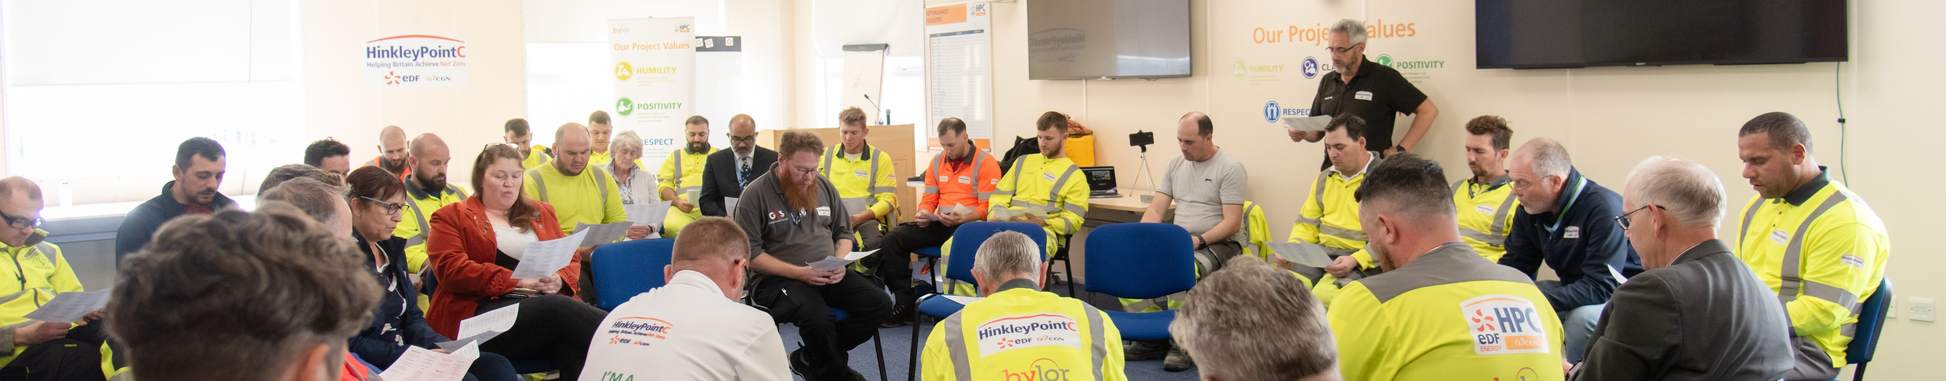
What will help us live out our vision, and what difference will that make?’
Growing church Transforming communities

Slide 8
The Challenge
Intentionally to seek to grow each of our benefices by one child (net) and by one adult (net) next year, the year after, and every year.

Slide 9
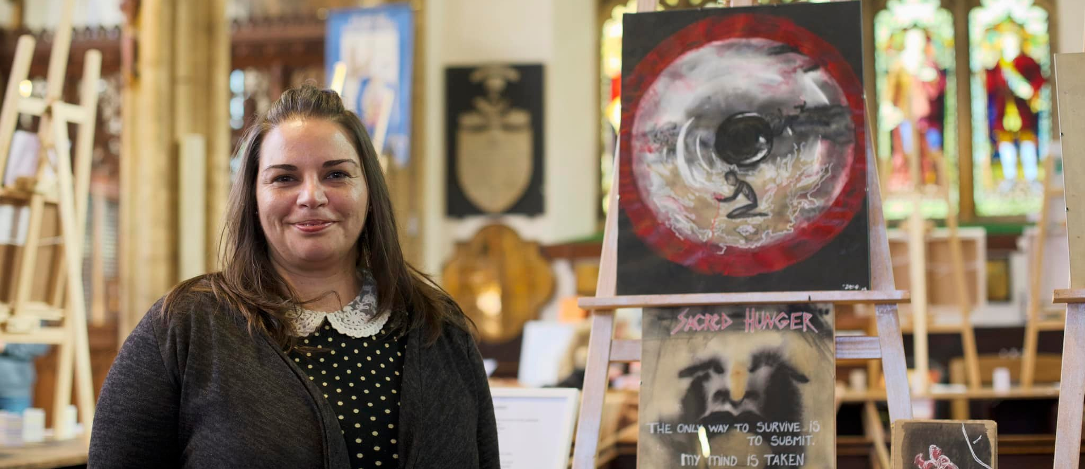
Transforming communities
Tackling modern slavery - Hidden Voices art exhibition

Slide 10
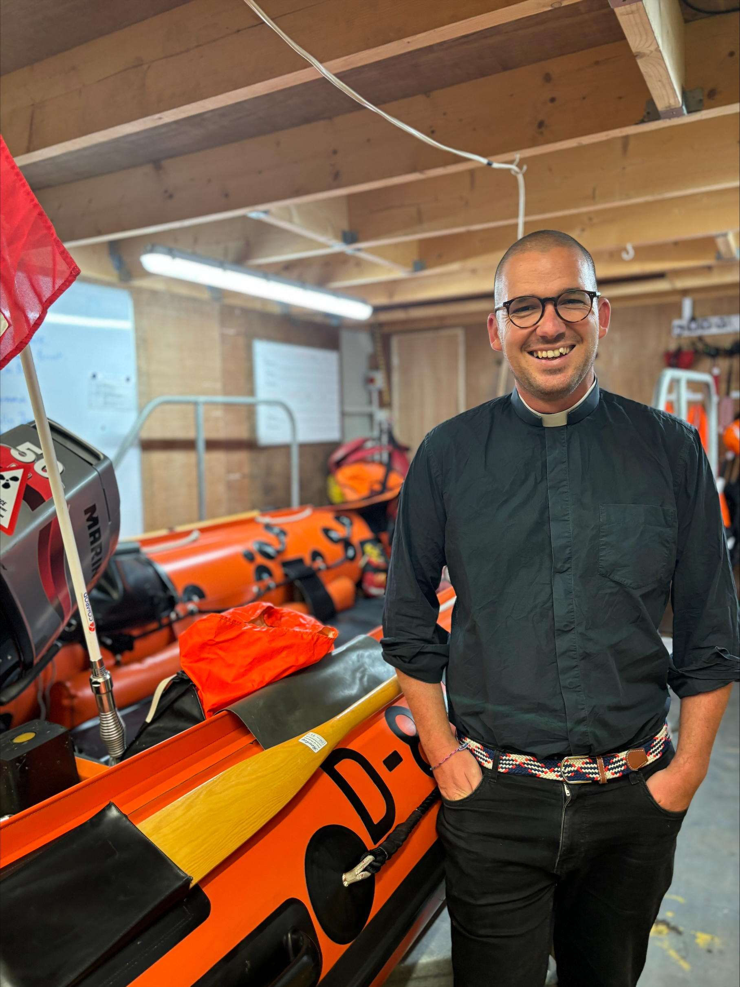
Transforming communities
Chaplaincy – new chaplain to the RNLI

Slide 11
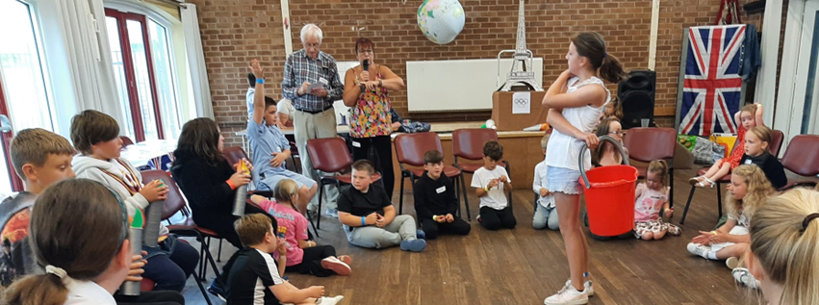
Transforming communities
Supporting families and children - St Francis Holiday Club

Slide 12
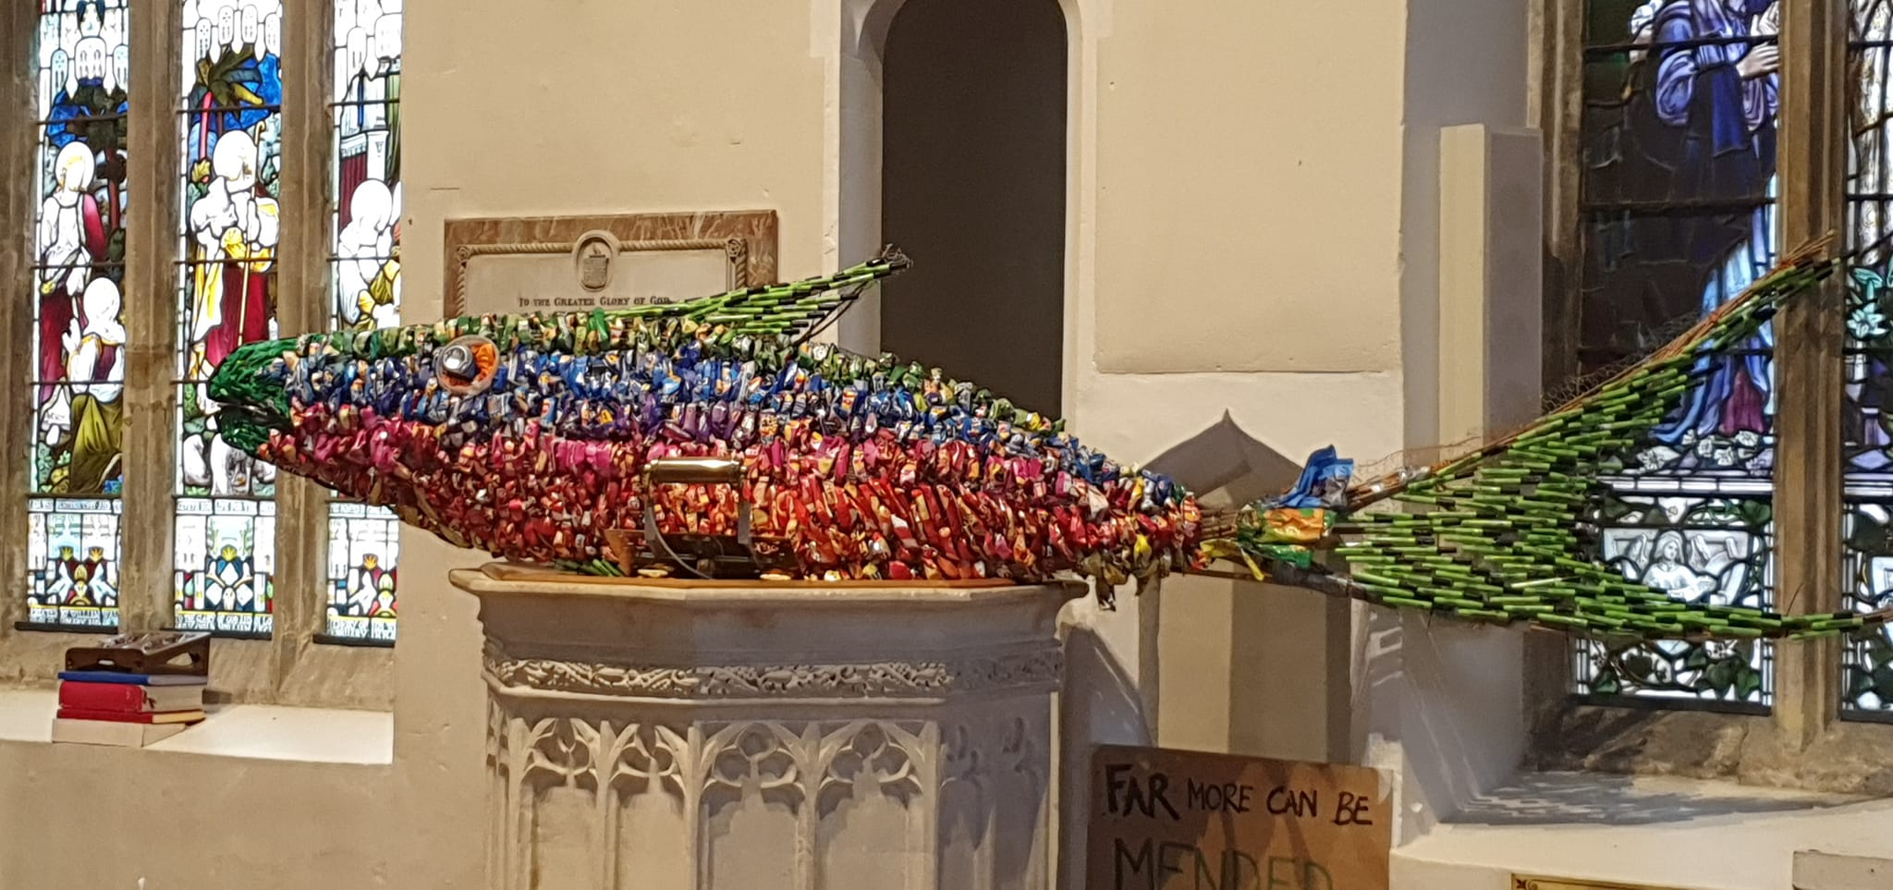
Transforming communities
Caring for the environment - Portishead eco art

Slide 13

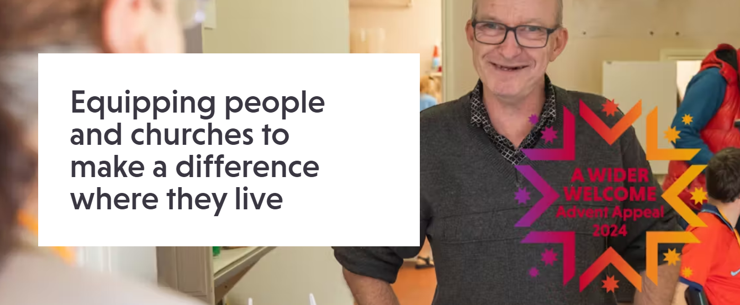


Church Urban Fund

Slide 14
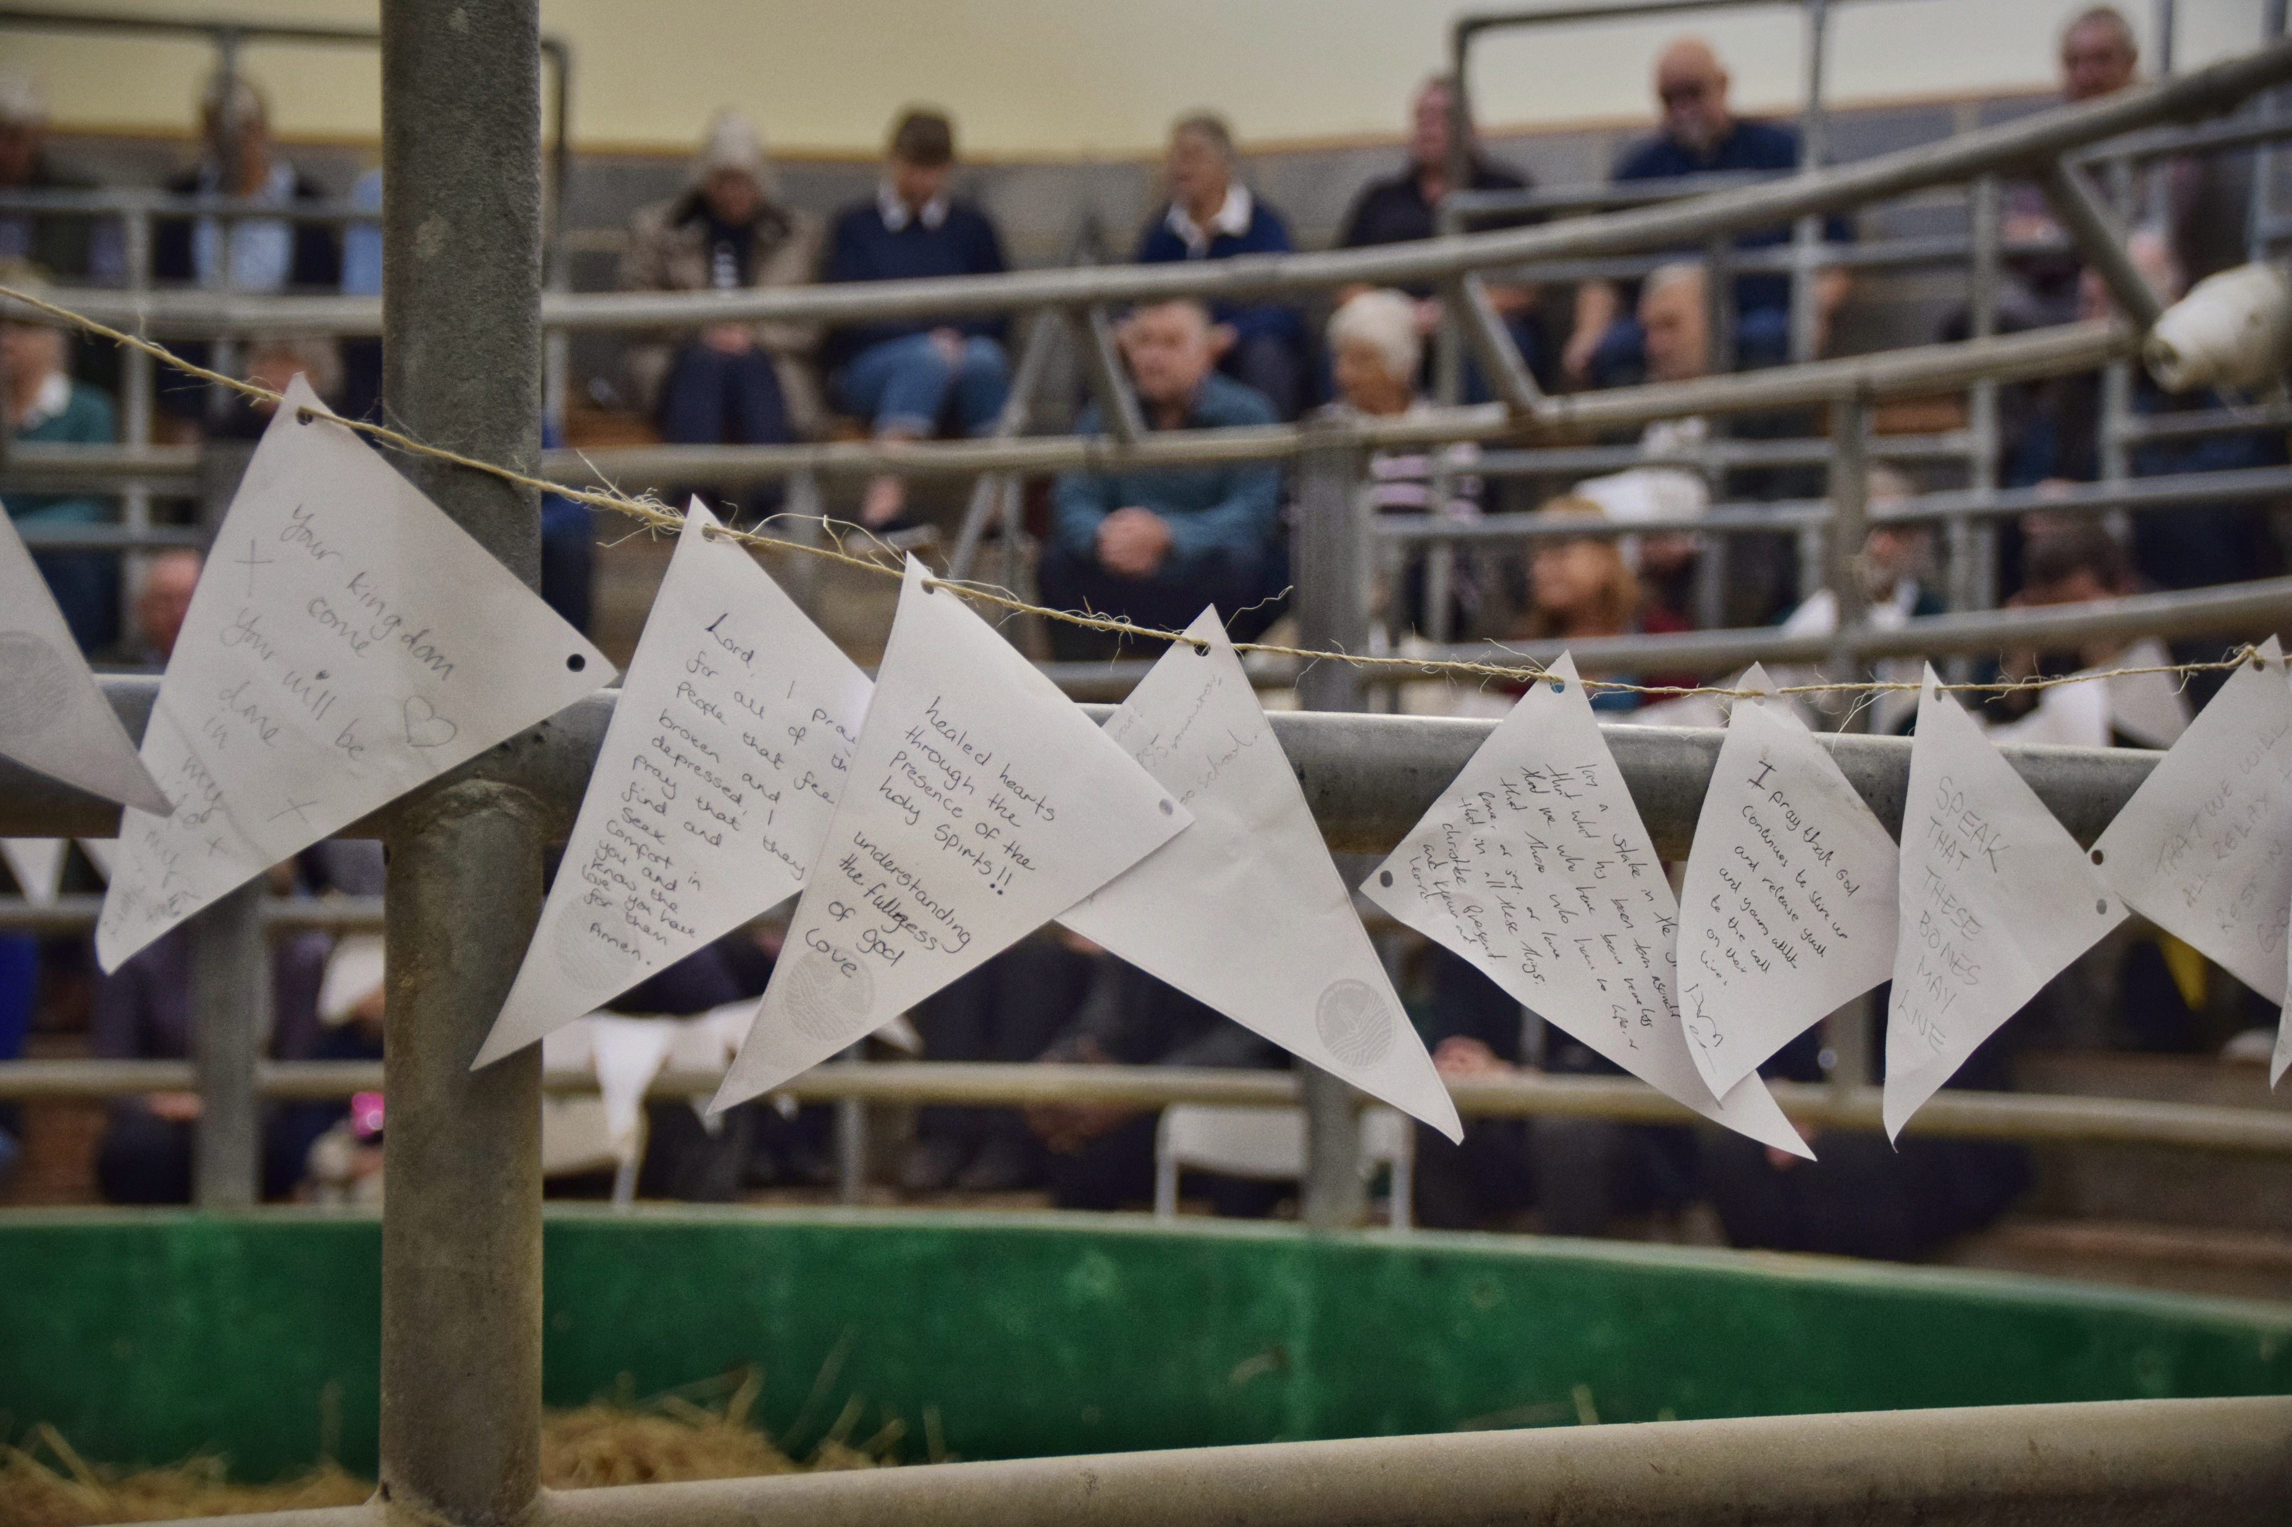

Prayer at the heart of all we do

Slide 15
Our areas of focus

Slide 16
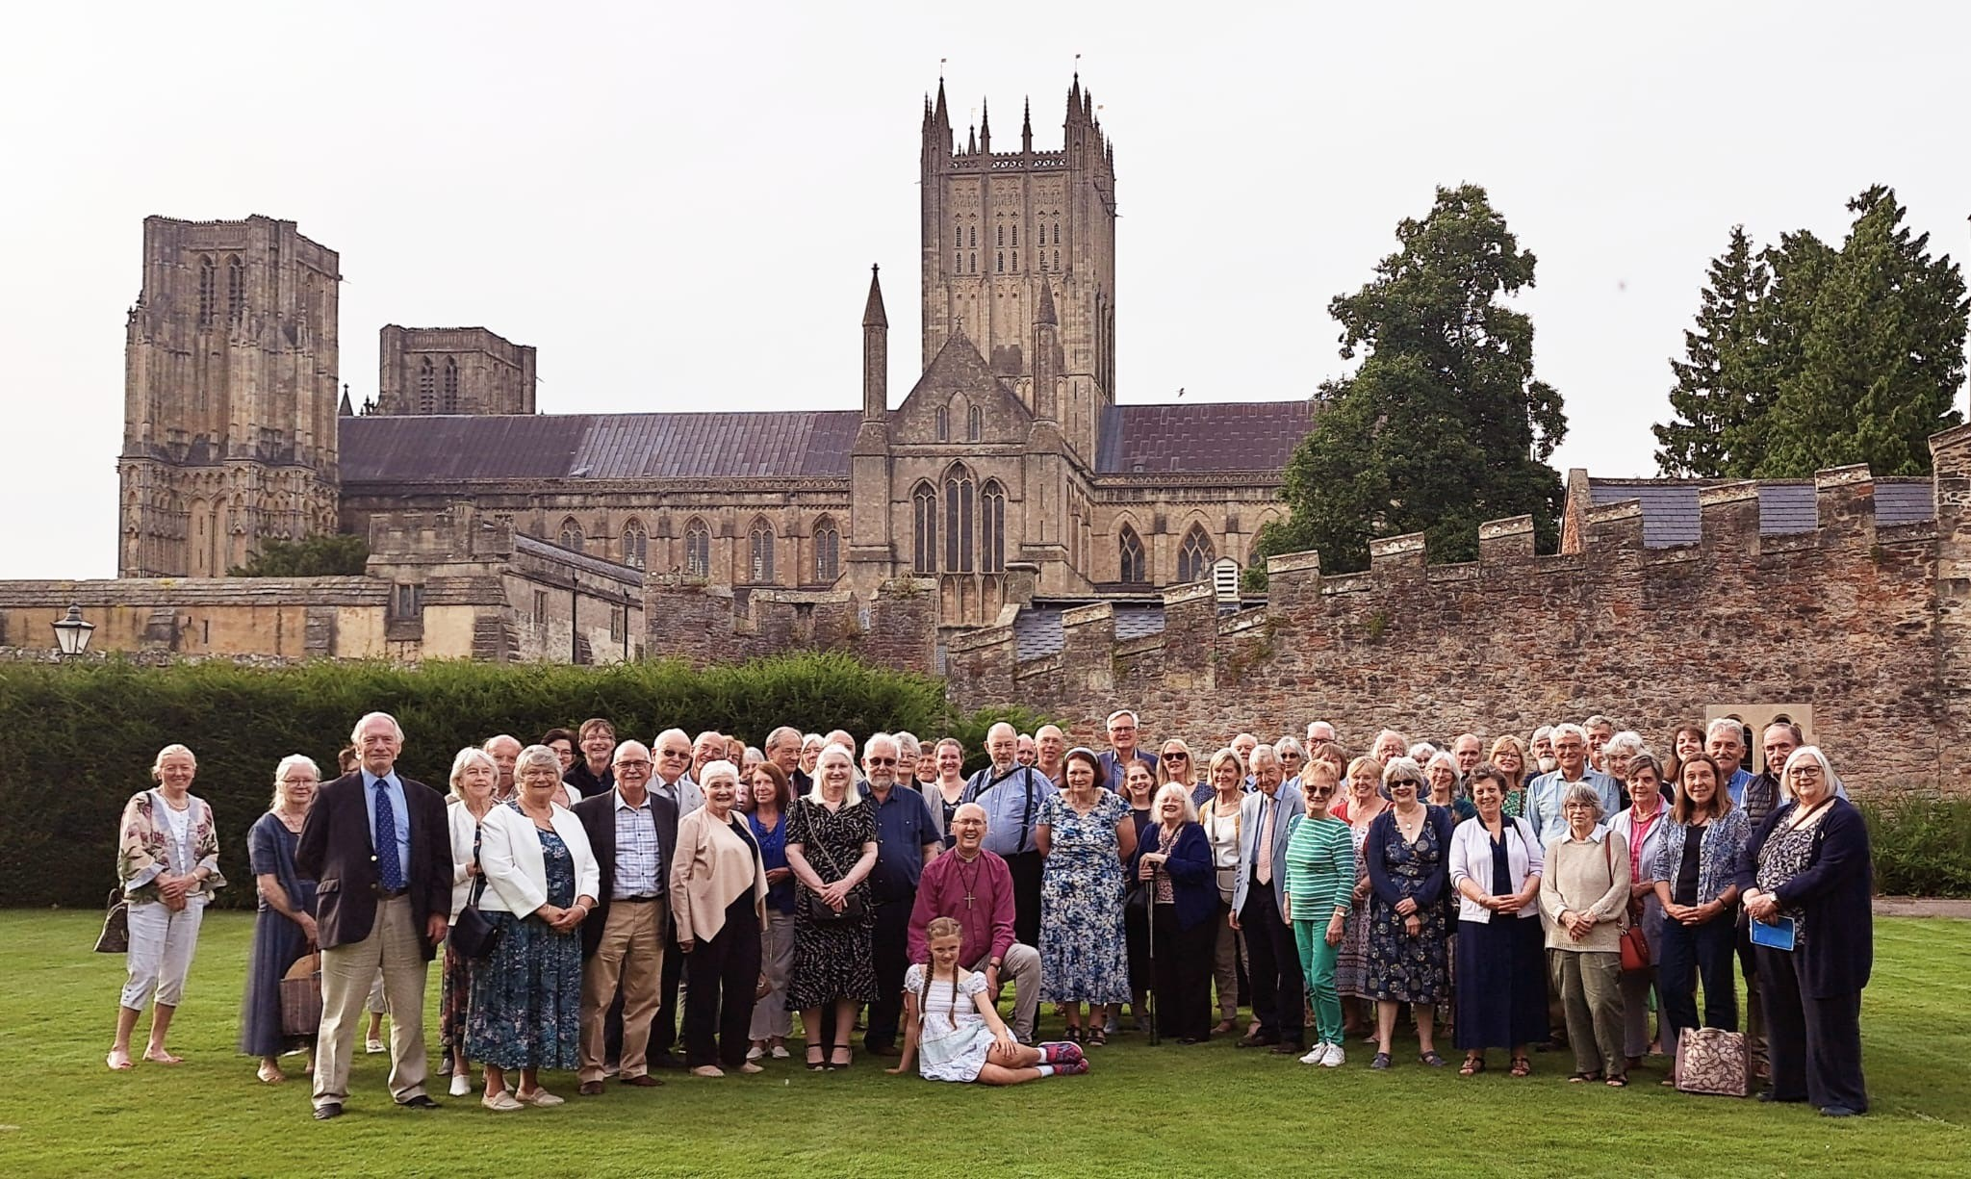
Value, cherish and develop the people and resources we already have

Slide 17
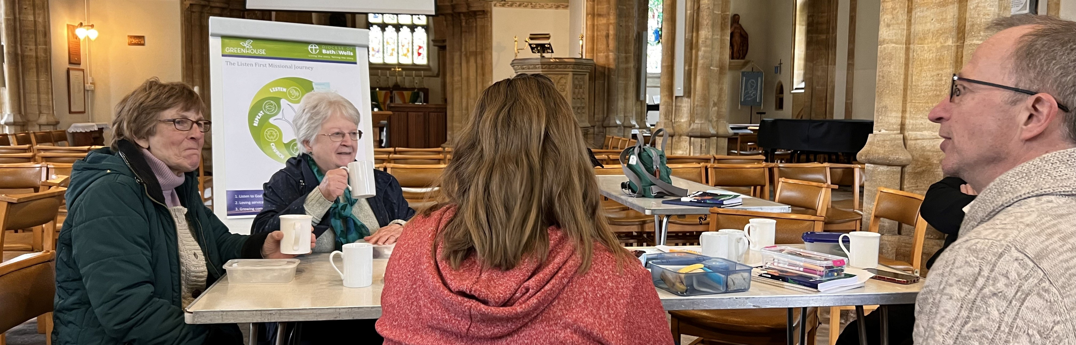
Develop new worshipping communities alongside our existing offers

Slide 18
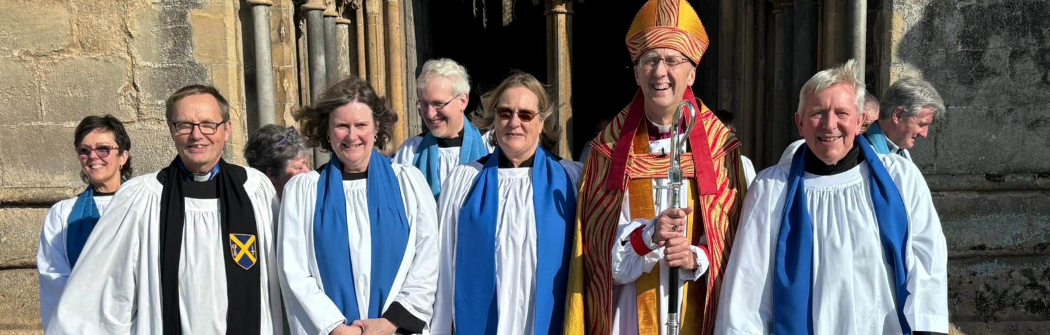
Share in ministry and leadership

Slide 19
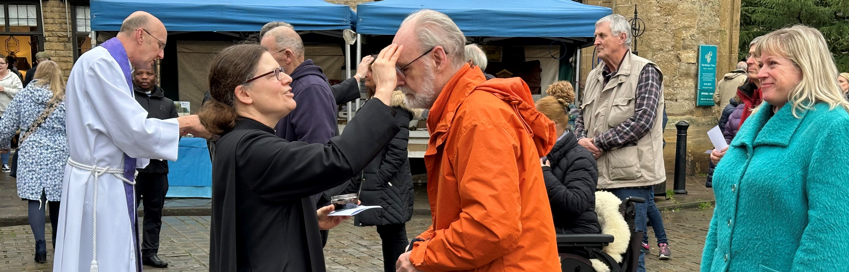
Deepen and grow our faith

Slide 20
Listening and supporting
Deanery Reviews - underway
Benefice Visits and Ministerial Development Reviews - from 2025/26

Slide 21
Tackling our financial challenges together
Supporting parish income growth
New Common methodology
Diocesan budget
Buildings strategy
New Diocesan Chair of Diocesan Board of Finance

Slide 22

Living in Love and Faith

Slide 23

Assisted suicide

Slide 24
Our diocese
Bishop’s Council
Finance Committee
Board of Patronage

Slide 25
Thank you!

