Slide 1
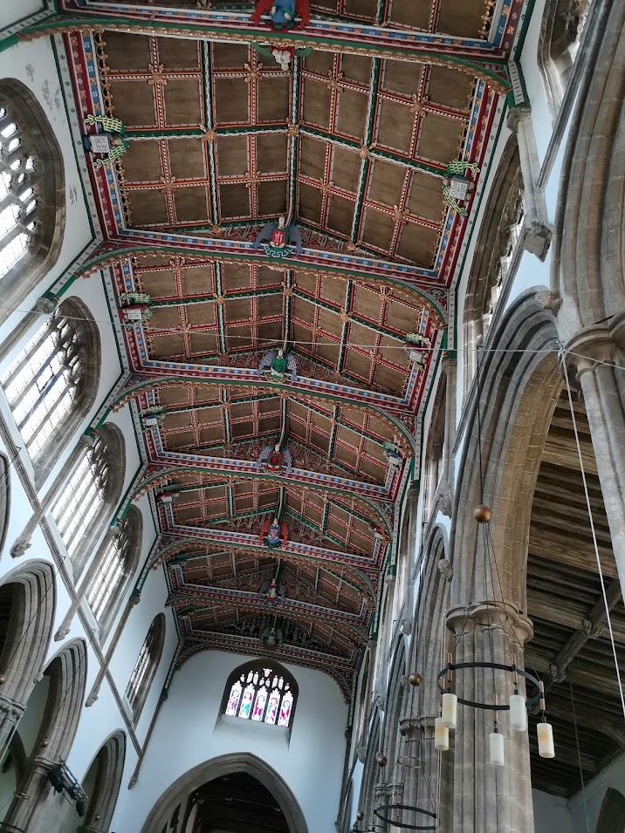
St Cuthbert’s Wells
Heating and Energy
RENEWABLE Energy Report
William Grafton | 05/08/21

Slide 2
OVERVIEW OF REPORT
AUTHOR’S AIMS
basis for the heating and the electrical energy in the church, in a more long-term and environmentally-friendly way.
suggest a ‘smorgasbord’ of ideas to explore and provide building blocks to use to meet the future energy use of this church, and possibly others.

Slide 3
ISSUES TO CONSIDER
How much heat we need
2. The sort of energy we wish to use and how we are going to use it

Slide 4
3. Getting the heat to where it is wanted
4. Keeping the heat where it is wanted
5. Making sure it is there when you want it
And running throughout…..
ENVIRONMENTAL CONSIDERATIONS

Slide 5
CURRENT HEATING
185kW Oil Boiler and 2 pipe wet heating system

Slide 6
HISTORY
Boiler is more than 20 years old, but parts still available
Conversion to gas not an option – carbon footprint!
Originally matched to capacity of the current radiators
PLUS
Some electric heaters in recently updated areas

Slide 7
FUTURE HEATING AND ENERGY
LOTS!!
1. How much heat do we need?

Slide 8
HEAT LOAD = quantity of heat that must be fed into church every hour to maintain a given temperature
Present boiler had capacity of 185kW when installed (not at peak efficiency now).
Calculations arrive at required heat load of ……
between 188 kW and 250kW
(on a frosty day and depending on chosen temperature)
More is also needed to reach the given temperature

Slide 9
2. What sort of Energy ?
Considerations:
We wish an environmentally friendly solution
for a Grade I listed building
in the middle of Wells

Slide 10
This, therefore, excludes:
burning gas, oil or wood to generate the electricity to drive any other form of heating
using our own wind turbines for the same purposes
using electricity from non-renewable sources through the grid
NB We are already using electricity certified as coming
from renewable sources.

Slide 11
Other sorts of Energy – Solar
Could generate enough energy for (perhaps) 30% of heating requirements
Could sell to energy supplier in the summer
Could operate heat pump in winter
Solar panels not visible from ground
Budget guesstimate £50k – 60k

Slide 13
Other sorts of Energy – Mains electricity
This is a reliable source.
It is possible to specify that only electricity from renewable sources is supplied.
The National Grid can be used as a sort of storage system.
We feed in during the summer and draw on it in the winter.
Unfortunately it costs more to take out than we are paid to feed it in!

Slide 14
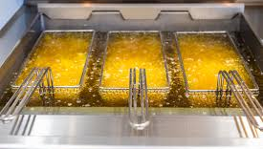
Other sorts of Energy – Oil
Using the existing boiler …..
but with Recycled Cooking Oil?

Slide 15
Its pros and cons
Carbon-neutral, although it does produce other waste products
Re-used, treated vegetable oil can be used (with replacement burners)
Output similar to current oil
Price at present 30p per litre more than current oil
2019 oil requirement = 5,733 litres so extra cost then would have been £1,719.90
Trials in progress and it is still to be approved

Slide 16
How are we going to use that energy
Using a Heat Pump
Why?
What?

Slide 17
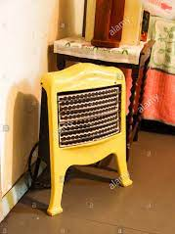
Direct Electric Heating
£100 worth of electricity in
£100 worth of heat out

Slide 18
You need an OUTPUT MULTIPLIER!!

Slide 19
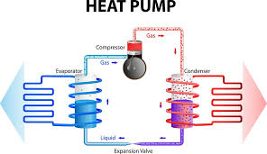
Heat pumps are the usual form of output multiplier
£100 worth of
electricity
£300+ worth
of heat out
Output Multiplier of around 3.0

Slide 20
Heat Pumps (HP)
encouraged by the Government because they :
use electricity, preferably from renewable source - ideally your own!
extract heat already in the environment around the equipment.
Local heat sources could be ….

Slide 21
Water Source - no suitable water source
Ground Source – would have to come from churchyard, with pipes going either horizontally or vertically to allow enough contact with the ground’s heat
Air Source – could be several, relatively small, domestic units joined together to increase the output
Water output to the radiators is noticeably cooler than that of normal boilers so more or larger radiators are needed.
BUT.. Large industrial Air Source Heat Pumps get round this
More later!

Slide 22
Ground Source Heat Pumps (GSHP)
They extract heat in the ground from
EITHER an enormous web of horizontal pipes
OR very deep vertical boreholes
HORIZONTAL PIPES
~ digging hundreds of metres several feet deep, to install horizontal pipes through a churchyard??

Slide 23
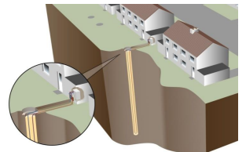
VERTICAL BOREHOLES
Not impossible!
26 bore holes at 160m deep and minimum of 8m apart.
cost around £125,000 for the holes.
cost additional £80,000 for the heat pumps to support heat load.
one-time investment, with well over 100-year life expectancy.
large number of individual pump units and so maintenance might be more difficult.

Slide 24
Air Source Heat Pumps (ASHP)
large industrial unit, using 3 phase electricity (manufactured by Clade in Bristol)
operates with CO2 as its gas for compression.
temperature of the water for heating: 80⁰C (rather than current 50⁰ – 60⁰C …….
restores effectiveness of existing radiators
Pump technology is most effective when heat emitters really do emit most of the heat that is put into the circulating water

Slide 25
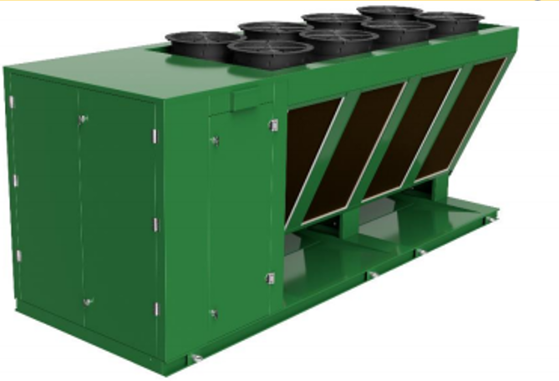
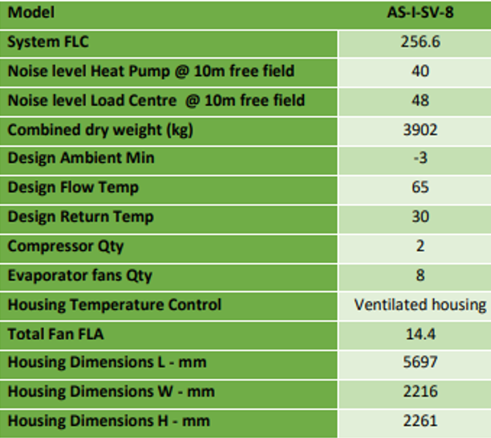
Could be positioned where the existing oil tank sits, close to the existing boiler room and the pumps for the church heating.

Slide 26
3. Getting the heat to where it is needed:
Lovely – thank you!
It’s alright for some!

Slide 27
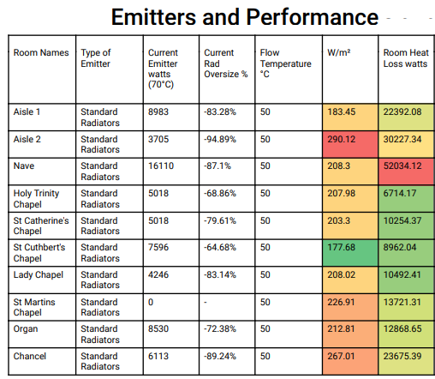
Can our current radiators do the job?
CURRENT HEAT OUTPUT
HEAT REQUIREMENT
Aisle 1
8,983 watts output from current radiators
Loss ie requirement of 22,392 watts
pale green (not too badly underheated!)
Nave
difference much greater
dark red

Slide 28
The big issue
Overall, our present radiators can emit approximately 1/3 of the heat required to balance the heat load of St Cuthbert’s, when teamed with a heat source operating at the temperature of our current boiler.
What to do?
Throw them away and start again?

Slide 29
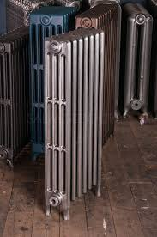
A THREE-TIER SYSTEM OF HEAT EMITTERS:
Tier 1 Our existing radiators
in reasonable condition
very expensive to replace with modern ones
New radiators would provide limited
improvement in heat output

Slide 30
Tier 2 New, small, under-pew radiators
installed under all fixed wooden pews
increase the general heat output to the church
comfort of users in the pews.

Slide 31
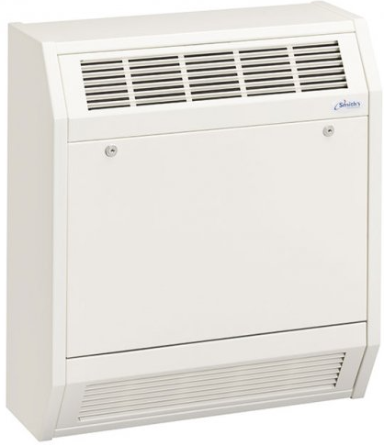
Tier 3 New fan heaters
positioned to drop the temperature of the circulating water still further while heating areas not covered by the first two tiers.
The different tiers could be controlled separately to play to their strengths.

Slide 32
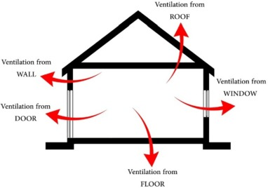
4. Keeping the heat where it’s wanted
Sources of Heat Loss / Insulation Options

Slide 33
Report:
“Modelling with theoretical extra roof insulation for around 50% of the roof, did not really affect the heat loss that greatly.
(7kW of difference, in a figure of 188kW plus)
Church Buildings Council:
“address the current heat loss, before worrying too much about increasing the heat you put into the church building.”
Why?

Slide 34
It is the walls, floors and the vastly thermally inefficient windows that appear to lose the most heat.
BUT….
No practical solution available

Slide 35
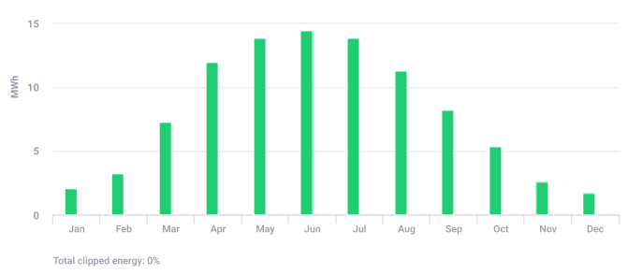
5. Ensuring energy for heat is there when you want it
a) Solar PV electricity
Is not available all the time
Predicted power output generated in Wells
Most output during summer months to sell to grid
Useful output, even in winter, to help with heating etc

Slide 36
b) Mains electricity
Is a very reliable source, but
significantly cheaper overnight
cheap electricity can be stored in battery for later use
cheap electricity can be converted to heat and stored in thermal store
we have a tariff which gives ‘over-night’ rates right through the weekend, in addition to the weekday over-night periods.
cost during the day would be almost irrelevant if we have solar panels
Tariffs are likely to develop in the months and years to come

Slide 37
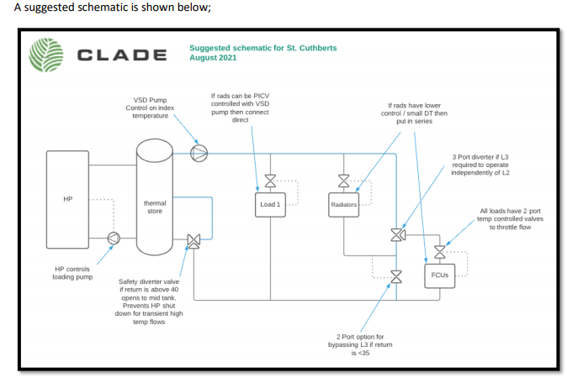
How would this all fit together?
Radiators and under pew heaters, capable of being controlled separately.
Heat pump
Thermal store or buffer
Heating system must have modern temperature and time control systems!

Slide 38
Report author’s conclusions
Big PV (Solar Panel) System across the roof as designed
Air Source Heat Pump e.g. Clade’s industrial model
Enhanced Heat Emitters e.g. Finned Tubes under pews, and Fan Coils to supplement the fairly meagre radiators, covering say 20%?
Clever use of tariffs and big buffer storage
A large budget maybe £200 - £250k.

Slide 39
Other suggestions from the report:
Negotiate a heat purchase contract
“If we could find say 10 to 50 Churches and negotiate together energy suppliers would provide the kit and the end users could buy the heat at x pence per kwh”
Commission further modelling of insulation options, but it would cost extra and may well not be worthwhile!
Parish Buying, of which we are part, is looking into this area and may be a very effective link for this.

Slide 40
There are a lot of questions and issues!
But it is always cold….
Very expensive to heat, even to our current standard:
several times our heating bill for the whole week.
Other projects needing money:
e.g. lighting, chairs, AV stuff
Very expensive to heat for one-off events:
How many winter concerts are there?
How many groups stop in the winter?
A great deal of oil burned for a cold church: our carbon footprint is huge!
How long will our current boiler last? Then what?
It will never pay for itself!
We can never afford that much.
How is this going to help the mission of the church?
We don’t have the expertise to do this.
General Synod has said we shall be carbon-neutral by 2030. How??
We don’t know enough to make this sort of decision…..

Slide 41
A final thought from the report’s author
This is a major step forward in how churches work towards sustainability
leading model for all churches
publicity for church
attract grant funding
attract crowdfunding
Do we dare?

Slide 42
A reminder of what is proposed
A very large array of solar panels on the roof
An industrial Air Source Heat Pump to generate most of the heat, using electricity from the solar panels or cheap, ‘green’, mains electricity
A very large tank of hot water, heated with cheap electricity, to supplement the Air Source Heat Pump
Under pew heaters to warm us, not the angels
Additional heat emitters to supplement the existing radiators

Slide 43
OPTIONS
Lots of effort required
Big commitment, lasting years
Appeal will be needed
Crowdfunding to explore
Grant applications to make
New opportunities will arise
Doesn’t have to stop everything else!
Etc etc
More money available for other priorities
Problem of carbon-neutral pledge by Synod
Church is still cold and unwelcoming, particularly in winter
Old heating won’t last forever. Then what?

Slide 44
My proposals for this meeting:
We either:
ask Sheila to put an item onto the next PCC meeting agenda to decide whether to commission a fuller, costed design and business plan for this scheme, likely to cost around £2,000 + VAT.
Or
decide that we wish to commission the detailed report straightaway.
We each take a copy of the Powerpoint slides to act as an aide mémoire and to allow us to check details later.
We consider whether we would like to see the full report from which this Powerpoint was abstracted – I am happy to send it by email.
We all pray long and hard about what we believe God would like us to be doing at this stage in our church’s history.

