Slide 1



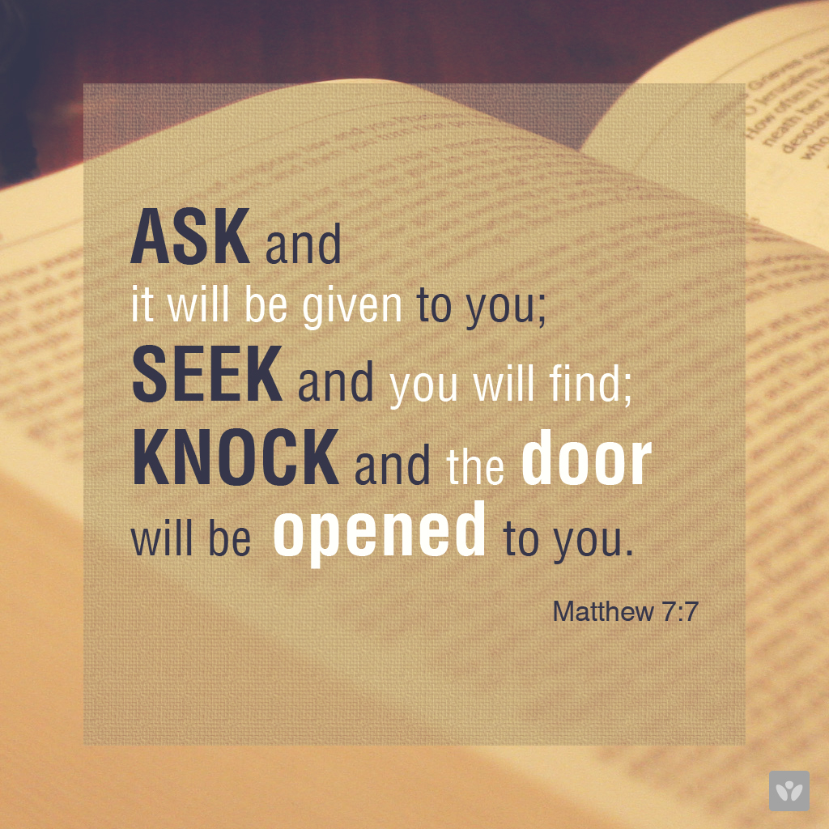
This Photo by Unknown Author is licensed under CC BY-NC-ND
This Photo by Unknown Author is licensed under CC BY-SA
Pilgrimage can aid your own well-being as you allow yourself to
release, receive and return. You can do this as you walk along a path, follow a finger labyrinth or simply in your mind.
Take your own pilgrimages this Lent – even if only the journey from car or gate to the school door!
This Photo by Unknown Author is licensed under CC BY-NC-ND

