Slide 1
Heated Cushions in Churches Results from a Trial during winter 22/3 in St Edmundsbury and Ipswich Diocese
Presentation to Church Energy Advisers Network
4th May 2023
Tony Allwood, Oliver Clarke

Slide 2
Objective
To evaluate the feasibility of using “Sit and Heat” heated cushions as the main heat source in:
small rural churches,
or for small congregations (e.g. mid-week services, meetings, etc.) in larger churches, either rural or urban.

Slide 3
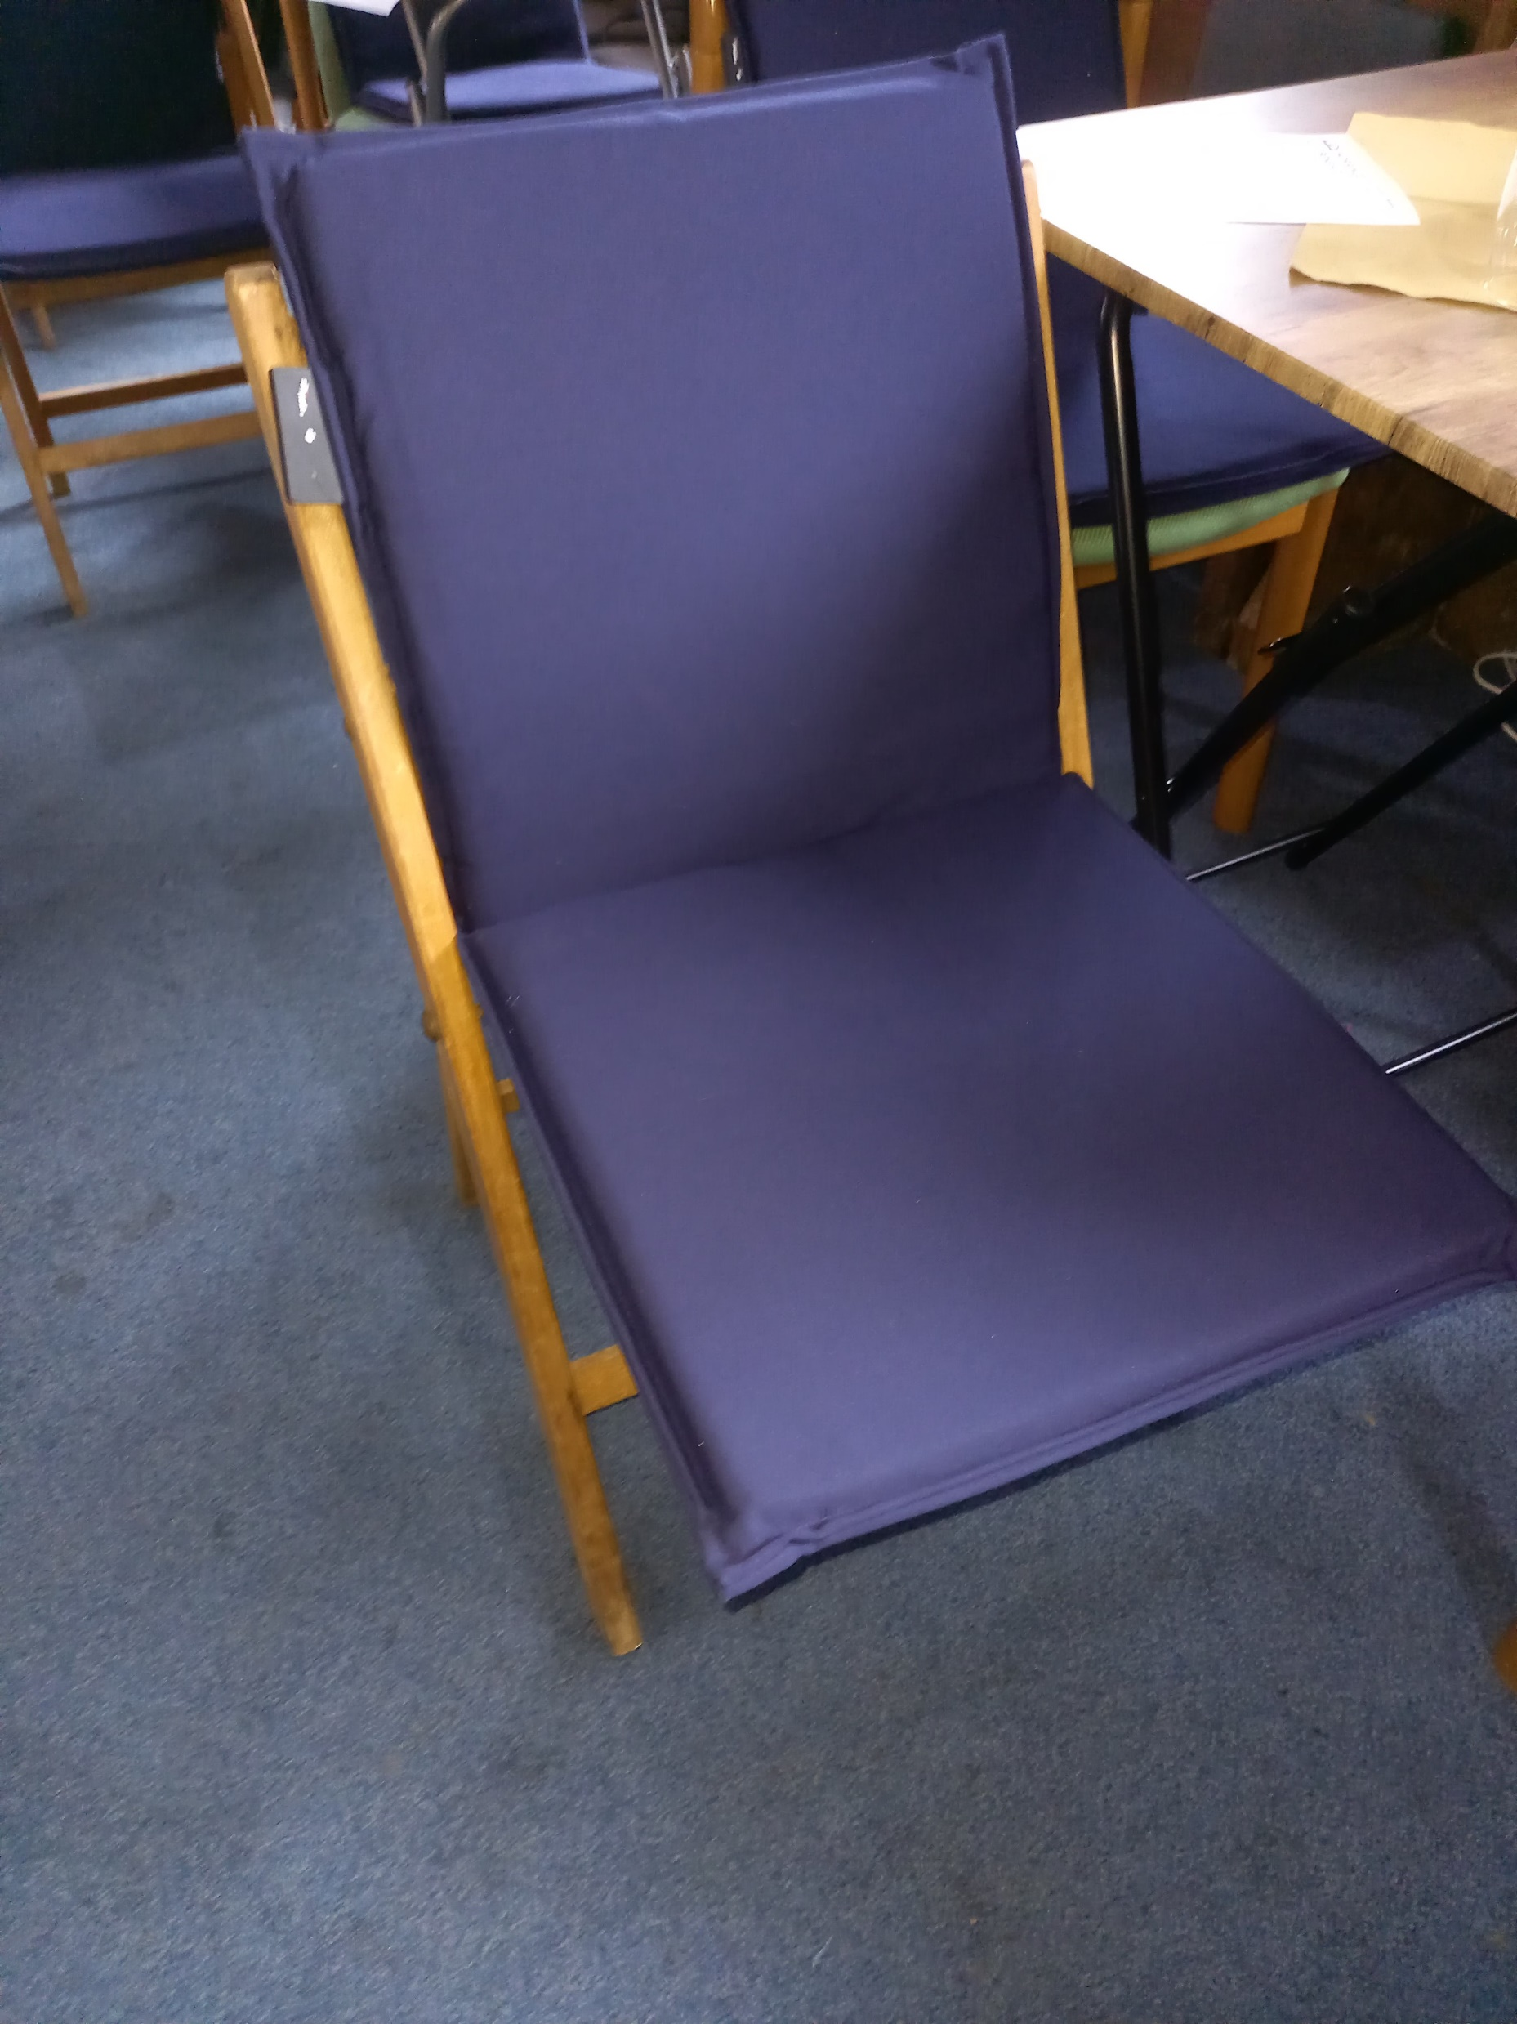
Cushions Used 1: Sit and Heat Nimma Battery Powered
30W spread over seat and back
20 cushions for 1¼ hour service uses less than 1 kWh
Turns on when sat upon
Made to measure
About £190 each

Slide 4
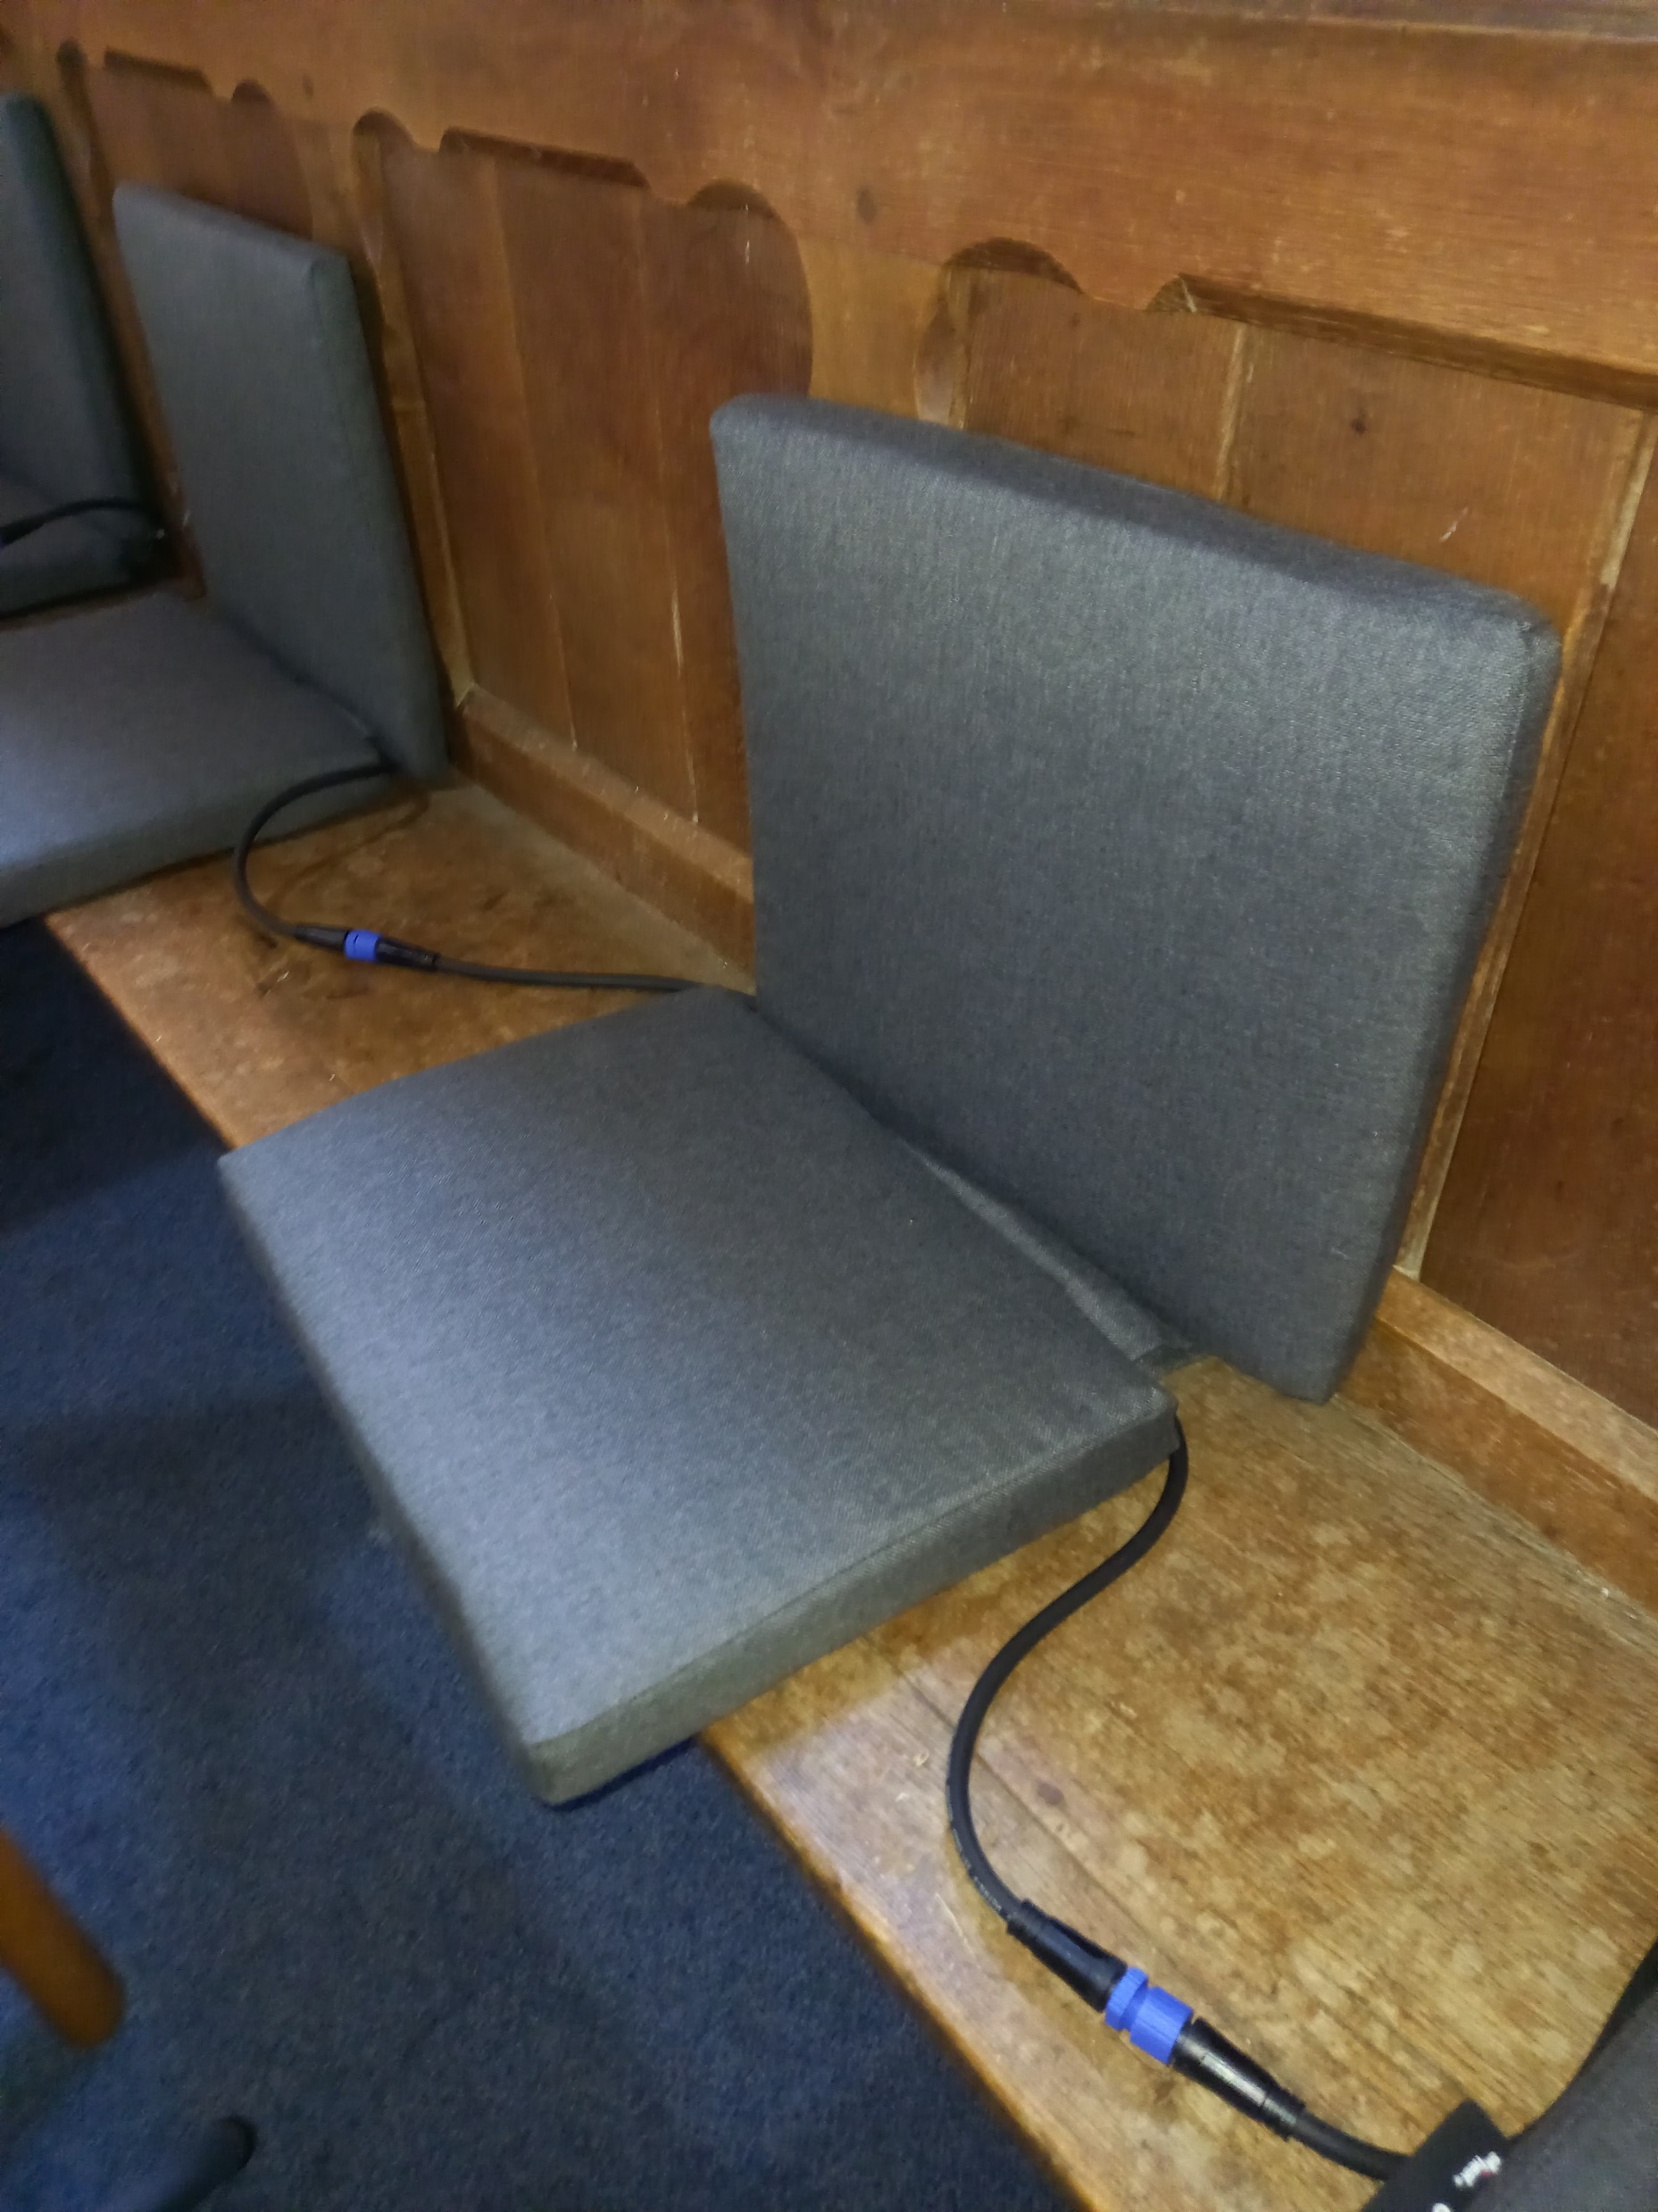
Cushions Used 2: Sit and Heat Nimma Daisy-Chained version
Powered via transformer which will supply up to 4 cushions
40W spread over seat and back
20 cushions for 1¼ hour service uses about 1 kWh
Turns on when sat upon
Made to measure
About £220 each

Slide 5
The Trial
Trialed at 14 churches across the diocese
Mainly small, rural churches with a few in small towns
Existing heating system was turned off in most cases
Some days were -5 degrees outside and felt even colder in the church!
Mainly pews (of various shapes and sizes) and some chairs
175 feedback forms completed

Slide 6
Feedback Results 1

Slide 7
Feedback results 2

Slide 8
Feedback Results 3

Slide 9
Feedback Results 4
1 Church so impressed that they have bought cushions, 2 others have received quotations and intend to purchase cushions over the summer
Many very positive comments:
Wonderful
Lovely and warm on a freezing cold day
Excellent, made so much difference
Just lovely
Just right – very good idea
Well worth purchasing
Definitely purchase ASAP
I am happy to buy my own
Some negative comments:
Would still need background heating
Depends on price
My body was warm, but feet like ice

Slide 10
Observations
Heated cushions are a very energy-efficient way of heating people, several times more efficient than pew-back heaters
Square cushions fit well on chairs but pews need more rectangular seats of the correct size
Battery pocket hanging over seat back can interfere with hymn book shelf
Seat and back heated cushions are preferred, but seat only cushions do provide significant benefits
There is minimal heat transmitted down into the pews
“Sit & Heat” cushions are made to measure, but expensive
“KovoSchmidt” manufacture made to measure heated cushions for pews, but they too are expensive
Other suppliers eg “Thaw” manufacture square or rectangular heated seats of a fixed size and these are much cheaper than made to measure cushions

Slide 11
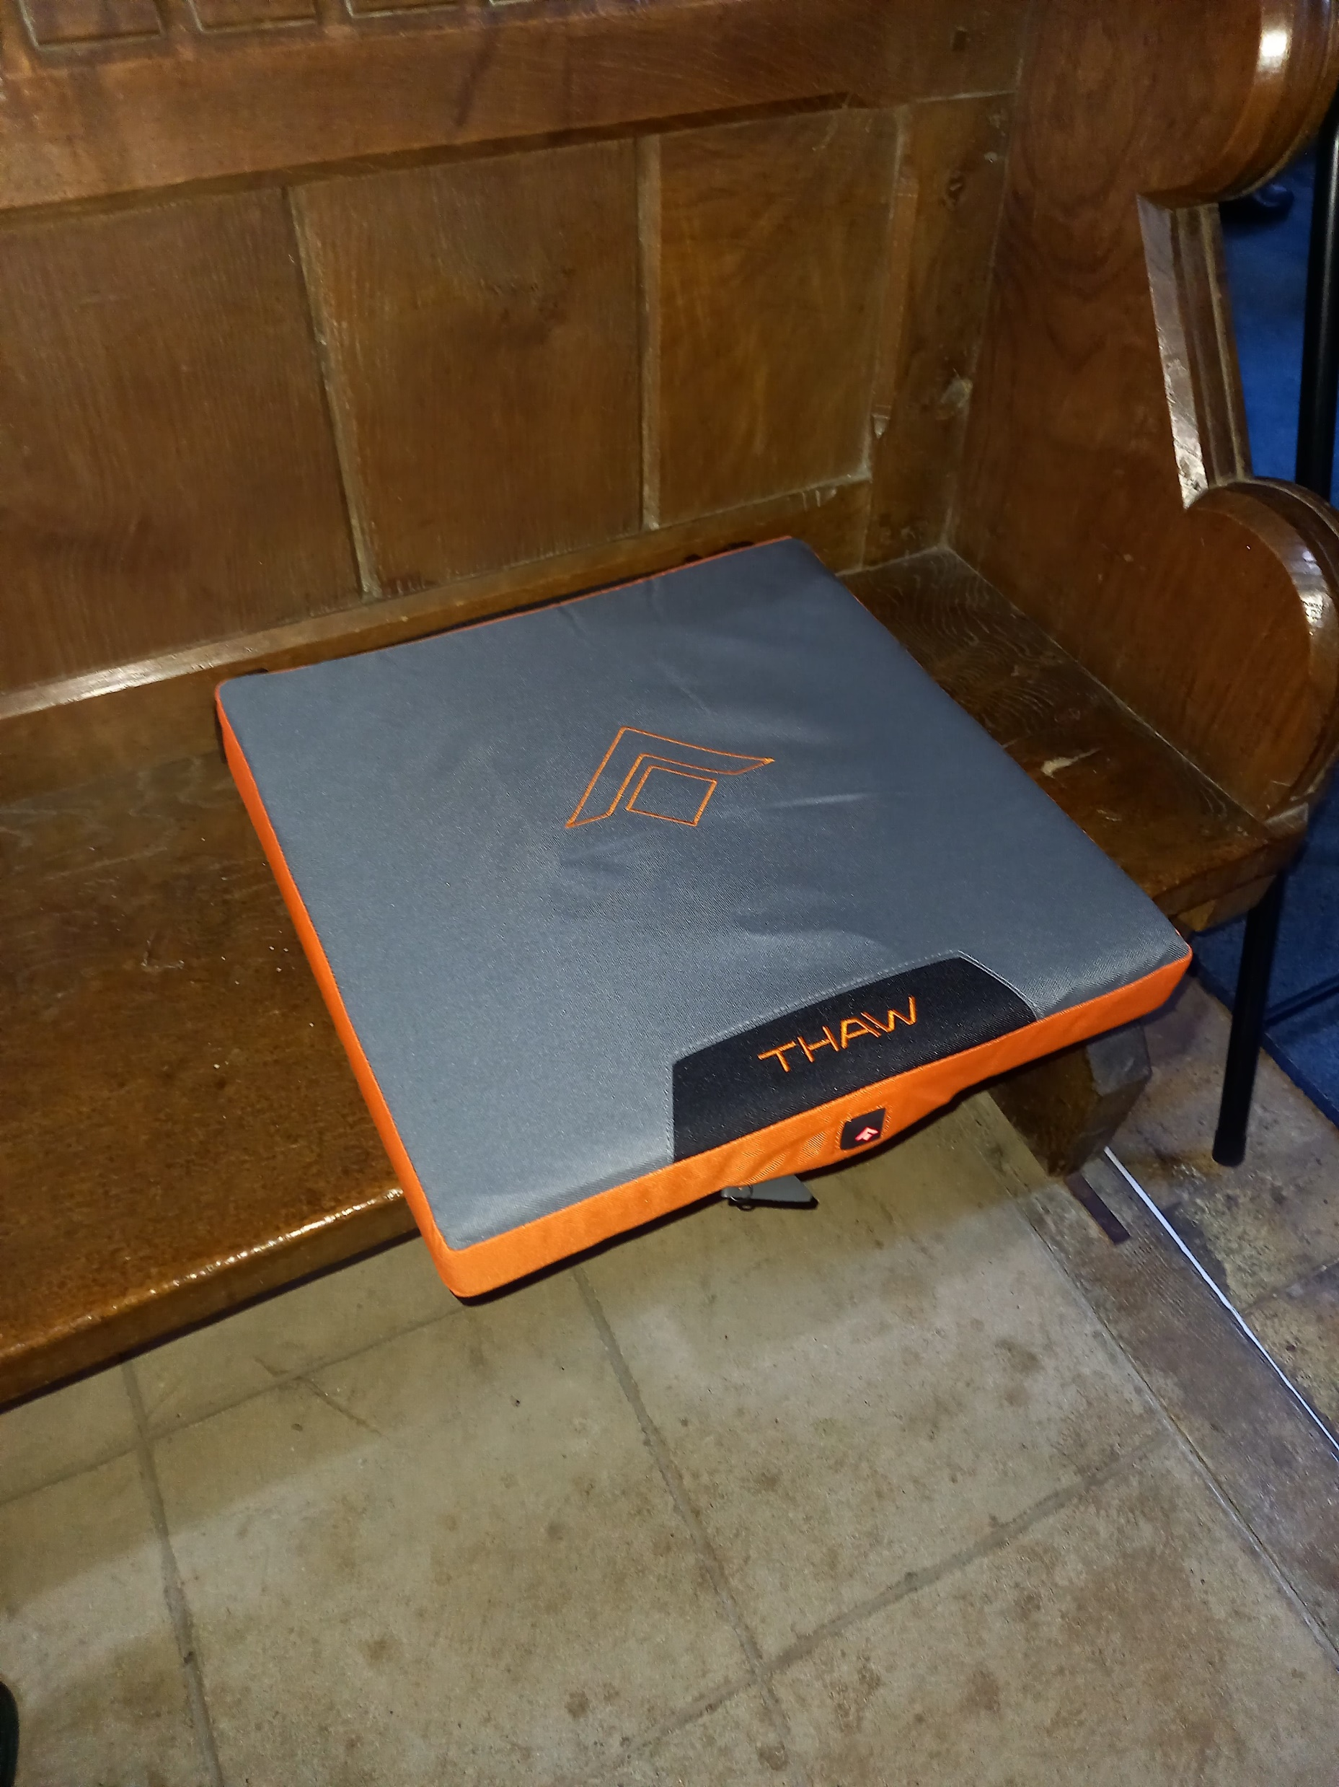
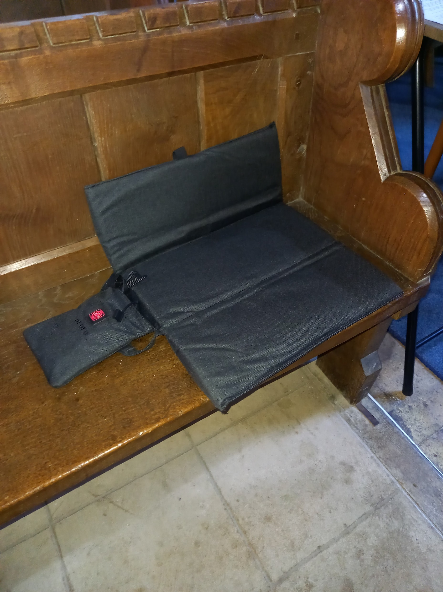
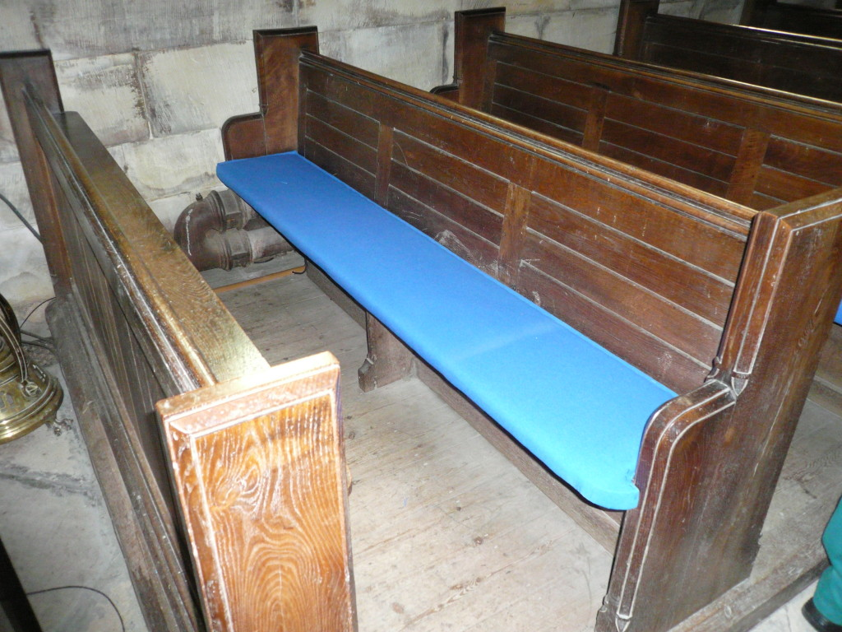
Selection of Other Cushions Available
KovoSchidt
Thaw
Ororo

Slide 12
Conclusions
Good acceptance of heated cushions as low running cost church heating
Most suitable for situations where unable to use under-pew or pew-back electric heating because:
Moveable chairs
Historic pews with no attachments allowed
Moving to electric heating would require expensive upgrade to electricity feed to the church
Could be useful as alternative heating for small congregations in large churches e.g. mid-week communion services, or extra heating for specific individuals to enable less main heating to be used

Slide 13
Recommendations
Publicity and guidance on use of heated cushions in churches
Further investigation to identify and trial cushions from other manufacturers, with a view to including more heated cushions (beyond KovoSchmidt) on Parish Buying

