Slide 1

Financial conversations
Autumn 2022

Slide 2
What is the most common commandment in the Bible?
‘Do not be afraid’

Slide 3


Reasons for fear
Cost of living crisis
Energy bills
War in Ukraine
Political instability / uncertainty
Diminished congregations
Loss of families and young people

Slide 4

Responses to fear
Self-protection
Panic
Retreat
Anger
Finger pointing

Slide 5
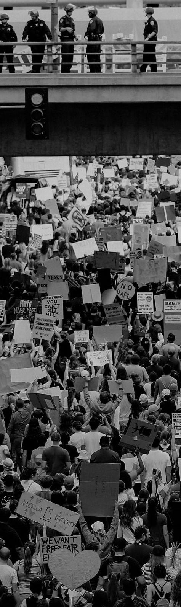
1 John
Community divided and in crisis
This time parish share was not the cause
False prophets denying the incarnation of Jesus
People turning from the faith left the numbers of orthodox believers depleted

Slide 6
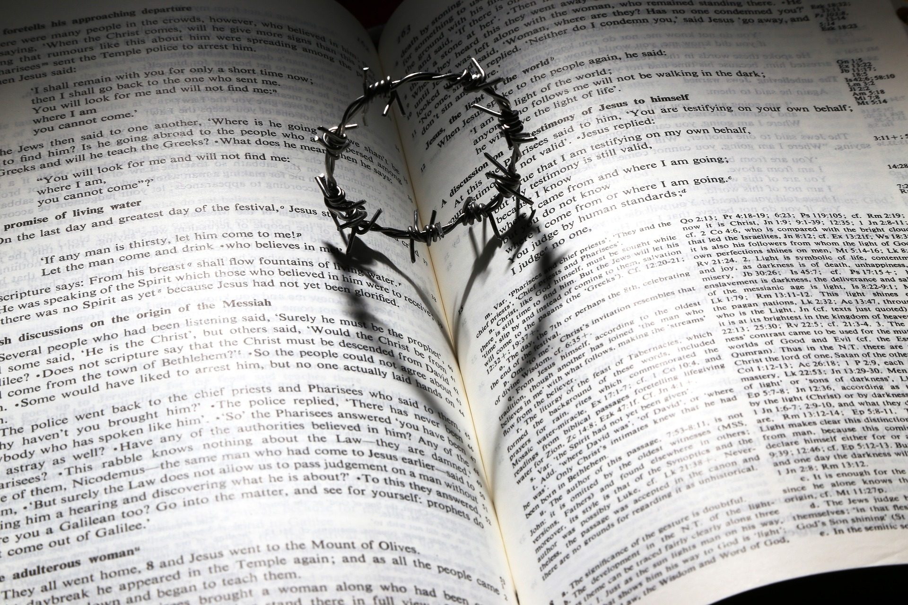
John’s response
A call to love and mutuality
1 John 4:18
There is no fear in love, but perfect love casts out fear
1 John 3:18
Let us love, not in word or speech, but in truth and action
1 John 3:16
We know love by this, that he laid down his life for us – and we ought to lay down our lives for one another

Slide 7
We live in challenging times
Our calling is to respond
Not in fear but out of love
Not just with words or speech but by truth and action
In mutuality and togetherness, not in fragmentation and self-care

Slide 8
Mutuality in action
Listening to each other and naming our fears – what precisely are the challenges we face?
Asking questions and growing in understanding
Encouraging each other and seeking responses that are creative and life giving
Understanding ourselves to be part of a greater whole, not just isolated units – we are not alone.

Slide 9
Financial update
Autumn 2022

Slide 10
Income
Income
Total income before gains and reserves utilisation
Parish share and parochial fee income
£m

Slide 11
Income

Slide 12
Expenditure & income
Income
Parish share and parochial fee income
Total income before gains and reserves utilisation
Expenditure

Slide 13
Reserves
Restricted funds | Endowment funds | Unrestricted funds
£2m various Can only be used for specific purposes | £42m parsonages Capital that can only be released if no longer a parsonage | £3.5m general Available as reserves
 | £48m fund Capital that cannot be used | £2m Loan Fund & Mission Development Fund Committed to pioneer project or back to back loans to parishes
 | £3m other Capital that cannot be used | £5m tangible fixed assets Available only when assets sold

Slide 14

The path to recovery
Everything you are doing at a parish level
Increased income from investments and glebe portfolio | £430K per annum
Reduced/reshaped support services team | £320K per annum
Reduction in stipendiary posts to 150 | £400K per annum
Reduction in stipendiary curates to 7 per year | £30K per annum
Reduction in houses owned to 220 | £310K per annum
Additional 1% drawdown on total return investments | £250K per annum
(Current estimates)

Slide 15
Building resilience
Support for stewardship and ways to give:
  Gary Watson, Lead Giving and Funding Adviser, plus Archdeaconry-based advisers
    Planned giving reviews
    Community giving strategies
    Giving tools – e.g. contactless giving
    Legacies
Implementation of Parish Giving Scheme
  Improved PCC cashflow
  Automatic claim of Gift Aid
  Inflationary adjustments to giving (optional)

Slide 16
Building resilience
Below inflation increase to parish share requests for 2023
Signposting to grants and other sources of funding to support PCC expenditure and counter the cost of living crisis
National Church Energy Costs Grant
  £309K distributed directly to PCCs in Bath and Wells

Slide 17
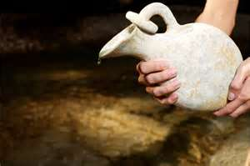
1 Kings Chapter 17

Slide 18
Saviour Christ,
in whose way of love lies the secret
of all life and the hope of all people,
we pray for quiet courage
to match this hour.
We did not choose to be born
or to live in such an age:
but let its problems challenge us,
its discoveries exhilarate us,
its injustices anger us,
its possibilities inspire us
and its vigour renew us
for your kingdom’s sake.
Amen

