Slide 1

Collective Worship resource
This series of six Collective Worship outlines for Primary Schools has been put together as part of the 2023 Everyday Faith event as we explore together the theme ‘Everyone, Everywhere, Growing in Faith’ across our diocese.
The six outlines explore six themes spelling out the word GROWTH:
1. Growth 2. Rhythms 3. Others 4. Word 5. Together 6. Hope
Each session includes four sections: Gathering, Engaging, Responding and Sending. Feel free to adapt the material to fit the context of your school.
For other resources relating to 2023 Everyday Faith event visit: bathandwells.org.uk/everyday-faith-event/
For more resources for Collective Worship visit: bathandwells.org.uk/collective-worship/
These Collective Worship plans are developed from the ‘Everyday Questions’ pack which was created as a Lent resource and can be found at https://www.bathandwells.org.uk/ministry-for-mission/discipleship/everyday-faith/everyday-questions/
Everyday Question:

Slide 2
A Collective Worship outline exploring... Growth
Gathering | You may choose to light a candle, use liturgy, play some music or have something visual for children and adults to see.
Engaging | Song: Living and Learning (Out of the Ark) or This Little Light of Mine. Share the question slide on page 3: What do you want to be when you grow up? What will help you as you grow? How does God want us to grow and develop? Bible Story: The Parable of the Sower (Matthew 13). Have a large picture on flip chart for volunteers to come up and illustrate the story. Add words as suggested by children for what the barriers or blockages are to us growing (e.g. peer pressure) and what encourages us to grow.
Responding | Prayer and reflection activity: Ask three children to pray about some of the things mentioned - ‘How does God want us to grow and develop?’.
Sending | You may like to have a Bible verse or thought or a challenge for everyone to take away with them in their thoughts. You may share some liturgy or blow the candle out and perhaps share some music.
These Collective Worship plans are developed from the ‘Everyday Questions’ pack which was created as a Lent resource and can be found at https://www.bathandwells.org.uk/ministry-for-mission/discipleship/everyday-faith/everyday-questions/
Everyday Question:

Slide 3
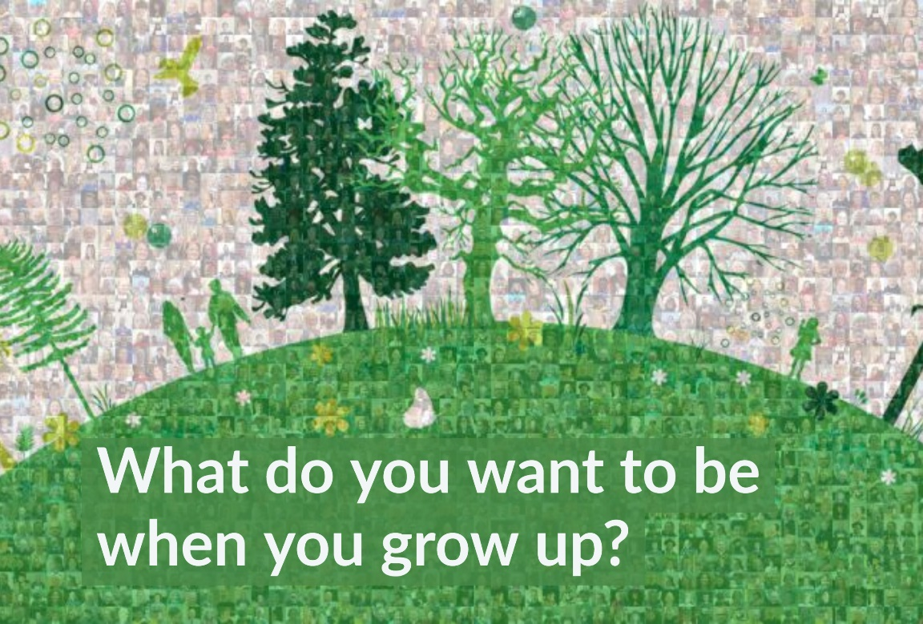

Slide 4
A Collective Worship outline exploring... Rhythms
Gathering | You may choose to light a candle, use liturgy, play some music or have something visual for children and adults to see.
Engaging | Game: Who is the quickest at saying the months of the year or days of the week? Share the question slide (p5): What is your favourite time of the day? Why? Bible Story: Daniel praying 3 times a day (Daniel and the Lions, Daniel 6 v1-28) Read the story and have some children act it out as you read. What does God want us to do every day? Why? Song: The Lord’s Prayer (any version)
Responding | Prayer/reflection activity: Pebble prayers. Children come to the front to thank God for different times of the day (either out loud or quietly in their heart) and put a pebble in the basket.
Sending | You may like to have a Bible verse or thought or a challenge for everyone to take away with them in their thoughts. You may share some liturgy or blow the candle out and perhaps share some music.
These Collective Worship plans are developed from the ‘Everyday Questions’ pack which was created as a Lent resource and can be found at https://www.bathandwells.org.uk/ministry-for-mission/discipleship/everyday-faith/everyday-questions/
Everyday Question:

Slide 5
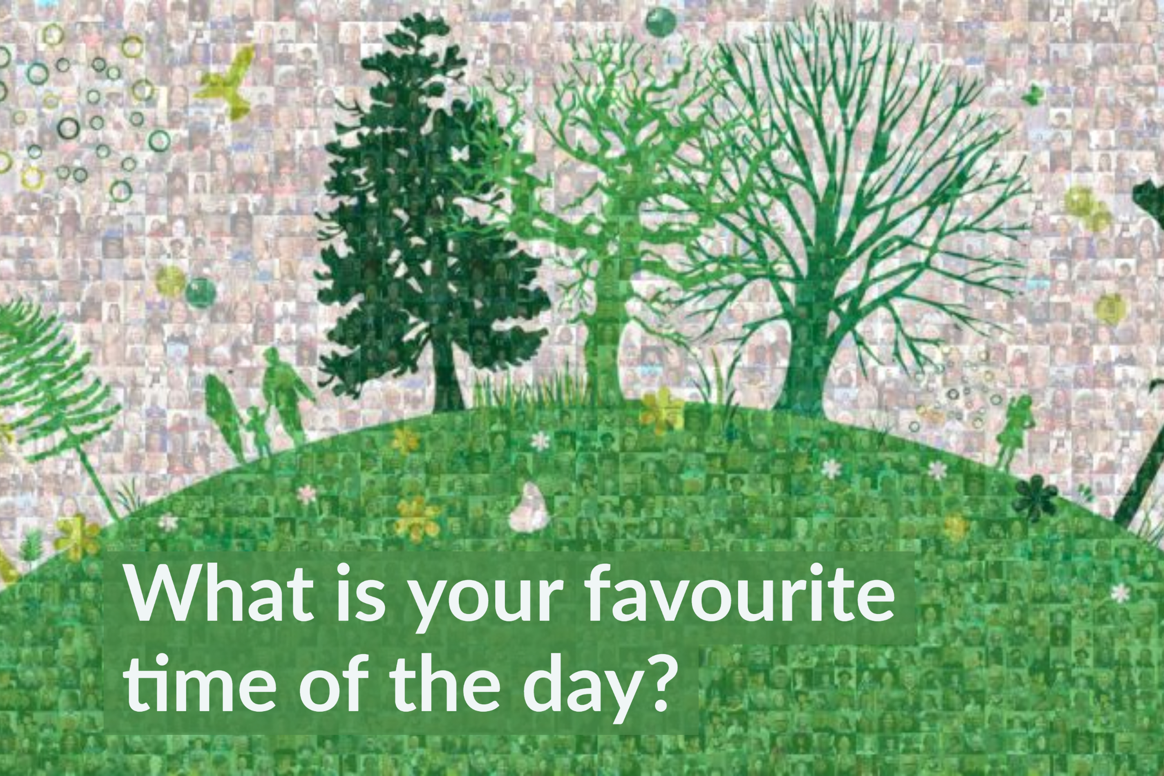

Slide 6
A Collective Worship outline exploring... Others
Gathering | You may choose to light a candle, use liturgy, play music or have something visual for children and adults to see. Try https://www.popuk.org/life-is-always-better
Engaging | Show a picture of a desert island. Ask 3 volunteers what 3 things they would take with them? Are any of them people? Who would you miss most? Share the question slide (p7): Who are the people you love seeing the most? Why are these people special? Who are we special to and why? What do we do or say that makes the relationship a good one? Bible: Jesus said ‘Love God and love others as yourself’ (Mark 12 v30) Song: The Blessing, shared worldwide during the pandemic when we couldn’t always be with others https://www.youtube.com/watch?v=uiWZXLsdE9w&t=3s
Responding | Prayer: Each person prays the thing their neighbour said first and then their prayer. Keep the prayer chain going. Praying with and for others is important.
Sending | Share your school vision or your usual liturgy and perhaps some more music.
These Collective Worship plans are developed from the ‘Everyday Questions’ pack which was created as a Lent resource and can be found at https://www.bathandwells.org.uk/ministry-for-mission/discipleship/everyday-faith/everyday-questions/
Everyday Question:

Slide 7
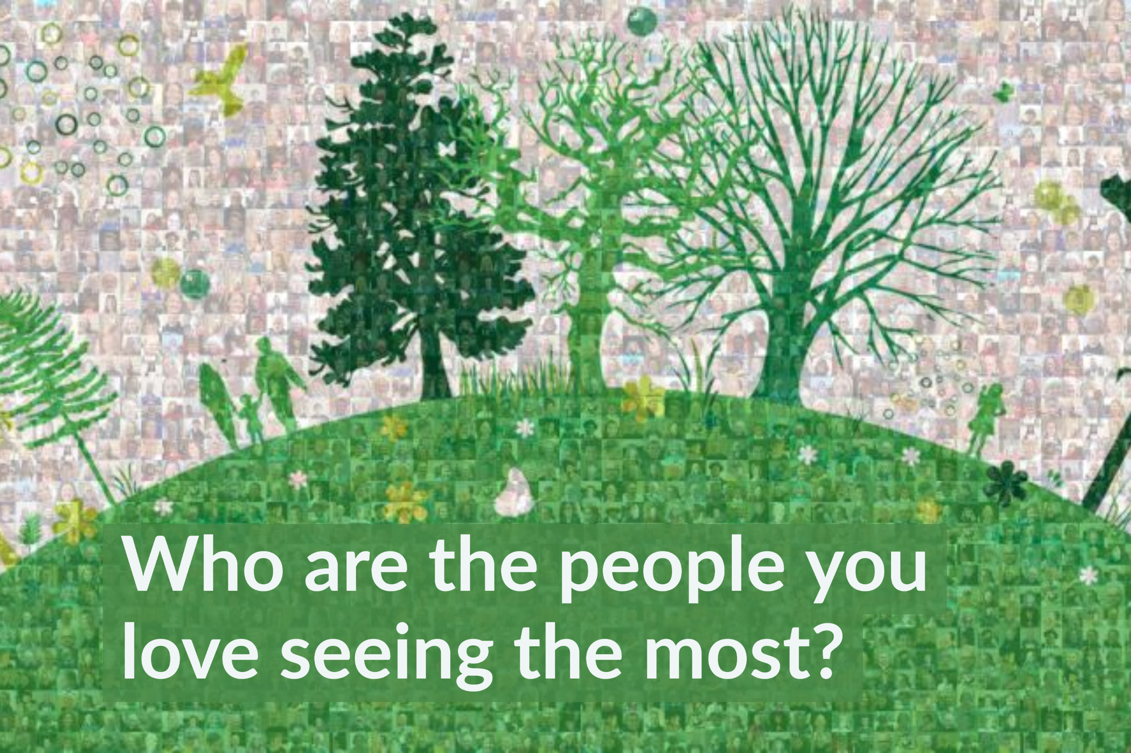

Slide 8
A Collective Worship outline exploring... Word
Gathering | You may choose to light a candle, use liturgy, play some music or have something visual for children and adults to see.
Engaging | Bible Quiz: See questions on the next page. Prepare answer cards to choose from. Song: The Wise Man Built His House Upon The Rock Bible Story: The Wise and Foolish Builders (Matthew 7 v24-27) Share the question slide on page 10: Do you have a favourite Bible story? Does the Bible guide us? How? Who else guides us? Do we hear them?
Responding | Prayer and reflection activity: Teaspoon prayers (TSP = Thank you, Sorry, Please). Think of some things you are thankful for, share ideas and then pray ‘Thankful prayers’. Then think, share and pray some ‘Sorry prayers’. Then do the same again for ‘Please prayers’.
Sending | You may like to have a Bible verse or thought or a challenge for everyone to take away with them in their thoughts. You may share some liturgy or blow the candle out and perhaps share some music.
These Collective Worship plans are developed from the ‘Everyday Questions’ pack which was created as a Lent resource and can be found at https://www.bathandwells.org.uk/ministry-for-mission/discipleship/everyday-faith/everyday-questions/
Everyday Question:

Slide 9

Bible Numbers Quiz
Try this Bible Numbers Quiz. You could make it easier by having cards with the numbers/answers on, for the children to choose from. Answers in brackets.
1. How many days did it take God to create the world? [6 + a day off]
2. How many days and nights did it rain on Noah? [40]
3. How many brothers did Joseph (of multicoloured coat fame) have? [11]
4. How many commandments did God give to Moses? [10]
5. How many feet tall was the giant Goliath supposed to be? [9]
6. How many days was Jonah in the fish for? [3]
7. How many years was Jesus on the earth for? [33]
8. How many loaves and fish did it take to feed the 5,000? [5 loaves + 2 fish]
9. How many people were added to the believers on the day of Pentecost? [3,000]
10. How many books are there in the Bible? [66]

Slide 10
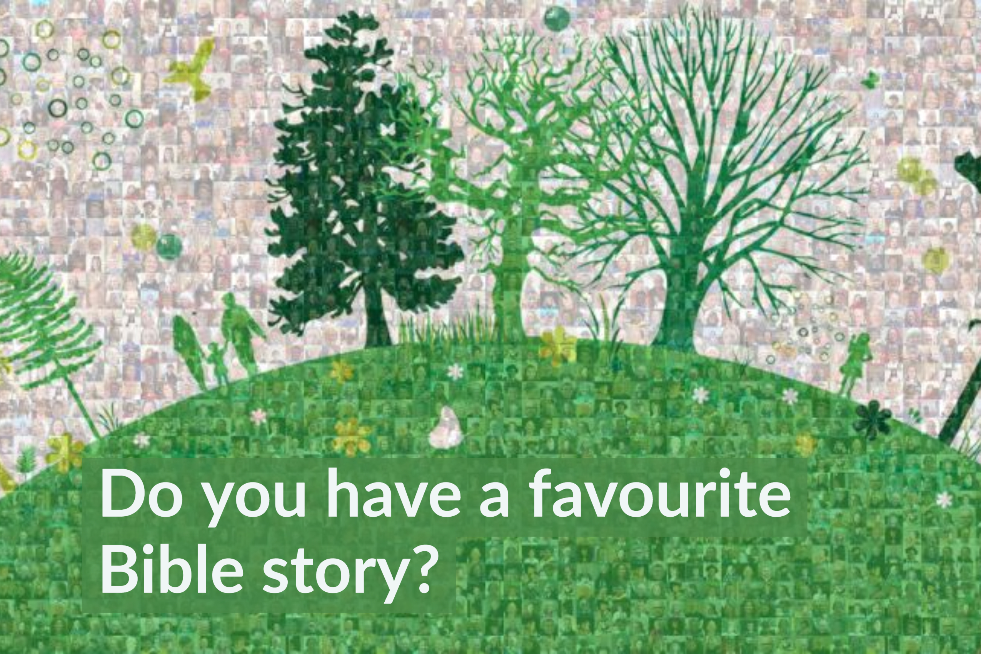

Slide 11
A Collective Worship outline exploring... Together
Gathering | You may choose to light a candle, use liturgy, play some music or have something visual for children and adults to see.
Engaging | Song: Together (Out of the Ark) or Life is Always Better (Pop UK) https://www.popuk.org/life-is-always-better Bible Story: Jesus needed a team of friends (Calling the Disciples, Mark 1 v14-20) How many disciples did Jesus have? What were their names? What do you know about them? How did they help Jesus? Share the question slide on page 12. What teams are you a part of, e.g. class team, football team, Cub Pack, Brownie Six or Guide Patrol.
Responding | Prayer and reflection activity: Share your school prayer together, or write one.
Sending | You may like to have a Bible verse or thought or a challenge for everyone to take away with them in their thoughts. You may share some liturgy or blow the candle out and perhaps share some music.
These Collective Worship plans are developed from the ‘Everyday Questions’ pack which was created as a Lent resource and can be found at https://www.bathandwells.org.uk/ministry-for-mission/discipleship/everyday-faith/everyday-questions/
Everyday Question:

Slide 12
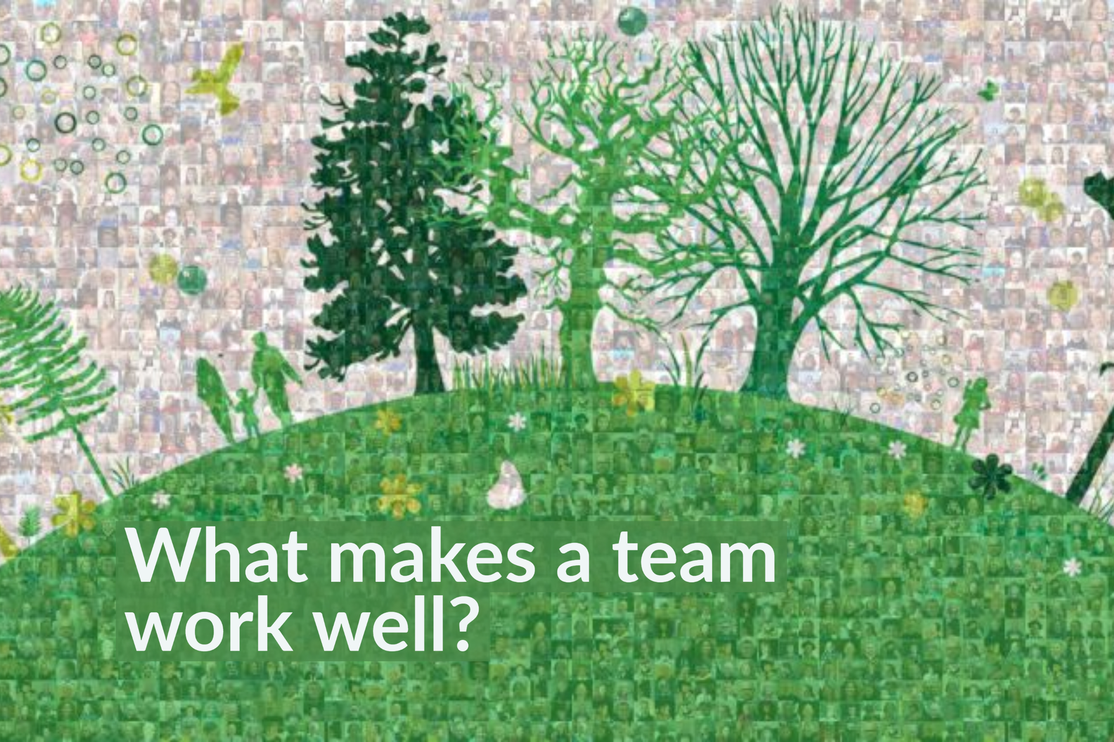

Slide 13
A Collective Worship outline exploring... Hope
Gathering | You may choose to light a candle, use liturgy or play some music. Try ‘Peace Perfect Peace’(Come & Praise) https://www.youtube.com/watch?v=lj9A4klqbqY
Engaging | Song: Hope Will Rise, Signs of Hope or A Better Day Will Come (Pop UK) https://www.popuk.org/collective-worship-selection Bible Story: Down Through The Roof (Lion Storyteller Bible, p72 / Luke 5 v17-26) How do you think the man being carried and his friends felt before meeting Jesus. Hopeful or hopeless? How did that change? Share the question slide (p14): What gives you hope?
Responding | Prayer and reflection activity: Have a rug (or picture, to symbolise the mat in the story) to collect the written or drawn hopes of the children/adults. You could use a natural object to symbolise each one instead. Ask Jesus to hear our hopes.
Sending | Share this paraphrase from Jeremiah 29 v11: God says ‘I have plans for you to have hope and a great future. Remember this and call on me’.
These Collective Worship plans are developed from the ‘Everyday Questions’ pack which was created as a Lent resource and can be found at https://www.bathandwells.org.uk/ministry-for-mission/discipleship/everyday-faith/everyday-questions/
Everyday Question:

Slide 14


