Slide 1

Wellbeing – Foundation Governors Forum
Name and job title of presenter
General guidance for the session
Please mute your microphone unless you are addressing the group
If you have any questions, please type them in to the chat box
Please amend your name details so we know how to address you

Slide 2
Wellbeing
The thief comes only in order
to steal, kill, and destroy.
I have come in order that you might have life
life in all its fullness.
John 10:10

Slide 3
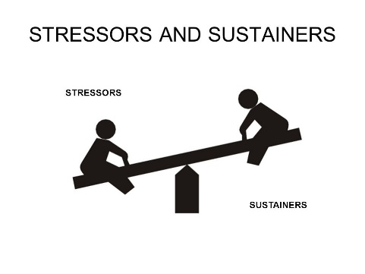
Wellbeing – looking after your self
What are some of the things that stress you?
What are some of the things that sustain you?

Slide 4

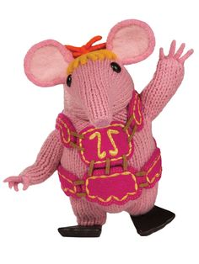
Wellbeing – looking after your self
Connect / Learn / be Active / / Notice - pay attention / Give
Eat well / Relax / Sleep

Slide 5
Wellbeing: Anxiety
Anxiety is:
  Normal
  A healthy response to danger
  Varies in intensity
  Can become a problem
Anxious life situations
Anxious thinking
Anxious emotional feelings
Anxious physical feelings
Anxious behaviours

Slide 6
Wellbeing - burnout
1 Feeling constantly under pressure
2 Boundaries difficult to keep
3 Behaviour impacts on relationships
4 Collapse!
Prevention
• Pre-emptive
• Professional

Slide 7
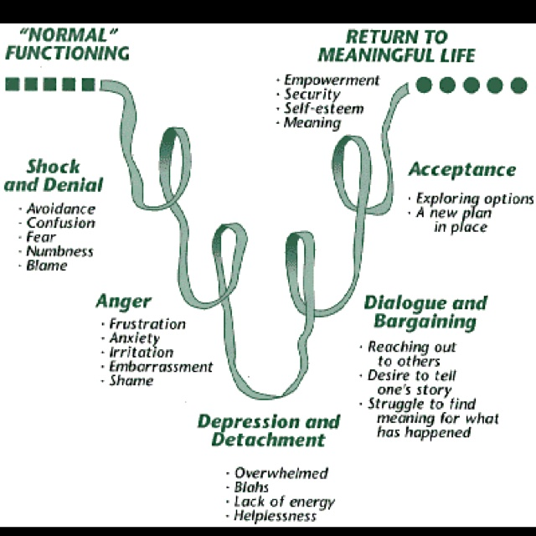
Wellbeing – coping with change
Elisabeth Kubler-Ross (1969)

Slide 8
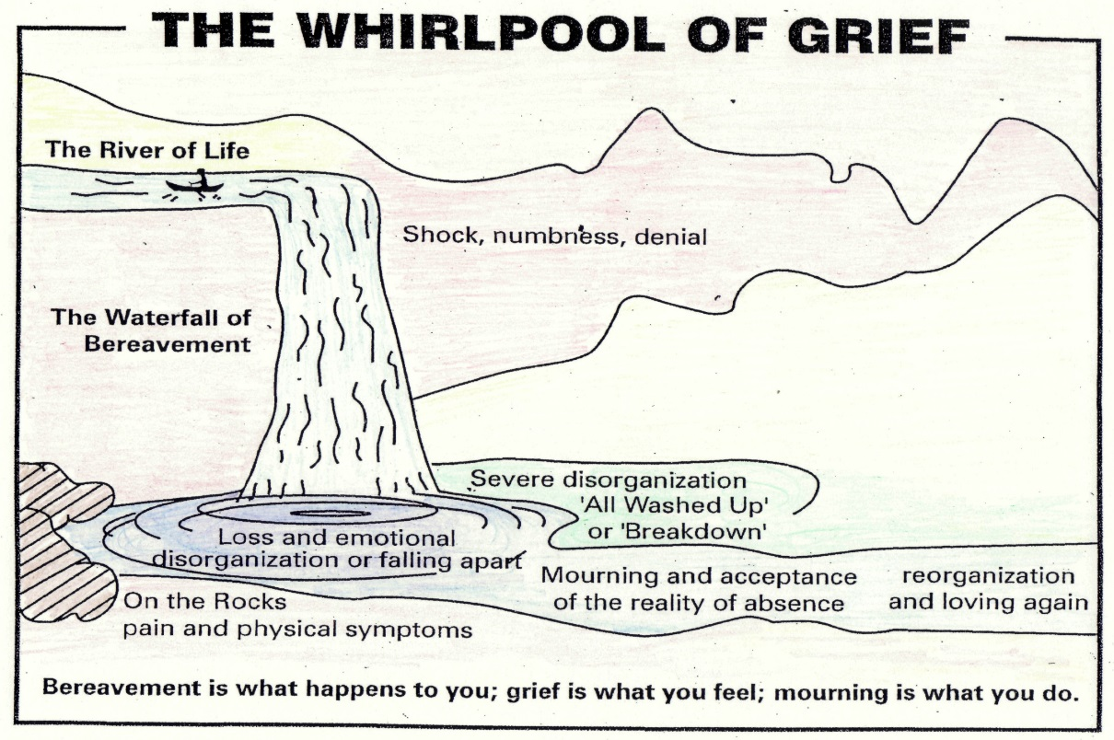

Slide 9
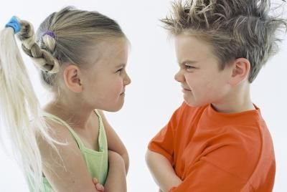
Wellbeing: Sustaining ourselves – relationship with others.
Discussion
What are some of the needs we all have in order to sustain positive working relationships?
The need to be….
What happens if these needs are not being met?

Slide 10
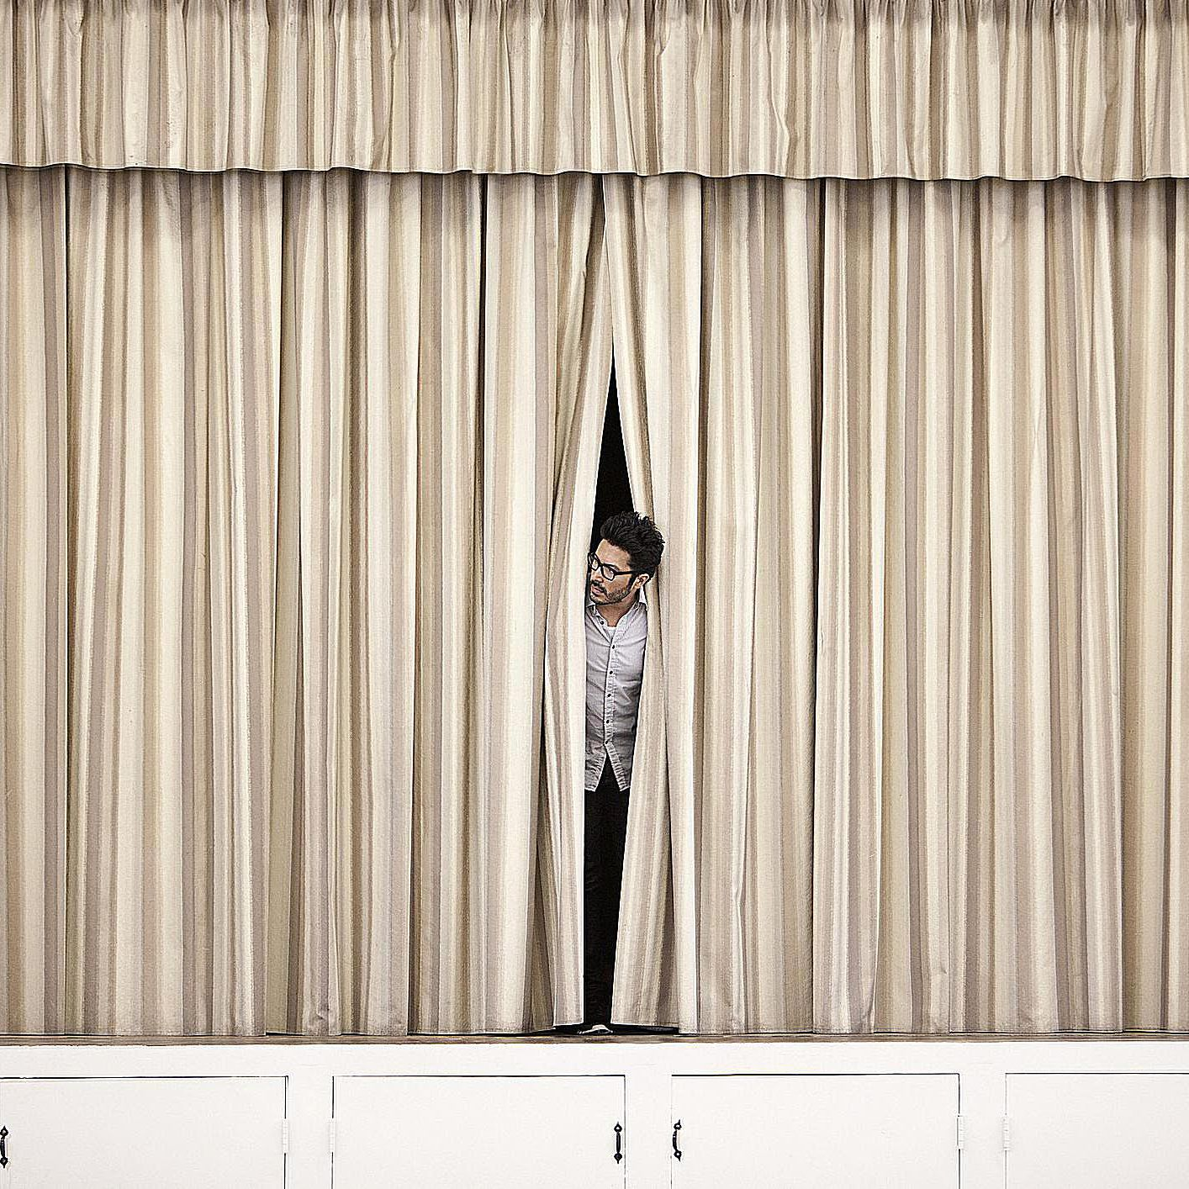

Slide 11

Wellbeing: Relating well with others trust – honesty - hope
Carl Rogers – core conditions
Empathy
Congruence
Unconditional Positive Regard
‘Seek first to understand rather than to be understood.’

Slide 12
Wellbeing
‘I’ve learned that people will forget what you said,
people will forget what you did,
but people will never forget how you
made them feel!’
Maya Angelou

Slide 13
Wellbeing – actions to consider
Policies
Wellbeing information available
Opportunities to connect
  Buddy up – staff/governor
  Making contact – email / letter / card
  Surprises – cake / chocolate / fruit / flowers
  Thank you
Prayer – awareness in the parish
Being there!

Slide 14
Children’s Wellbeing – top tips
• Listen to our children
• Keep friendships going
• Teach through life learning
• Keep routines
• Take care of ourselves

Slide 15
Wellbeing – time
I can’t accept , having no time.
I can’t think, I can’t read, I’m swamped, I haven’t time.
I’d like to pray, but I haven’t time…
And so we all run after time Lord.
We pass through life, running – hurried, jostled, overburdened, frantic, and we never get there. We haven’t time
In spite of all our efforts, we’re still short of time.
Lord you must have made a mistake in you calculations
There is a big mistake somewhere.
The hours are too short, the days are too short, our lives are too short.

Slide 16
Wellbeing – time
Lord, I have time, I have plenty of time,
All the time that you give me.
The years of my life, the days of my years, the hours of my days,
They are all mine, mine to fill, quietly, calmly,
But to fill completely, up to the brim…
I am not asking you tonight, Lord,
For time to do this and then that,
But your grace to do conscientiously,
In the time that you give me,
What you want me to do.

Slide 17
Wellbeing
The thief comes only in order
to steal, kill, and destroy.
I have come in order that you might have life
life in all its fullness.
John 10:10

Slide 18

Thank you
You will have received an email with a link to the following:
  Feedback form – we would really like to hear what you think of our training
  The power-point slides used in this session
  Any resources referred to in this session
Further CPD opportunities
Please visit our website for more information www.bathandwells.org.uk/supporting-children/

