Slide 1
Clerks’ Forum David Williams – Assistant Director School Effectiveness
General guidance for the session
Please mute your microphone unless you are addressing the group
If you have any questions, please type them in to the chat box
Please amend your name details so we know how to address you

Slide 2
Wellbeing
The thief comes only in order
to steal, kill, and destroy.
I have come in order that you might have life
life in all its fullness.
John 10:10

Slide 3
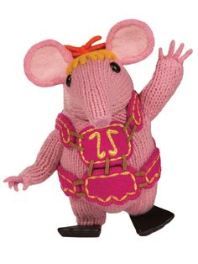
Wellbeing – looking after your self
Connect / Learn / be Active / / Pay attention / Give
Connect / Learn / be Active / Notice / Give / Eat well / Relax / Sleep

Slide 4
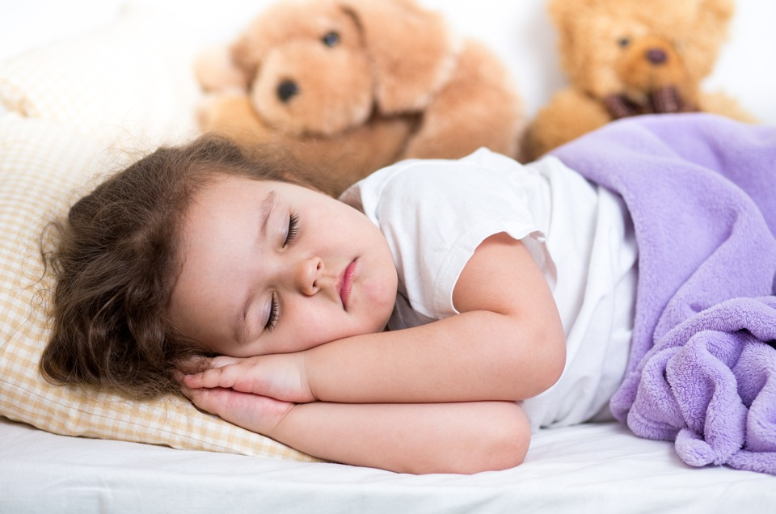
Wellbeing – research into ‘Rest’
November (2015) an online survey called The Rest Test was launched to investigate
what rest means to different people,
how they like to rest and
whether there is a link between rest and well-being.
18,000 people from 134 countries
Would you like more rest? No 32% / Yes 68%
What were the top restful activities?

Slide 5
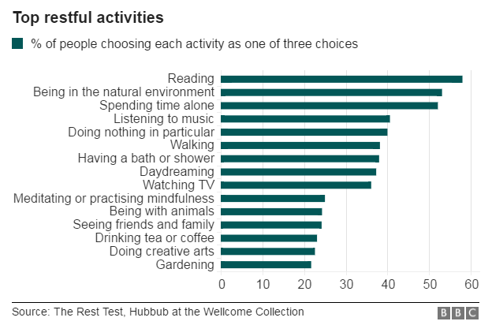

Slide 6
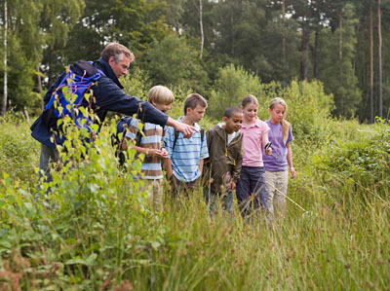
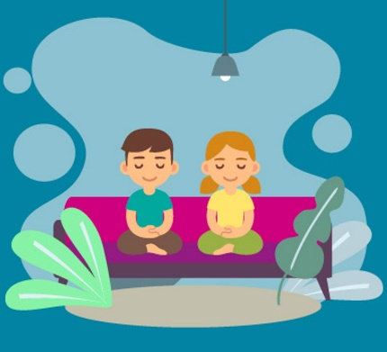

Slide 7
Sacred Pathways/Spiritual Temperaments
Naturalists: experiencing spirituality through the outdoors
Sensates: experiencing spirituality with the senses
Traditionalists: experiencing spirituality through ritual and symbol
Ascetics: experiencing spirituality in solitude and simplicity
Activists: experiencing spirituality through confrontation
Caregivers: experiencing spirituality through loving others
Enthusiasts: experiencing spirituality through mystery and celebration
Intellectuals: experiencing spirituality with the mind
Contemplatives: experiencing spirituality through adoration

Slide 8
Wellbeing – time
I went out Lord, people were coming out,
They were coming and going, walking and running,
Everything was rushing, cars, lorries, the street, the whole town.
People were rushing not to waste time.
They were rushing after time,
To catch up with time, to gain time.
Goodbye sir, excuse me, I haven’t time,
I’ll come back, I can’t wait, I haven’t time,
I must end this letter – I haven’t time,
I’d love to help you, but I haven’t time.

Slide 9
Wellbeing – time
I can’t accept , having no time.
I can’t think, I can’t read, I’m swamped, I haven’t time.
I’d like to pray, but I haven’t time…
And so we all run after time Lord.
We pass through life, running – hurried, jostled, overburdened, frantic, and we never get there. We haven’t time
In spite of all our efforts, we’re still short of time.
Lord you must have made a mistake in you calculations
There is a big mistake somewhere.
The hours are too short, the days are too short, our lives are too short.

Slide 10
Wellbeing – time
Lord, I have time, I have plenty of time,
All the time that you give me.
The years of my life, the days of my years, the hours of my days,
They are all mine, mine to fill, quietly, calmly,
But to fill completely, up to the brim…
I am not asking you tonight, Lord,
For time to do this and then that,
But your grace to do conscientiously,
In the time that you give me,
What you want me to do.

Slide 11
Wellbeing
The thief comes only in order
to steal, kill, and destroy.
I have come in order that you might have life
life in all its fullness.
John 10:10

Slide 12
Thank you
You will have received an email with a link to the following:
Feedback form – we would really like to hear what you think of our training
The power-point slides used in this session
Any resources referred to in this session
Further CPD opportunities
Please visit our website for more information www.bathandwells.org.uk/supporting-children/

