Slide 1

Introduction to Working in a Church School or Academy
General guidance for the session
Please mute your microphone unless you are addressing the group
If you have any questions, please type them in to the chat box
Please amend your name details so we know how to address you
Karen Sancto
November 2020

Slide 2

Reflection and Prayer
Lord – we thank you for the gifts you have blessed us with, and we thank you for the gift we can be to other people. Help us to recognize it and not be afraid to be who you made us to be. Amen

Slide 3

Teaching in a Church School or Academy
for new and recently appointed staff
This session will explore the distinctive nature of church schools and give both new teaching and non-teaching staff, including NQTs, a confidence in their role:
Exploration of how Christian vision and values underpin a church school
The context of church school education
The expectations and opportunities for teaching RE
Collective worship at the heart of the school
Opportunities for spiritual development
How the diocese can support you
Discussion

Slide 4
The Diocese of Bath and Wells
183 Church Schools (VC and VA)
4 local authorities (LAs)
Bath and Wells Multi Academy Trust (BWMAT)
Church schools in ’mixed’ MATs
Parish partners
Governors

Slide 5
Education Department
Director of Education – Ed Gregory
(PA to Director - Helen Garrett)
Schools Team (01749 670777)
School Effectiveness
Team lead: David Williams
Pauline Dodds
Karen Sancto
Rev. Jeremy Hellier (Secondary RE)
Admin: Jan Chandler
School Organisation
Team lead: Suzanne McDonald
Claire Hudson
Vicky Christopher
Tina Wilkes (Academies)

Slide 6
Education Department …..
Parishes ‘Go Team’
Team lead: Tony Cook (Bath Archdeaconry)
Cheryl Govier (Wells archdeaconry)
Andy Levett (Taunton archdeaconry)
Admin: Sarah Lockie
Chaplaincy in schools
Mike Haslam

Slide 7

2016 C of E Vision for Education
‘Deeply Christian, Serving the Common Good’
Educating for Wisdom, Knowledge and Skills
Educating for Hope and Aspiration
Educating for Community and Living Well Together
Educating for Dignity and Respect
/

Slide 8
Breakout room discussion
‘Life in all its fullness’
Educating for Wisdom, Knowledge and Skills
Educating for
Hope and Aspiration
Educating for Community and Living Well Together
Educating for Dignity and Respect

Slide 9
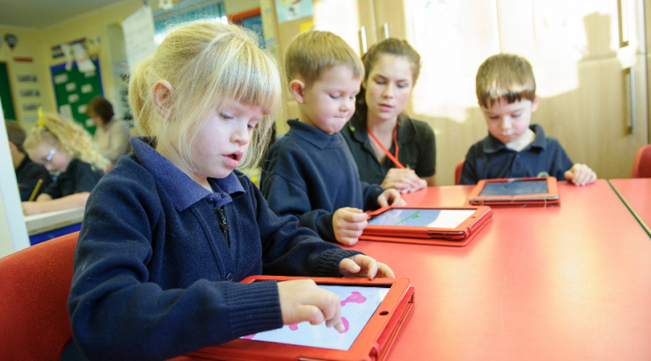
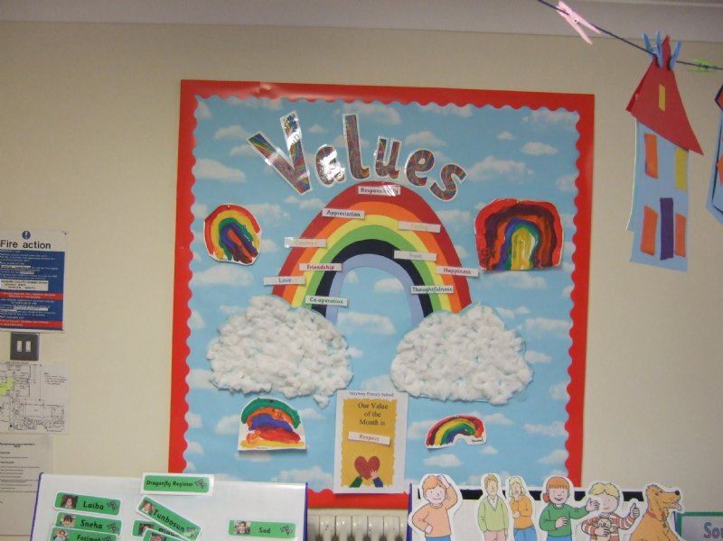
Diocesan Vision
‘Living and Telling the Story’ John 10:10
Who are we?
What are we here for?
How then do we live?

Slide 10
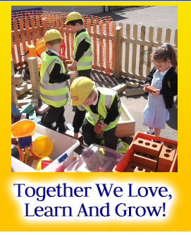
Your school vision!
Achieving excellence through the pursuit of good
Let Your Light Shine
Matthew 5:16

Slide 11
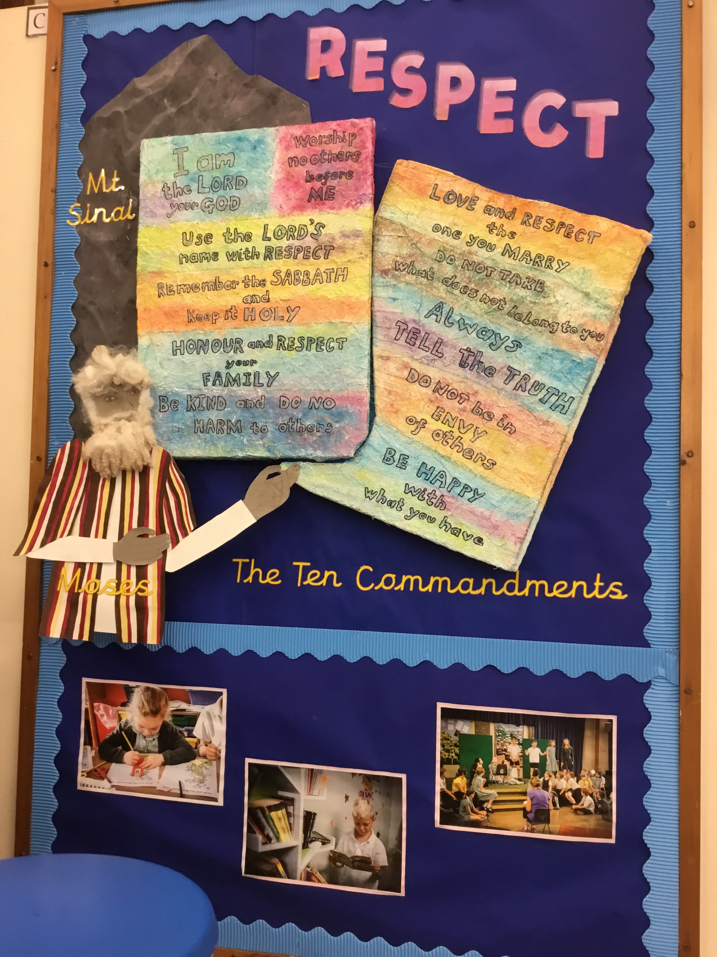
Your School’s Christian Values
‘Who are we? Why are we here? How then do we live?’
All church schools have a ‘handful’ of Christian values; such as compassion, forgiveness, hope.
Challenge – how do you embrace these and contribute to these in your school context?

Slide 12
Diocesan Education Team Priorities
All church schools sustainable and providing high quality education so all can flourish
- SIAMS, Ofsted, leadership development, governance, rural schools
All church schools offering clear pathways to distinctively Christian support and activities
- Mixed MATs, church/school partnership, community, chaplaincy, work with C&YP in parishes, foundation governor recruitment and training

Slide 13


SIAMS (Statutory Inspection of Anglican and Methodist Schools) - the single, overarching inspection question
How effective is the school’s distinctive Christian vision, established and promoted by leadership at all levels, in enabling pupils and adults to flourish?

Slide 14
Strand 2
Wisdom, Knowledge, Skills
Strand 3
Hope, Aspiration, Courageous advocacy
Strand 7
Religious Education
Strand 1
Vision and Leadership
Strand 6
Collective Worship
Strand 4
Community and Living Well Together
Strand 5
Dignity and Respect

Slide 15
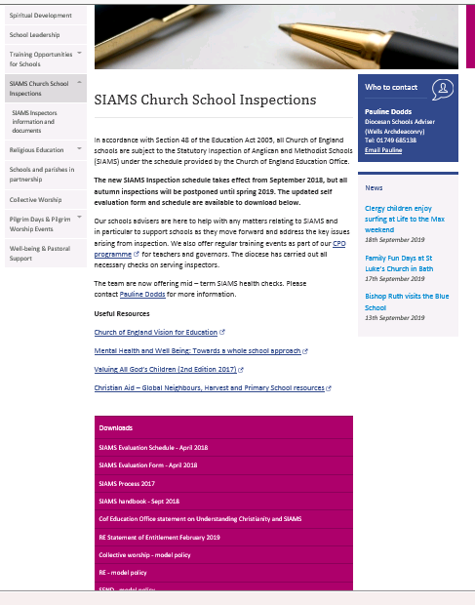
Lots of valuable resources freely available!

Slide 16
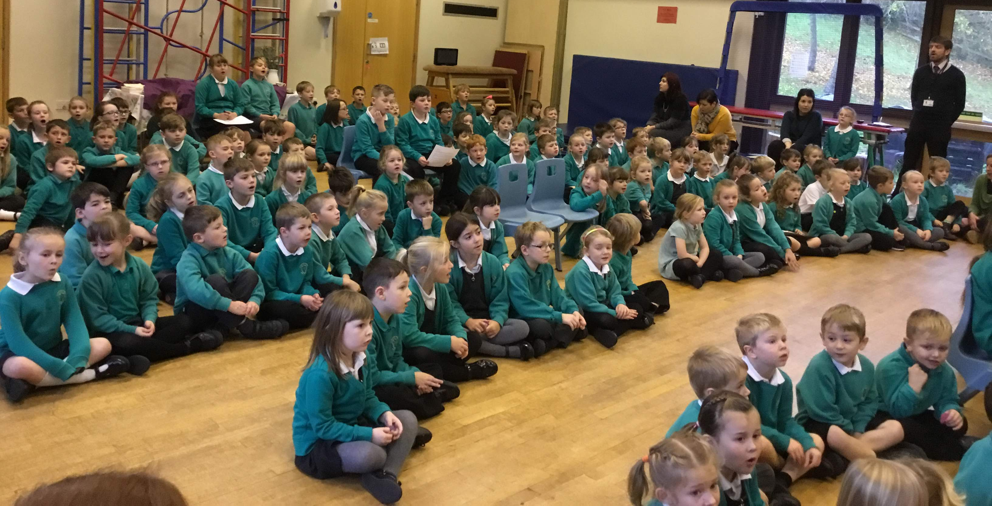
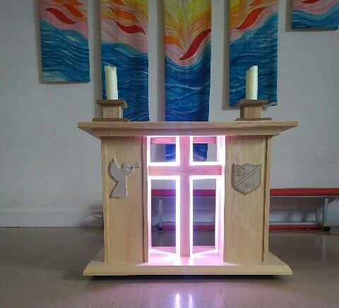
Collective Worship
Collective Worship in church schools should be inclusive, invitational and inspiring and be an expression of the school’s Christian vision. It can be the heart and soul of a school, offering the opportunity for children and adults to grow spiritually.

Slide 17
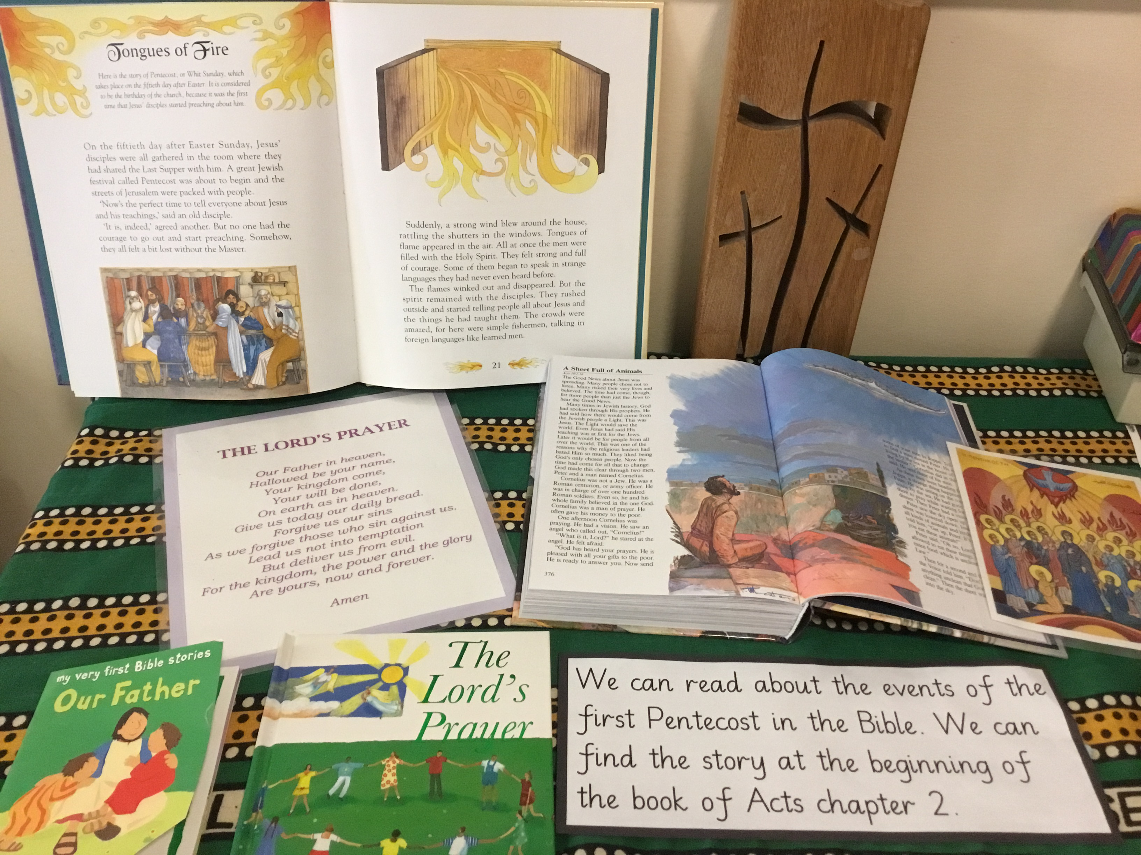
Religious Education
Support with quality teaching and learning
Support with planning a long-term overview
Use of your LA syllabus
Using the Understanding Christianity resource
Support for the RE Lead
Diocesan RE web page
Training and LTLRE hubs

Slide 18

School and Parish Partnership
What does your partnership with your church or churches look like?
What works really well?
How can you enhance this?
Discussion

Slide 19
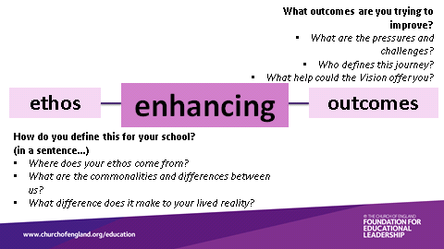
Quality of Teaching and Learning
When can this get ‘railroaded’?

Slide 20

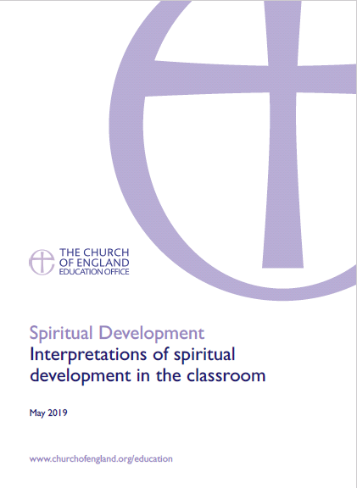




Spiritual Development
  What is spirituality?
  Why is children’s spiritual development important?
  How can spirituality be woven into the life and learning of the school?
  How will it raise academic achievement
  and personal development?

Slide 21
DfE guidance for NQTs specifically
NQT support and inductions from September 2020
Statutory Guidance on NQT Inductions
Induction for NQTs during the coronavirus (Covid-19) outbreak

Slide 22

Prayer of commission
We thank you Lord for all those here today and pray for them in their role in school.
May you guide them and give them wisdom in all their decision–making.
May you give them hope and aspiration for the children, young people, staff, governors, families and communities.
May you bless them as they serve the communities in their care.
May you empower them to nurture respect within their school contexts.
We send them out in the power and love of your name.
Amen

Slide 23
You’re not on your own!
Diocesan support:
CPD
Events
Diocesan Website
School and RE Newsletters
School Adviser

Slide 24

Thank you
You will have received an email with a link to the following:
  Feedback form – we would really like to hear what you think of our training
  The power-point slides used in this session
  Any resources referred to in this session
• Further CPD opportunities
Visit our website for more information www.bathandwells.org.uk/supporting-children/

