Slide 1
Headteacher Induction
General guidance for the session
Please mute your microphone unless you are addressing the group
If you have any questions, please type them in to the chat box
Please amend your name details so we know how to address you

Slide 2
Welcome and introductions

Slide 3
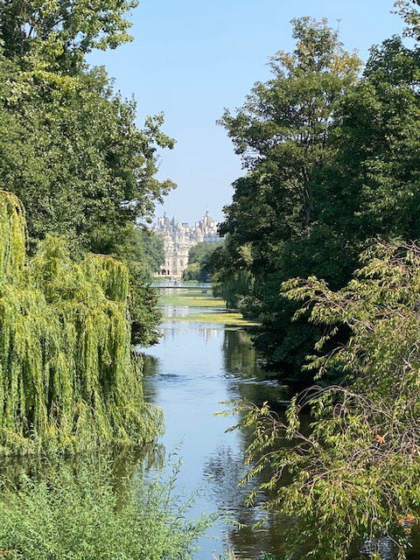
Reflection
Lord God, you are always with me.
You are with me by day and by night.
You are with me when I am happy and when I am sad.
You are with me when I am peaceful and when I am anxious.
Help me to be still, to remember and be thankful.
Amen

Slide 4
Aims and what we will cover
• Introduction to the diocese and ed team
• Church schools in context
• CoE Vision for Education
• SIAMS
• Collective worship
• Spiritual leadership
• Premises and capital, admissions, governance and academies
• Parish and school partnership
• Resources, support and key events
• Well-being

Slide 5
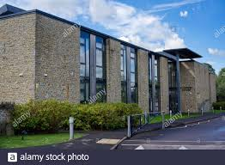
Diocese of Bath and Wells
183 church schools and academies
18 MATs
4 local authorities
3 archdeaconries
3 teams

Slide 6
Who’s who?
Director of Education: Ed Gregory
(PA - Helen Garett)
School Effectiveness Team
Team Leader - David Williams (Bath archdeaconry)
Pauline Dodds (Wells archdeaconry)
Karen Sancto (Taunton archdeaconry)
Jeremy Hellier (secondary RE)
Jan Chandler

Slide 7
Who’s Who?
School Organisation Team
Team leader - Suzanne MacDonald
Claire Hudson (governance and capital)
Vicky Christophers (admissions and foundation appointments)
Tina Wilkes (academies adviser)

Slide 8
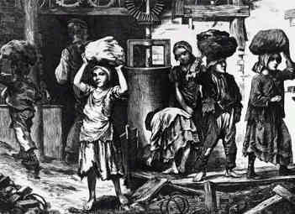
Church schools in context How would a visitor know that your school is a church school?
Your school’s Christian foundation:
A distinctive history and heritage
A distinctive language
Trust deed
Christian vision, values & ethos
An identity rooted in a Christian tradition
Foundation governors, but the corporate responsibility of all governors for the school as a church school
MAT foundation members, directors or trustees and governors
Partnership with local church and wider church

Slide 9
Church of England Vision for Education – March 2016
Educating for:
Wisdom, knowledge and skills
Hope and aspiration, courageous advocacy
Community and living well together
Dignity and respect

Slide 10
Diocesan Board of Education: Strategic plan
Diocese: Living and Telling the story
Education Department: That they might have life in all its fulness’ John 10:10
Aims to serve and support schools and parishes across the diocese
Key priorities:
All church schools are sustainable and providing highest quality education for all pupils and enabling all individuals to flourish.
All church schools offering clear pathways to distinctly Christian support or activities

Slide 11
‘A Christian approach to education, not an approach to educating Christians’ Justin Welby - Archbishop of Canterbury, Autumn 2016

Slide 12
SIAMS - Section 48
In ‘normal’ times:
Inspection every 5 years
One inspector, one day, one week’s notice
‘How effective is the school’s Christian vision, established and promoted by leadership at all levels in enabling pupils and adults to flourish?’

Slide 13
Strand 2
Wisdom, Knowledge, Skills
Strand 3
Hope, Aspiration, Courageous advocacy
Strand 7
Religious Education
Strand 1
Vision and Leadership
Strand 6
Collective Worship
Strand 4
Community and Living Well Together
Strand 5
Dignity and Respect

Slide 14
SIAMS - Section 48
In ‘now time’:
Lots of unknowns!
No inspections since March 2020, no definite restart
Schools to tell their ‘Covid story’ of flourishing and well-being
How is your school’s Christian vision been lived out during Covid? -what is the impact?

Slide 15
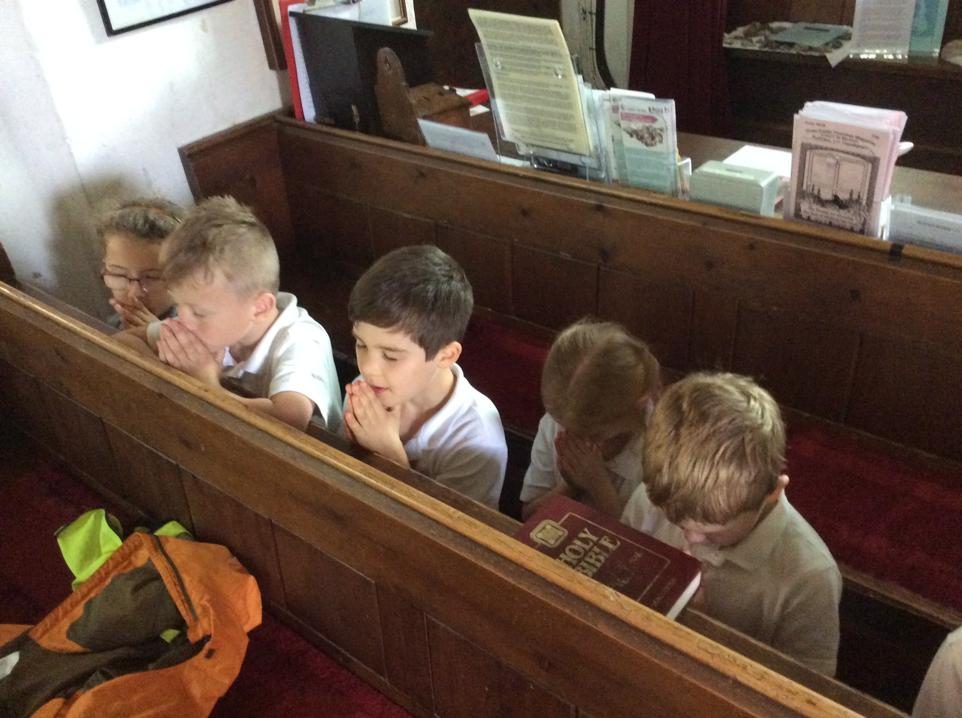
Collective Worship
• What is the ethos of CW in your school?
• Legal position
• SIAMS expectations
• How is it resourced?
• Dilemmas and rational

Slide 16
Spiritual Leadership
• What is spiritual leadership? Is it important?
• Staff definition of spirituality
• Website page for support and resources: https://www.bathandwells.org.uk/supporting-children/school-effectiveness/re-collective-worship-and-spirituality/spiritual-development/
• Planned and unplanned opportunities
• Windows, Mirrors, Doors model

Slide 17
School Organisation support
Land & Legal
Capital
Admissions
Academies
Governance

Slide 18
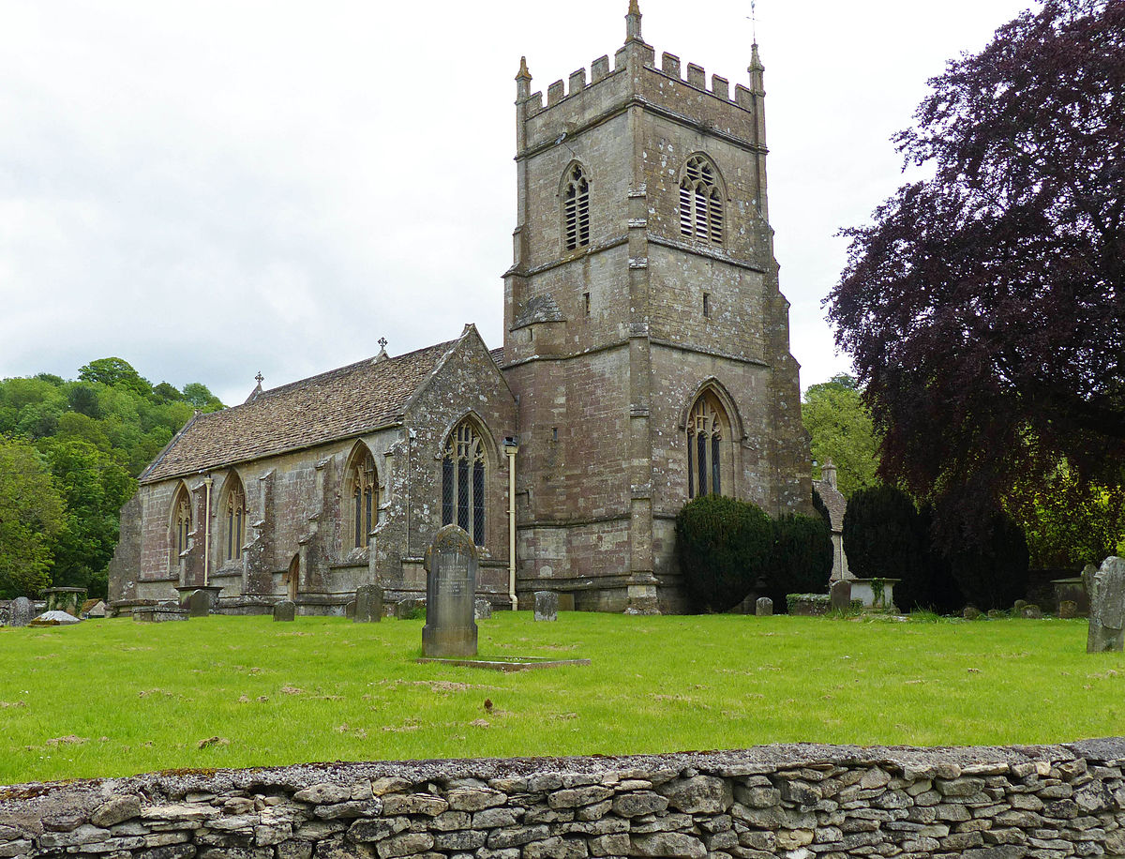
Schools and parishes in partnership
Questions to ask:
Have we got an effective partnership with our local church/es
What would we like the relationship to look like?
What might be the blocks?

Slide 19
Resources & Key Events
• Bath and Wells website
• CEEO (National Society)
• Events – Pilgrim days, HT conference, Heads and Chairs briefings
• BW School newsletter – who do you share it with?
• BW school advisers

Slide 20
Wellbeing – looking after your self
Connect / be Active / Learn / Give / Pay attention
Connect / Learn / be Active / Notice / Give / Eat well / Relax / Sleep

Slide 21
Any questions?
Key contacts
pauline.dodds@bathwells.anglican.org
karen.sancto@bathwells.anglican.org
david.williams@bathwells.anglican.org
jan.chandler@bathwells.anglican.org

Slide 22
Thank you
You will have received an email with a link to the following:
Feedback form – we would really like to hear what you think of our training
The power-point slides used in this session
Any resources referred to in this session
Further CPD opportunities
Please visit our website for more information www.bathandwells.org.uk/supporting-children/

