Slide 1
New & Aspiring Chairs
Claire Hudson
School Organisation and Governance Adviser
General guidance for the session
Please mute your microphone unless you are addressing the group
If you have any questions, please type them in to the chat box
Please amend your name details so we know how to address you

Slide 3
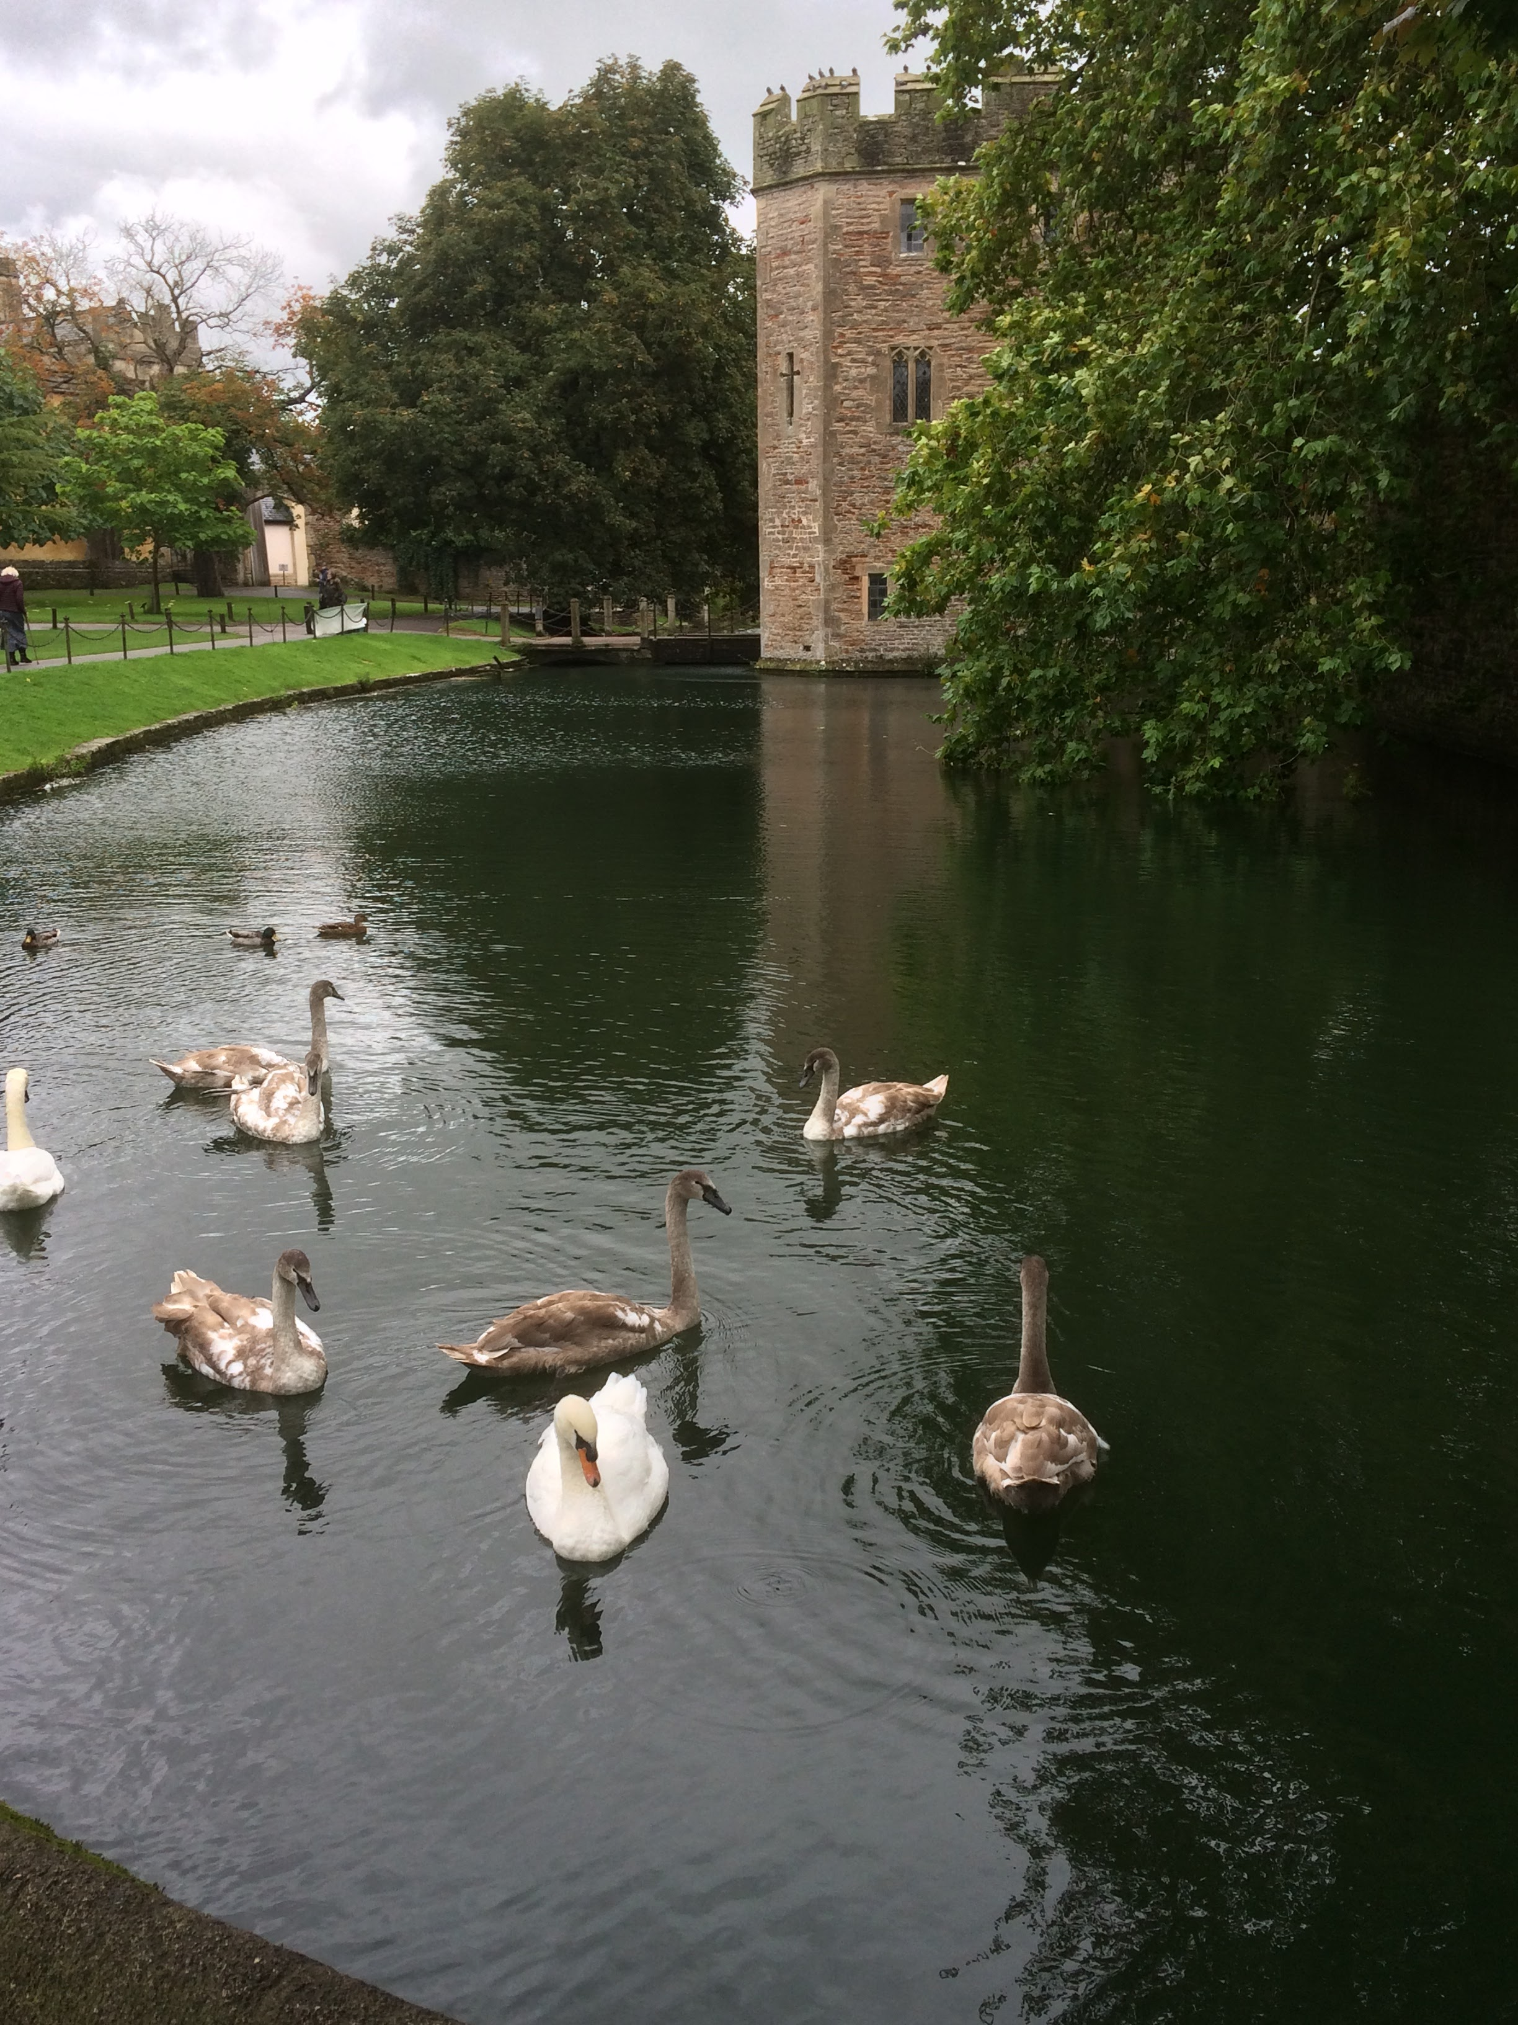
The Serenity Prayer
God grant me the serenity to accept the things that I cannot change,
The courage to change the things I can,
And the wisdom to know the difference.

Slide 4
Aims of the session
To discuss:
Key Skills
Roles and responsibilities of a chair of governors
The importance of linking vision through school documents
Your relationship with your head
Areas to pay special attention – HT PM, complaints, exclusions
Ensuring Effective Challenge

Slide 5
Core Functions of Governance
• Ensuring clarity of vision, ethos and strategic direction;
• Holding executive leaders to account for the educational performance of the organisation and its pupils, and the effective and efficient performance management of staff; and
• Overseeing the financial performance of the organisation and making sure its money is well spent.
Governance Handbook, 2020

Slide 6
How is the role of the chair different to being a governor? What skills do you think you need? What challenges will you face?

Slide 7
Key Skills
Strategic thinking
Effective communication with staff, parents, pupils, the trust and the wider community
Effective meeting chairing
Ability to facilitate difficult decision making and to manage expectations
Time management

Slide 8
Strategic vision
“The board should ensure that the organisation has a clear vision – which is articulated in a specific written statement. This should include ambitions for current and future pupils, as well as for the organisation’s relationship with other schools. For MATs, the vision should set out the level of ambition they have for future growth.”
Governance Handbook October 2020

Slide 9
Vision across inspection framework
Church schools must ensure clarity of vision, ethos and strategic direction (Governance Handbook)
Ensure leaders have a clear and ambitious vision for providing high-quality, inclusive education and training to all. This is realised through strong, shared values, policies and practice (Ofsted framework)
How effective is the school’s distinctive Christian vision, established and promoted by leadership at all levels, in enabling pupils and adults to flourish? (SIAMS framework)

Slide 10
Is your school’s vision fit for purpose?

Slide 11
The Chair (1)
Builds a team and supports that team.
Abides by the code of conduct and ensures governors do too.
Is the first among equals
Sets the tone

Slide 12
The Chair (2)
Has or develops Chairing skills
Insists on effective administration
Leads recruitment & retention
Is clear about their boundaries

Slide 13
Roles and Responsibilities
Leading effective governance with strong leadership and clear strategic focus
Building the team by recruiting effective governors and making sure they contribute their relevant skills and experience, upskilling as necessary
Building a strong relationship with the headteacher as a 'critical friend' by offering challenge, support and encouragement
Putting school improvement at the centre of all policies and strategies, and making sure all scrutiny is focused on the school's priorities
Leading the business by making sure all statutory requirements are met and board business is run efficiently
From the Key for Governors website

Slide 14
Relationship with the Head
Explore your expectations of the relationship with the headteacher. Are they the same or are you each making (different) assumptions?
Do the arrangements for keeping in touch suit both parties?
How effectively do you support, challenge and hold your headteacher to account? Could any aspects of your relationship be improved?
In which areas of work would you and the headteacher benefit from joint training?
How effective is performance management of the headteacher?
These questions taken from Leading Governors: the role of the Chair in schools and academies, DfE

Slide 15
Think about your current relationship with your head – what works well?
And what areas do you feel you need to improve?

Slide 16
Safeguarding
All governors should attend safeguarding training
You need to have confidence in your safeguarding governor – make sure you get reports
It is your responsibility to be able to answer the question ‘how do you know children are safe in your school?’

Slide 17
Pay special attention to:
Head’s Performance Management
Complaints
Exclusions

Slide 18
Holding Leaders To Account – at meetings
Our challenge ( or questions) should be on:
Educational performance, including attendance and behaviour
Data, including progress and results
Staff performance
Safeguarding/ Child protection
Progress towards meeting the objectives in the SIP.

Slide 19
Holding Leaders To Account – Governor Monitoring
School Improvement Plan
Link Governors
For this academic year:
Virtual Governor Monitoring

Slide 20
Wellbeing
You have a duty of care to be aware of the wellbeing of you head, and the staff in your school. Be aware of this during tough times.
Equally it is important you look after yourselves, that you know where to get help and support.

Slide 21
What has been most challenging about governing during a lockdown?
What support do you and your board need to be more effective?

Slide 22
Inspections
Ofsted
SIAMs

Slide 23
Things to do now
Implement a structured virtual monitoring programme – focus on key areas, including how the school will be catching-up the children who have missed some school.
Be aware of the issues with data
Continue to prioritise wellbeing
Put together a governors action plan
Undertake in person safeguarding and health and safety visits as soon as it is safe to do so. (Not before)

Slide 24
Thank you for your time
• We value your feedback
• For further resources please visit the Bath and Wells Diocesan website
https://www.bathandwells.org.uk/supporting-children/

