Slide 1

Collective Worship
Is it having an impact?
Karen Sancto
Autumn 2020

Slide 2

Our training will cover:
• Why do we monitor collective worship?
• What do we monitor?
• How do we monitor?
• Has this made a difference?

Slide 3

Reflection
What has brought you joy in the last week?

Slide 4
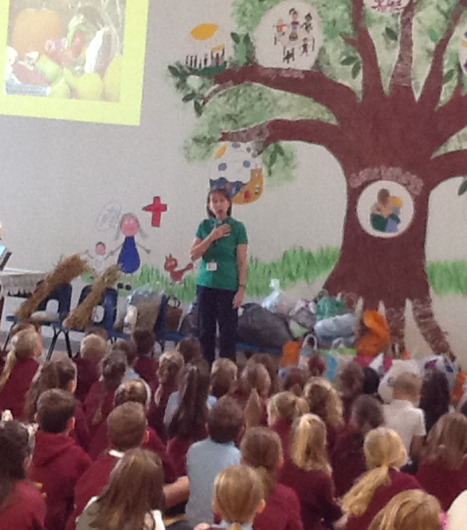
Why do we monitor collective worship?
We monitor so that we can evaluate.
Just imagine some potential scenarios of whole school and class collective worship if evaluation doesn’t take place – both good and bad!

Slide 5

So – is Collective Worship making a difference in your school community?
Can you think of three ways in which it is?

Slide 6
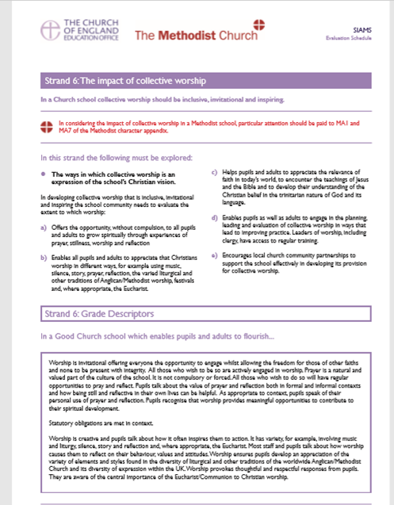
What does SIAMS say?
What aspects of collective worship does SIAMS indicate that you may like to monitor?
Look at Strand 6 of the SIAMS Schedule on page 13 and 14 in your breakout room
Could you choose a spokesperson and feedback 2 key points after your 5-minute discussion

Slide 7
How do we monitor?
What are your questions about collective worship?
• Who?
• How frequently?
•What types of monitoring are there?

Slide 8
Monitoring Resources
Bath and Wells Diocese Collective Worship Website Page
• monitoring booklet
• diocesan advisor
• mid-term SIAMS

Slide 9
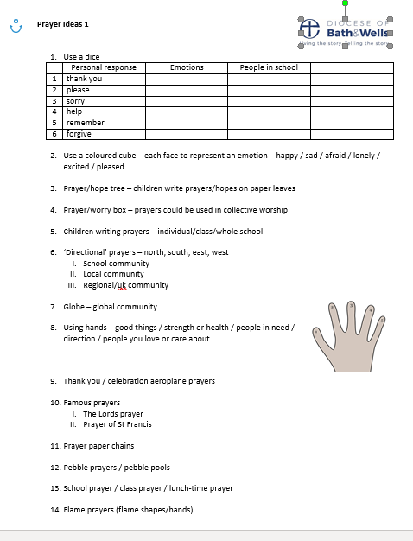
How effective is your monitoring?
Have you shared something because it is great?
Have you changed anything due to the information you have picked up through monitoring?

Slide 10

Questions
???
Collective Worship-Diocese of Bath and Wells website page
Please do contact us if you have further questions or would like any support.
Karen.Sancto@bathwells.Anglican.org
Pauline.Dodds@bathwells.Anglican.org
David.Williams@bathwells.Anglican.org

