Slide 1
Church School Governance – Part 2
Welcome
General guidance for the session
Please amend your name details so we know how to address you
If you have any questions, please type them in to the chat box whilst in main meeting space (not breakout rooms)
Please mute your microphone once we start, but feel free to keep it on now.
Karen Sancto – January 2021

Slide 2
God of Community, We look to you to inspire and empower us to live well together, to invest generously in our relationships; to contribute well to our communities; to seek justice and grace for our neighbour; to pursue activities and opportunities that help us Not simply to succeed, but to flourish together As we build your community here on earth. Amen

Slide 3
Aims of the session
• To deepen your understanding of the core role of governance in a church school
• To develop confidence in your strategic role in this within your own school
• To go away with practical ways of embedding your Trust or school vision
• To enhance your knowledge and understanding of all matters SIAMS!

Slide 4
Life as a Foundation Governor so far …….
• First round: Introductions – name, school
• Second round: What have you achieved since the last session?

Slide 5
SIAMS: The single, overarching inspection question
How effective is the school’s distinctive Christian vision, established and promoted by leadership at all levels, in enabling pupils and adults to flourish?

Slide 6
How effective is your school’s distinctive Christian vision?
What good governor questions, strategies or agenda items, would enable you to know if the school’s vision is having any impact on pupils and adults flourishing?
(Spokesperson to share 3)

Slide 7
‘Life in all its fullness’
Educating for Wisdom, Knowledge and Skills
Educating for
Hope and Aspiration
Educating for Community and Living Well Together
Educating for Dignity and Respect

Slide 8
What outcomes are you trying to improve?
What are the pressures and challenges?
Who defines this journey?
What help could the Vision offer you?
ethos
enhancing
outcomes
How do you define this for your school?
(in a sentence…)
Where does your ethos come from?
What are the commonalities and differences?
What difference does it make to your lived reality?

Slide 9
How do you embed a good ethos into governance?
• What are the tensions for your governing body?
• What enables a good governing ethos?
• What prevents a good governing ethos?
Discuss for 10 minutes
Discussion opportunity

Slide 10
Strand 2
Wisdom, Knowledge, Skills
Strand 3
Hope, Aspiration, Courageous advocacy
Strand 7
Religious Education
Strand 1
Vision and Leadership
Strand 6
Collective Worship
Strand 4
Community and Living Well Together
Strand 5
Dignity and Respect

Slide 11
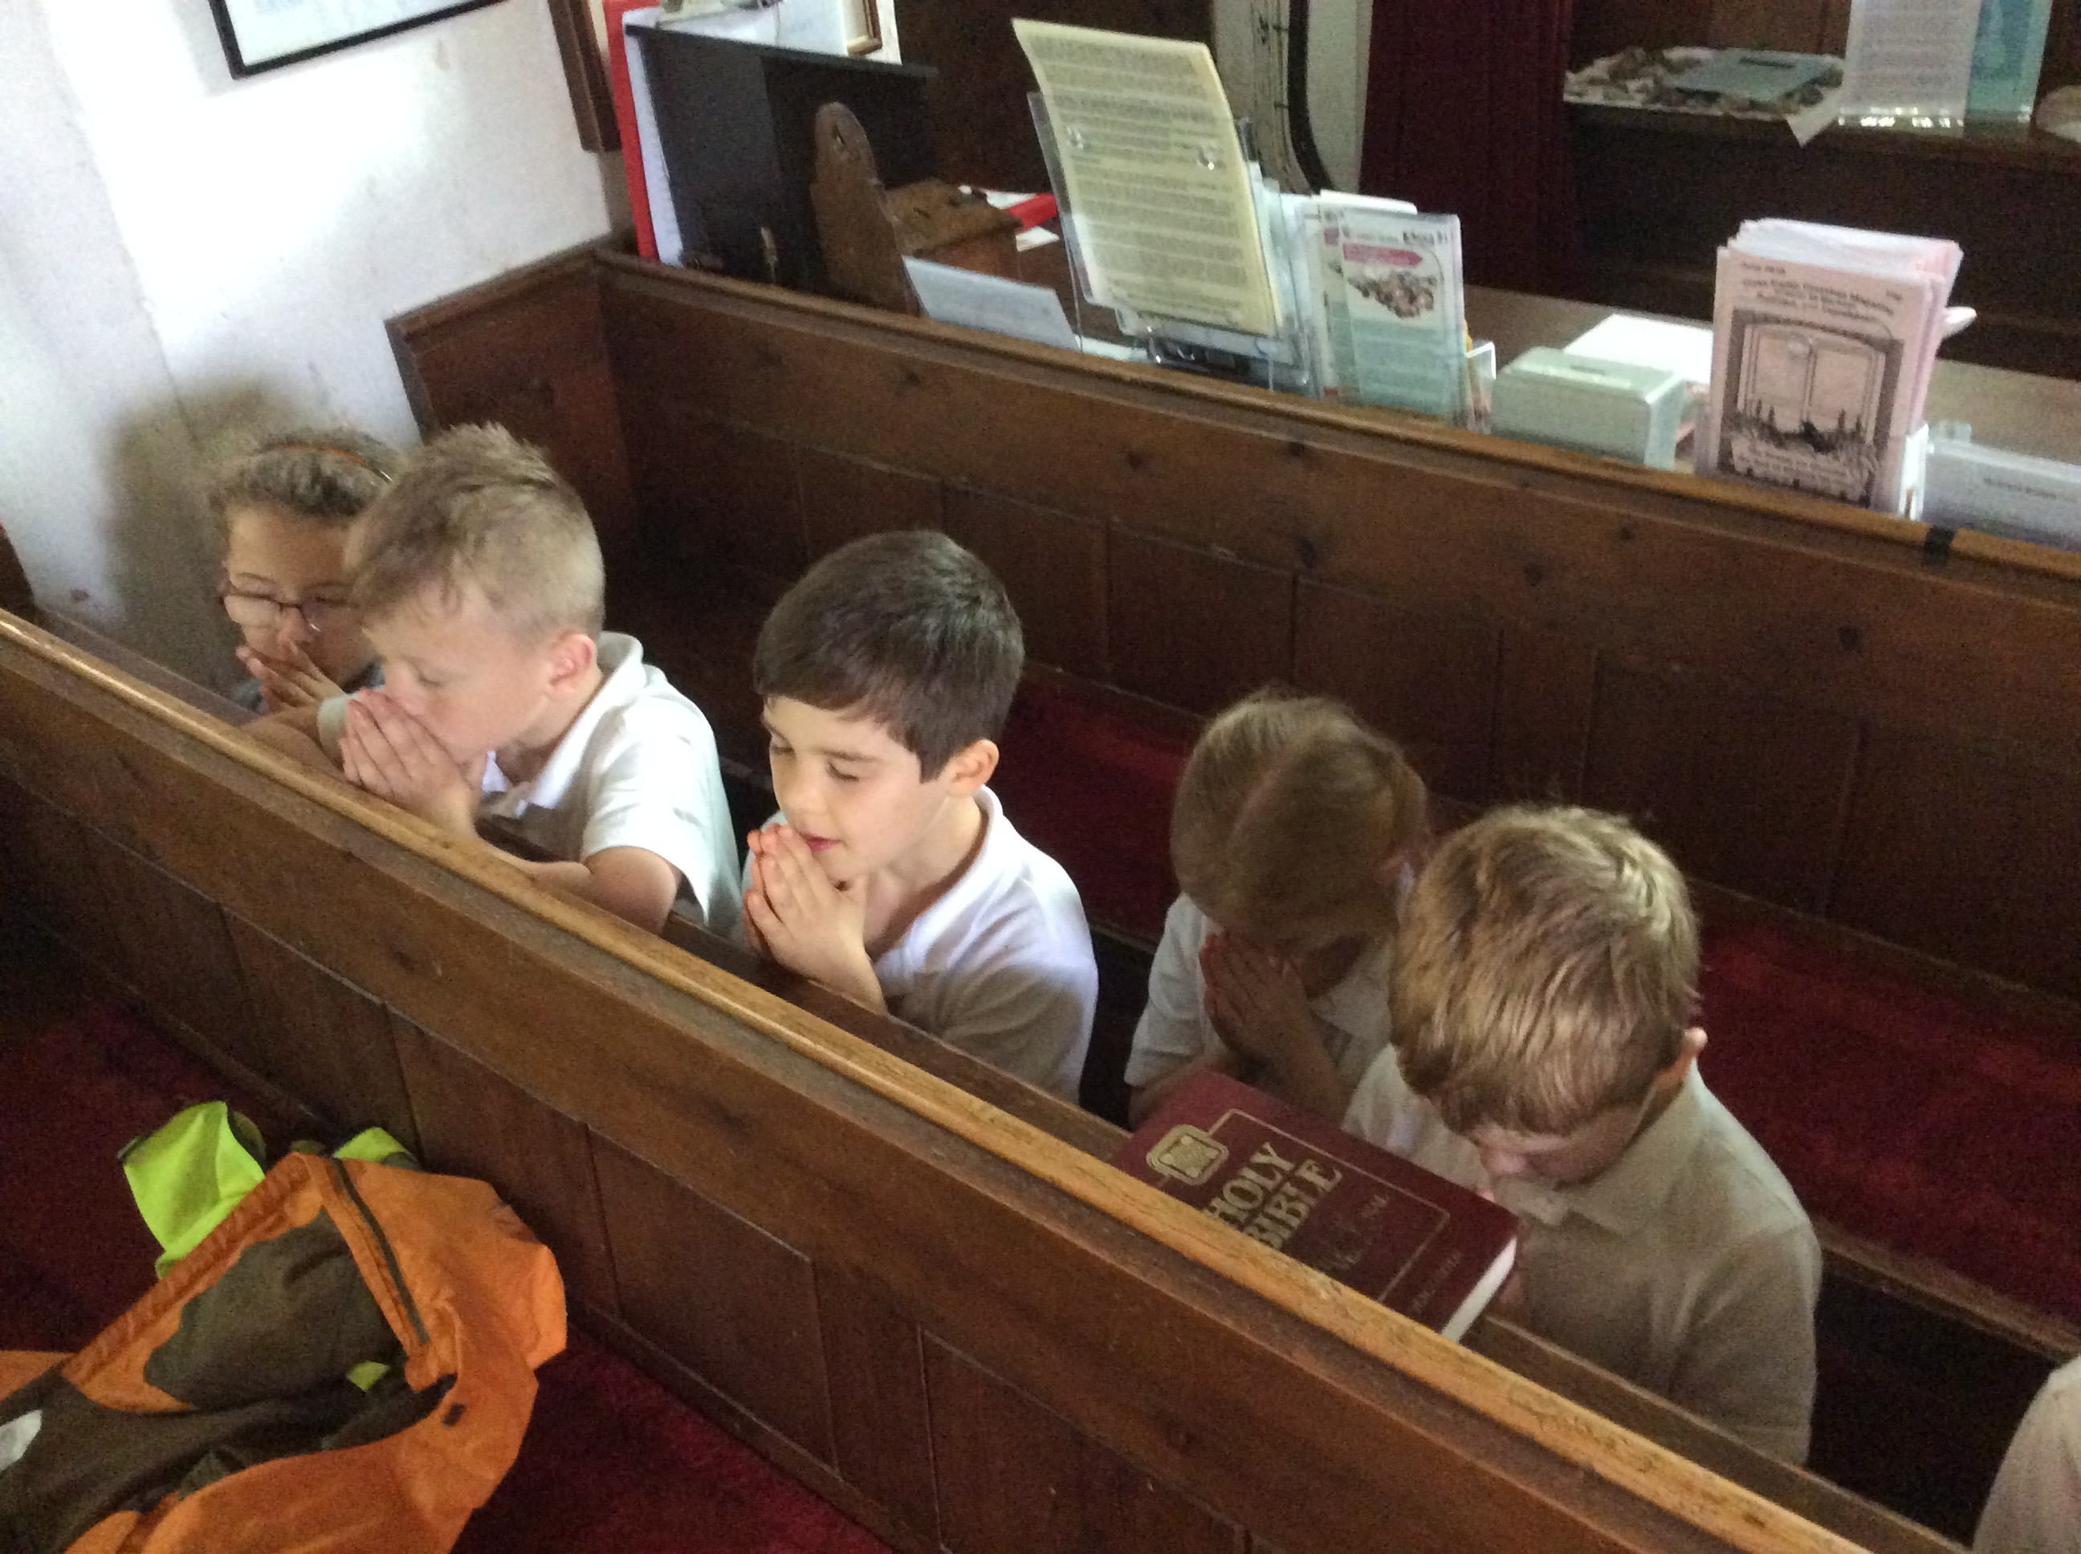
Your role in SIAMS
What does your SIAMS report say?
Choose one of your developmental points in your last SIAMS inspection report. How has this developed?
Think about provision AND impact.
Feed back general thoughts or questions.

Slide 12
Hopes and Dreams!
How do you know you’re making a difference?
• How can you support?
• How can you challenge?

Slide 13
Questions
Support
• Adviser email addresses on the website and you have Jan’s email.
Karen.sancto@bathwells.anglican.org
Claire.hudson@bathwells.anglican.org

Slide 14
Prayer of commission
We thank you Lord for all those here today and pray for them in their role in governance.
May you guide them and give them wisdom in all their decision–making.
May you give them hope and aspiration for the children, young people, staff, governors, families and communities.
May you bless them as they serve the communities in their care.
May you empower them to nurture respect within their school contexts.
We send them out in the power and love of your name.
Amen

Slide 15
Thank you!
You will have received an email with a link to the following:
Feedback form – we would really like to hear what you think of our training
The power-point slides used in this session
Any resources referred to in this session
• Further CPD opportunities
Visit our website for more information www.bathandwells.org.uk/supporting-children/

