Slide 1
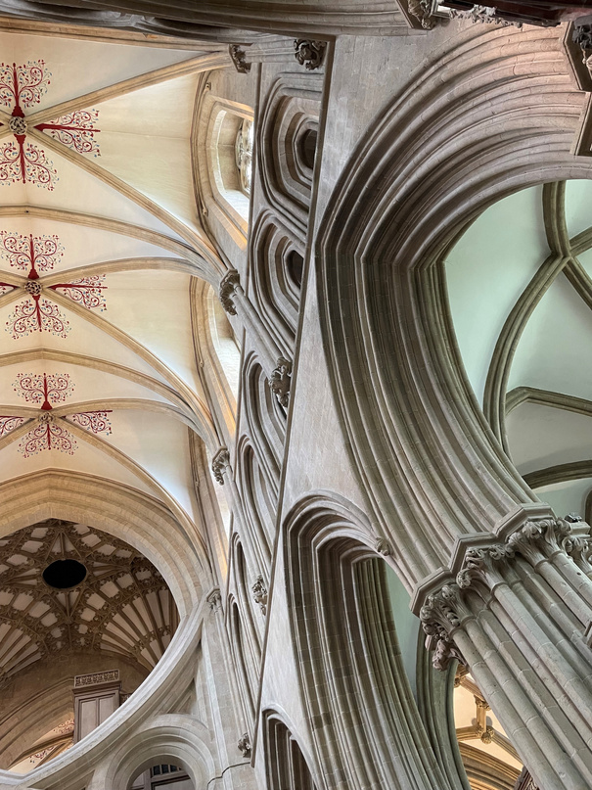
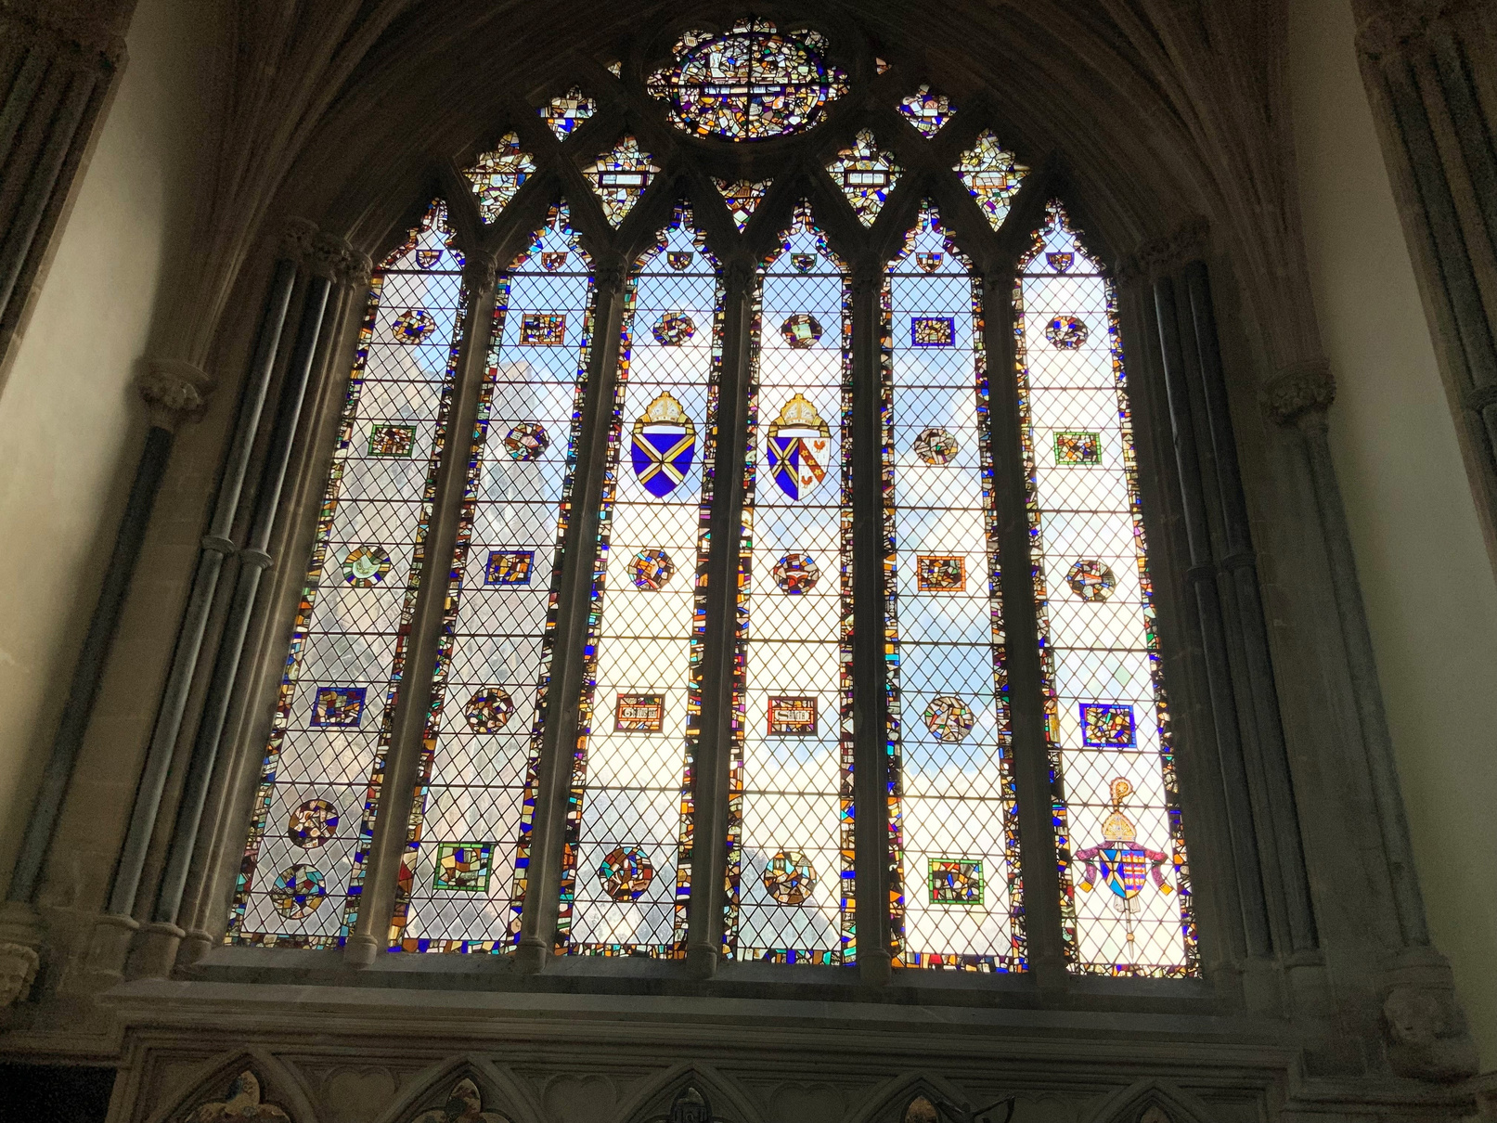
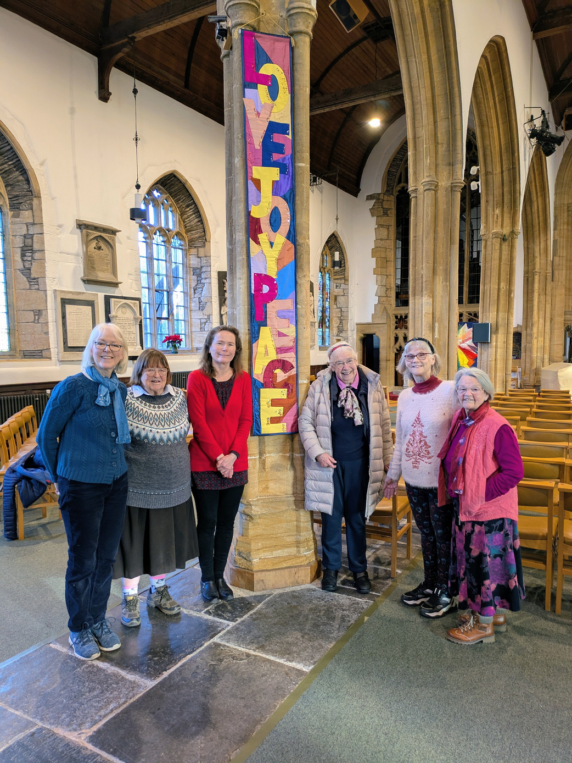
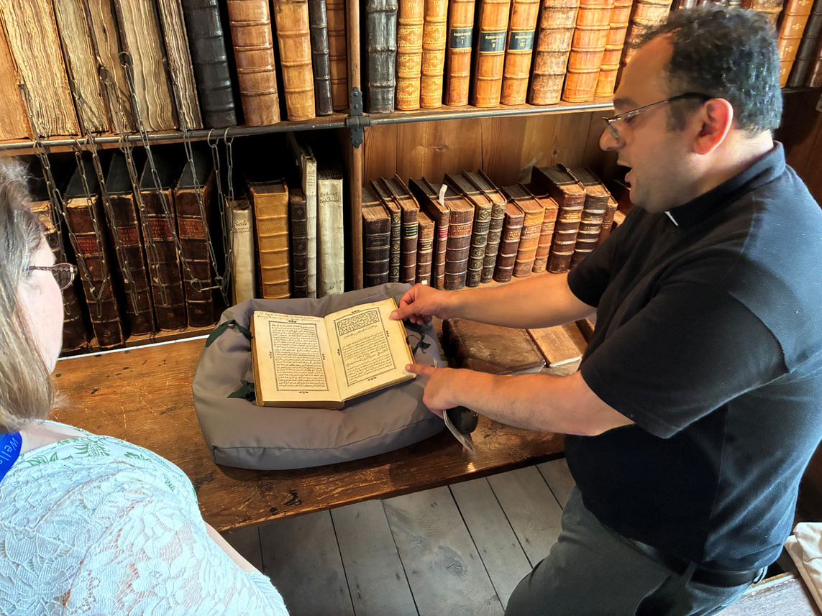
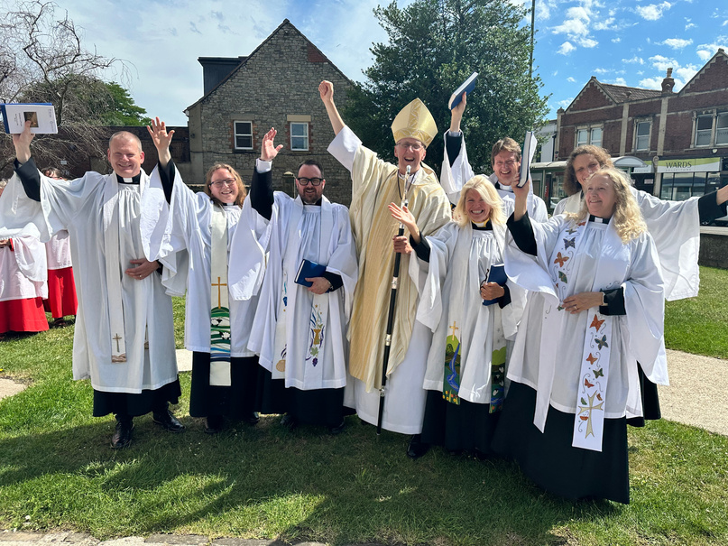
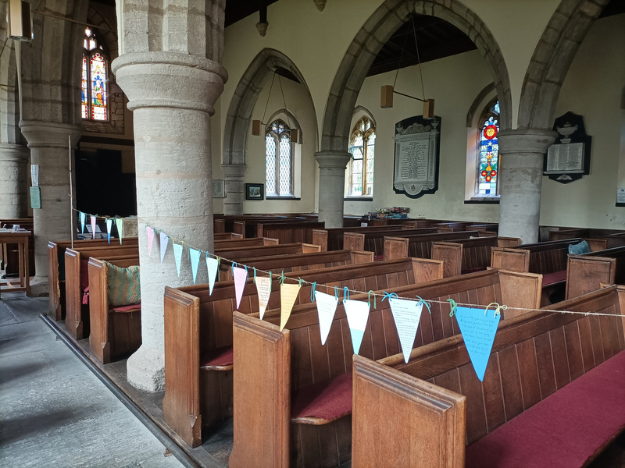

Chair of the Audit and Risk Management Group (ARMG)
Recruitment Pack
August 2026

Slide 2
Dear applicant
Thank you for your interest in the role of Chair of the Diocesan Audit and Risk Management Group (ARMG).
A huge amount of diocesan life and business is conducted with the support and approval of committees, a number of which are chaired by much respected and valued volunteers. Our volunteer chairs play a key role in bringing our vision to life and their expertise, time and insight are hugely appreciated.
To find out more about who we are, please visit our website.
We hope you’ll find that this pack provides all the information you need in order to consider your candidature for this post. If, however, you have any further questions please initially contact Human Resources.
If you would like an informal conversation about the role, you are welcome to contact Jenny Hollingsworth, our Diocesan Secretary and CEO, at jenny.hollingsworth@bathwells.anglican.org
Should you decide to apply for this post we look forward to receiving your application and wish you well. Details on how to apply are at the end of this pack.
Enita Andrews
HR Manager

Slide 3
Introduction
The Diocese of Bath and Wells broadly encompasses the historic county of Somerset, extending to include a small part of the county of Dorset. It is a diverse region with more than 500 settlements across the county, many of them small and rural which account for 43% of the population. Although two thirds of Somerset is rural, more than half the population lives in urban areas.
The diocese loves and serves in the region of 1,000,000 people who live here through its family of 466 parishes and 182 church schools and more than 170 chaplaincies.
The Bath and Wells Diocesan Board of Finance (DBF) is seeking to appoint someone with senior level leadership experience to the voluntary role of Chair of the Audit & Risk Management Group (ARMG).
The ARMG acts as an advisory group to the Diocesan Board of Finance to enable it to meet its responsibilities under Clause 10 of the Memorandum of Association that requires that “true accounts shall be kept of the sums of money received and expended by the Board” and that “once at least in every year the accounts of the Board shall be examined and the correctness of the balance sheet ascertained by one or more competent auditor or auditors”. The ARMG also advises the DBF on risk management within the organisation but the responsibility for risk management rests with the Board.
The Chair of the Audit & Risk Management Group leads the group in all aspects of its work and is responsible for effectively managing the affairs of the group and ensuring that it is properly organised and functions efficiently and effectively.
The Chair of the Audit & Risk Management Group shall be appointed by the Board of Trustees.

Slide 4
Role Description
Monitoring and management
The Chair of the ARMG is appointed by the Diocesan Board of Finance. This is a voluntary role, but expenses are paid.
Key Relationships
  The Bishops and Archdeacons - as key stakeholders of the Risk Register.
  Diocesan Secretary and all Heads of Dept of the DBF & DBE - as key stakeholders of the Risk Register.
  ARMG committee members
Whilst the Chair of the Audit & Risk Management Group is involved in policy making and ensuring there are effective internal controls and a robust risk management system, this is not an executive role. Executive functions of the DBF are carried out by the Diocesan Secretary, the Head of Finance and other staff under their direction.
Time commitment
The position of Chair of the Audit & Risk Management Group is voluntary, unpaid and requires time commitment.
The ARMG meets four times a year, during the day, and is also entitled to go into confidential session whenever it considers it to be appropriate to do so.
Additionally, the post holder will be required to attend five trustee meetings (Bishops Council) each year, as well as other ad-hoc meetings with management and external auditors as required throughout the year. They will also need to be available to offer consultation and decisions by phone or email within a reasonable time frame.
All volunteers are entitled to have their travel and other agreed expenses reimbursed.

Slide 5
Responsibilities
Monitoring and management
  To be an effective Chair of the DBF Audit & Risk Managmeent Group (ARMG) leading and supporting members in effective discussion and decision making.
  Ensure proper and effective flow of information between the AMRG and the Board of Trustees.
  Prepare a summary report of ARMG meetings for Bishop’s Council and Finance Committee and answer questions on the Group’s activities and responsibilities.
  Prepare ARMG agendas in consultation with the Diocesan Secretary and the Head of Finance, ensuring that all required business is brought before the Group to enable it to efficiently carry out its duties & responsibilities.
  Ensure the diocesan Strategic Risk Management Register is reviewed every 6 months and the corresponding risk report from DBF management to ensure it fully reflects the risks faced by the DBF.
  Ensure, in consultation with the Head of Finance, that all items requiring ARMG approval are appropriately tabled.
  Together with the Head of Finance, lead on the process appointing the DBF external auditors and recommend their appointment to Trustees at the AGM.
  To be a key contact and adviser for the Diocesan Secretary and Head of Finance on all matters relating to audit and risk and to be available for consultation as necessary throughout the year.
  To ensure the audited annual financial statements and findings are reviewed prior to approval by the trustees, providing the Diocesan Board of Finance with recommendations
  To support and work collaboratively with the Chair of the DBF and the Chairs of other Diocesan boards and committees. The Chair of the ARMG has the right to attend meetings of any other sub-committee of the Finance Committee as a non-voting member.
  To support the leadership team in continuing development of the planning and control cycle, evaluating and making recommendations to promote best risk practice and good governance
  To keep abreast of and review relevant policies, legislation and national campaigns and working with the Chair of the DBF, respond to them.

Slide 6
Skills and Experience
  A commitment to and support for the Diocese of Bath and Wells direction of travel and shared values articulated in our vision
  An understanding of the key concerns and issues in parishes across the diverse array of contexts and traditions in the Diocese of Bath and Wells.
  Effective chairing skills which enable committees to reach decisions positively and effectively.
  Experience in a senior corporate capacity, preferably with full financial responsibility and with experience of audit processes.
  A good working understanding of corporate and charity finance and law.
  Fully cognisant of published financial statements.
  Understanding of effective risk management within a charity or company.
  A track record of effective collaborative leadership.
  Good communication skills with experience of presenting to and communicating with large bodies of people with widely varying financial knowledge.
  A good general level of education ideally to degree level and beyond.
  The DBF is a company limited by guarantee and a registered charity with members of the Bishop’s Council being Trustees. The Chair of the ARMG must not be disqualified from serving as a director or charity trustee and must be a ‘fit and proper person’ as per HMRC guidance.
  The Chair of the ARMG must not have any conflicts of interests which would prohibit them from serving as a trustee under the DBF’s current Articles of Association, for example being a close relative of an employee of the DBF.
  No officer or former officer of the DBF, within three years of holding office, can be considered for this role.
It will also be helpful but not essential:
  Understanding of the workings of the Church of England at diocesan and potentially national level.
  Charity government experience and an ability to make change happen in the voluntary sector.

Slide 7
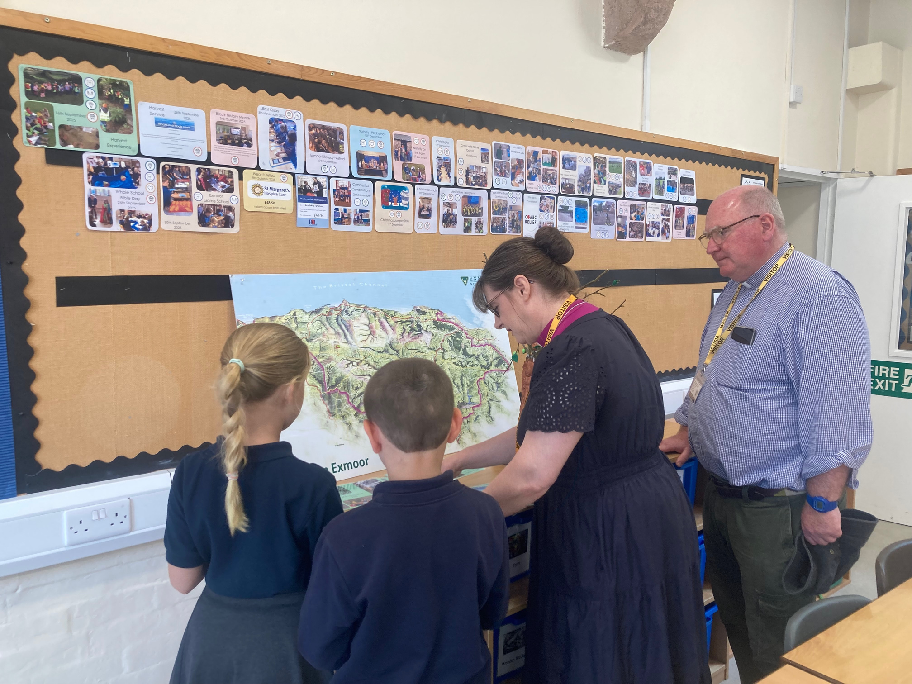
Application and Selection Process
Applicants are asked to submit their CV with a supporting statement outlining their suitability and interest for the role to the HR Department.
The closing date for applications is noon, Thursday 17 September 2026. Interviews will be held on the Diocesan Office in Wells on Monday 28 September 2026.
Contact details
HR Department - Enita Andrews, HR Manager
Phone: 01749 685113
Email: recruitment@bathwells.anglican.org

Slide 8


